Slide 1
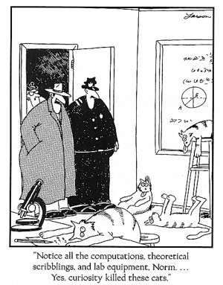
Forces That Drive Reactions - Enthalpy

Slide 2
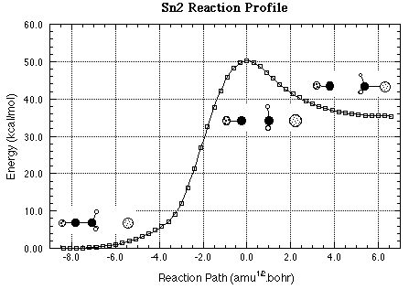
Energy
All matter has kinetic energy
Kinetic energy → energy of motions of molecules
All matter has potential energy
Potential energy → stored energy of chemical bonds

Slide 3
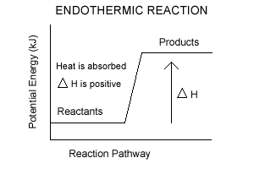
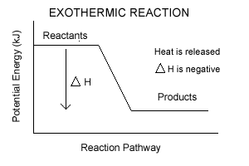
Conservation of Energy
Energy is neither created nor destroyed
When kinetic energy is converted to potential energy → reaction is endothermic
When potential energy is converted to kinetic energy → reaction is exothermic

Slide 4
Heat Flow
Heat flows from hot to cold.
When ice is applied to a sore shoulder, heat flows from the shoulder to the ice
In exothermic reactions → amount of heat released = the decrease in potential energy
Heat Flow Animation Link

Slide 5
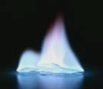
Spontaneous Reaction
Occurs without outside help → may need activation energy
May occur quickly, like the combustion of hydrogen, or slowly, like when graphite turns to diamond.

Slide 6
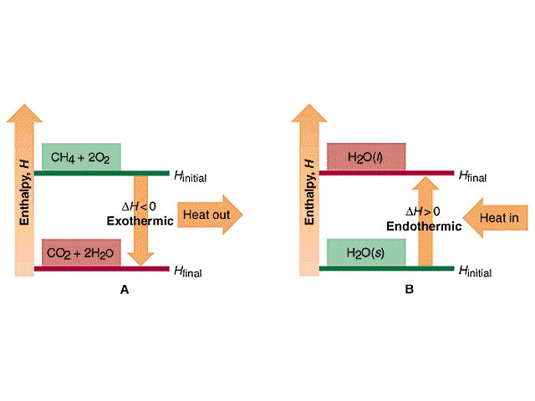
1st Driving Force of Reactions
Enthalpy: (H) heat content of a system
∆H = change in enthalpy
∆H = H of products – H of reactants

Slide 7
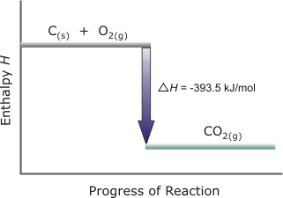
Enthalpy Change: Exothermic
∆H is negative
A + B → AB + Heat
Heat term on right
Downhill
Spontaneous
energy

Slide 8
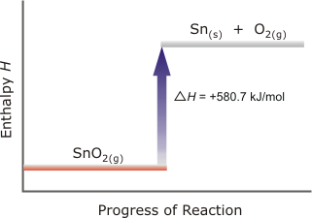
Enthalpy Change: Endothermic
∆H is positive
AB + Heat → A + B
Heat term on left
Uphill
Non-spontaneous
energy

Slide 9
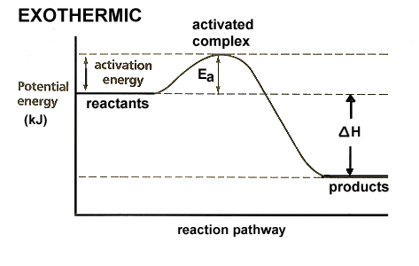
Nature favors exothermic reactions
Stability Increases

Slide 10
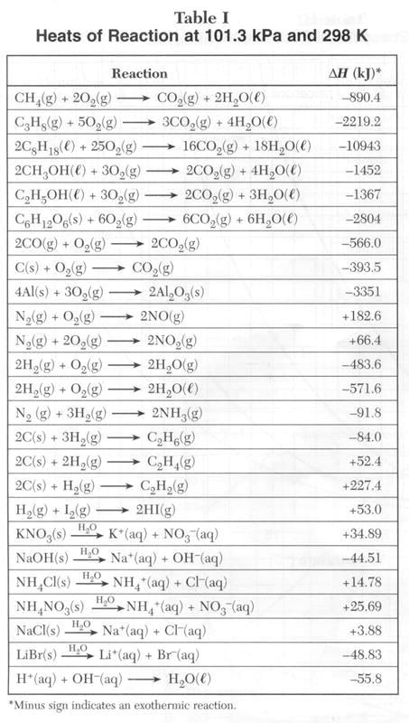
Heats of Reaction
Table I
* minus sign = exothermic reaction

Slide 11
5 Types of Reactions

Slide 12
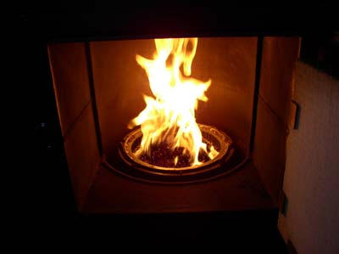
Heat of Combustion
Heat of reaction for the complete burning of 1 mole
From Table I
CH₄(g) + O₂(g) → CO₂(g) + 2H₂O(l) + ?KJ
1 mol CH₄ = 890KJ
2CO + O₂ → 2CO₂ + 566KJ
1 mol CO = 283KJ

Slide 13
Heat of Formation
Heat absorbed or released when a mole of compound is formed
Synthesis reaction
2H₂(g) + O₂(g) → 2H₂O(l) + 571.6KJ
**Heat of formation = 285.8KJ
How much energy is required to decompose 4.0 mol CO₂(g)?
4.0mol X 394KJ = 1576KJ
1mol

Slide 14
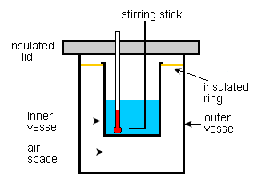
Heat of Solution
Heat released or absorbed when a solution is made
NaOH
NH₄NO₃
LiBr

