Slide 1
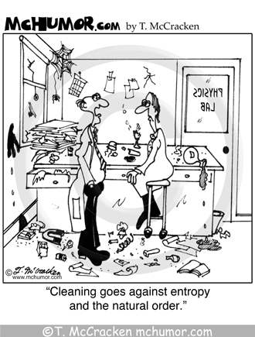
Forces That Drive Reactions - Entropy

Slide 2
Entropy (∆S)
Entropy is a measure of disorder
Matter tends to attain minimum potential energy = Enthalpy.
Matter tends to attain maximum randomness = Entropy.
Entropy → least organized, most random state possible

Slide 3
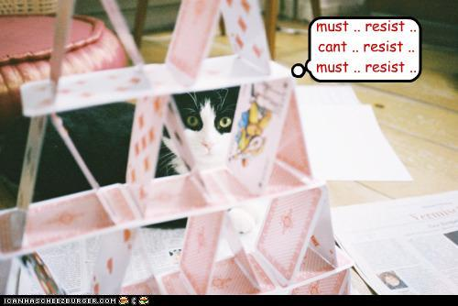
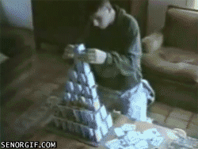
∆S Formula
The difference between the sum of the entropies of the products and the sum of the entropies of the reactants:
∆S = S_{products} - S_{reactants}

Slide 4
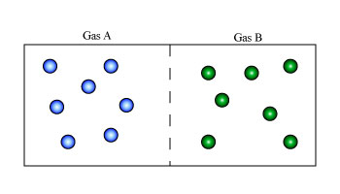
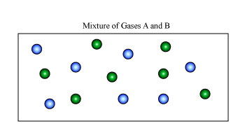
Law of Disorder
Things tend to go towards randomness
Drive towards maximum randomness

Slide 5
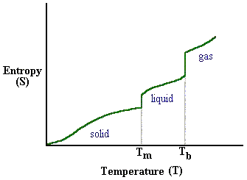
Measuring Entropy
Entropy increases when phases change from solid to liquid to gas
Solid = least entropy
Gas = greatest entropy

Slide 6
Phase change:
solid → liquid → gas
Entropy increases +∆S
Dissolving:
NaCl(s) → Na⁺(aq) + Cl⁻(aq)
Entropy increases +∆S
+∆S
-∆S
Gas
Solid

Slide 7
For Reactions:
Entropy increases on the side with more moles (particles)
Compounds are more organized (less entropy)
2H₂(g) + O₂(g) → 2H₂O
Entropy decreases (-∆S)
3 mol reactants → 2 mol products
Entropy increases (+ ∆S)
2 mol reactants → 3 mol products

Slide 8
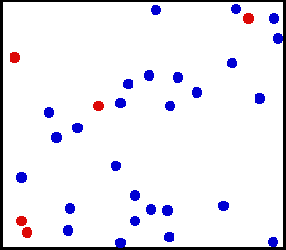
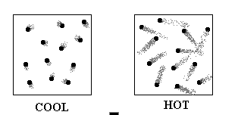
Temperature Change:
As temp. increases, ∆S increases
50°C → 100°C
Entropy Increases (+ ∆S)

Slide 9
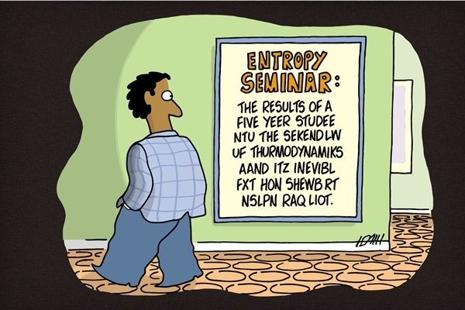

Slide 11
Spontaneous Reactions
Enthalpy Change = -∆H
Entropy Change = +∆S
Change is favored when:
Decrease in potential energy (-∆H)
exothermic
Increase in entropy (+∆S)

Slide 12
Learning Check
What is the enthalpy and entropy change in the combustion of ethane, ∆H = -2850 KJ?
2C₂H₆(g) + 7O₂(g) → 4CO₂(g) + 6H₂O(g)
Enthalpy =
Decreases (-∆H)
Entropy =
Increases (+∆S)
Reaction will be spontaneous due to decrease in potential energy and increase in entropy.

Slide 13
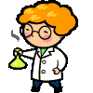
Free Energy (∆G)
Depends on ∆H, ∆S, and temp
∆G = ∆H - T∆S
-∆G → spontaneous rxn
+∆G → non-spontaneous rxn
∆G = 0 → equilibrium

