Slide 1
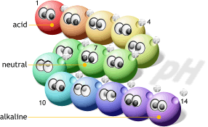
Properties of Acids and Bases

Slide 2
Matter
Elements
Compounds
Mixtures
Metal
Nonmetal
Semimetal
Noble Gas
Covalent
Ionic
Homogeneous
Solutions
Heterogeneous
Acid Base Salt

Slide 3
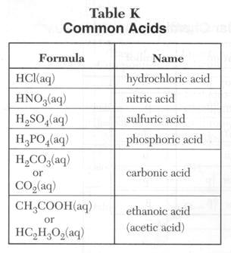
Electrolytes
Electrolytes – conduct in water
Acids:
start with H⁺
Table K
HCl, H₂SO₄

Slide 4
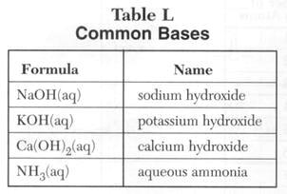
Electrolytes
Electrolytes – conduct in water
Bases:
end with OH⁻
Table L
NaOH

Slide 5
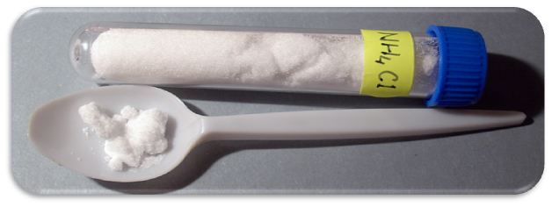
Electrolytes
Electrolytes – conduct in water
Salts:
metal + nonmetal → NaCl
metal + polyatomic ion → KNO₃
polyatomic ion + nonmetal → NH₄Cl
polyatomic ion + polyatomic ion → NH₄NO₃

Slide 6
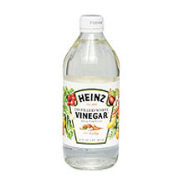
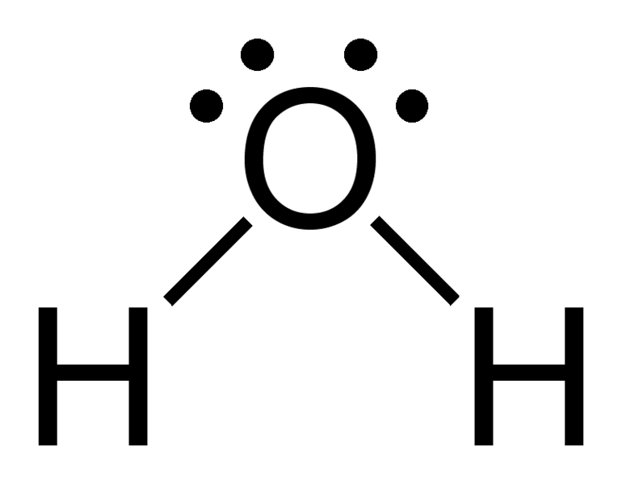
Nonelectrolytes
Molecules:
nonmetal + nonmetal
H₂O, CH₄
Exception → CH₃COOH (acetic acid)
- is an organic acid

Slide 7
Acids and Bases
Properties | Acids | Bases
Taste | Sour (vinegar) | Bitter (baker’s chocolate)
Conductivity | Yes (varies with strength) | Yes (varies with strength)
Reaction | Releases H₂ | --
Litmus | Red | Blue
Phenophthalein | Clear | Pink
Feel | -- | Slippery
Ions | H⁺ | OH⁻

