Slide 1
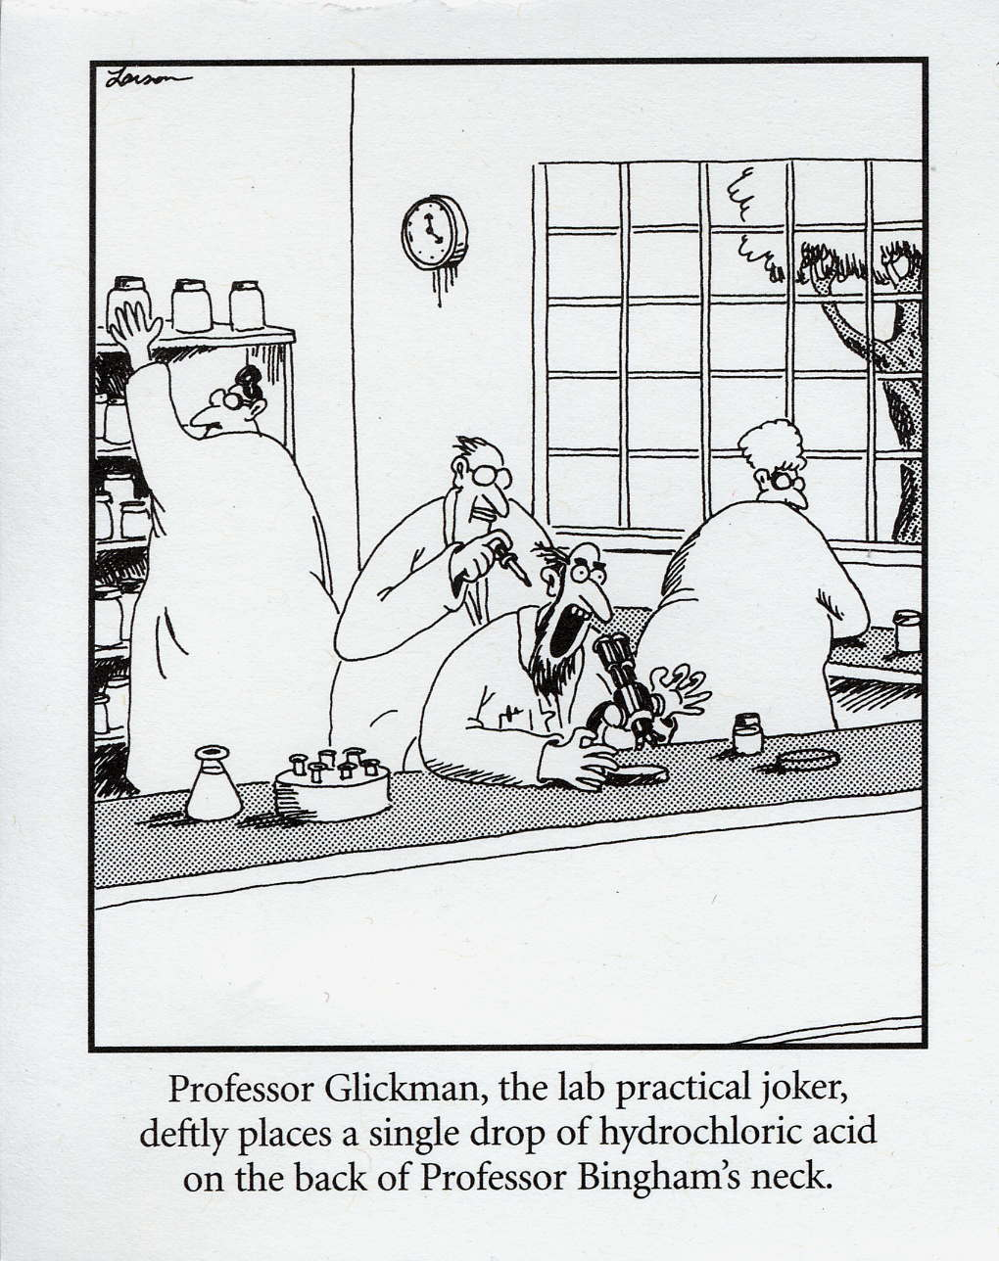
Arrhenius Model of Acids and Bases

Slide 2
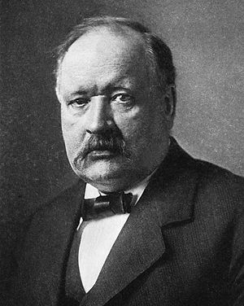
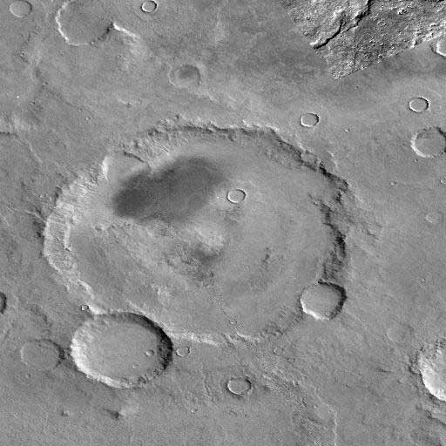
Svante August Arrhenius (February 19, 1859 – October 2, 1927) Swedish chemist

Slide 3
Acid + Base → Water + Salt

Slide 4
Acids
Acids – something with Hydrogen that makes hydrogen ions in water.
produce H⁺ ions
*(or hydronium ions H₃O⁺)
HCl → H⁺ + Cl⁻ monoprotic
H₂SO₄ → 2H⁺ + SO₄²⁻ diprotic
H₃PO₄ → 3H⁺ + PO₄³⁻ triprotic

Slide 5
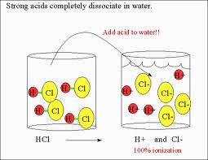
Acid Strength
Strong Acids – total dissociation
HCl → H⁺ + Cl⁻
Weak Acids – partial dissociation
HC₂H₃O₂ ⇌ H⁺ + C₂H₃O₂⁻

Slide 6
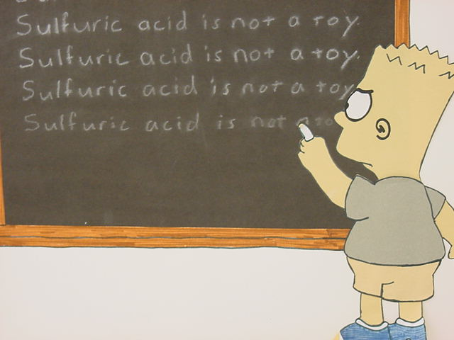
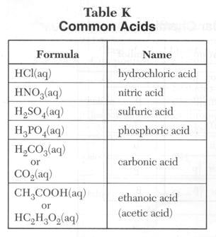
Table K
Strong
Weak

Slide 7
Bases
Bases – something with an OH⁻ group that makes hydroxide ions (OH⁻) in water
NaOH → Na⁺ + OH⁻
Ca(OH)₂ → Ca²⁺ + 2OH⁻
* alcohols are not bases (Table R)
CH₃OH (methanol) → Not a base!

Slide 8
Base Strength
Strong bases dissociate entirely into metal and hydroxide ion.
Strong Bases – total dissociation
NaOH → Na⁺ + OH⁻
Weak Bases – partial dissociation
Mg(OH)₂ ⇌ Mg²⁺ + 2OH⁻

Slide 9
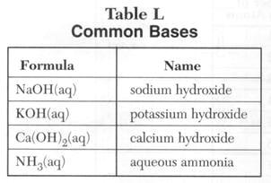
Table L
Strong
Weak

Slide 10
Concentration vs Strength (molarity) (nature)
 | Concentrated | Dilute
Strong | 12M HCl | 1M HCl
Weak | 12M HC₂H₃O₂ | 1M HC₂H₃O₂
Strong = dissociates
Weak = doesn’t give as many ions in water

Slide 11
Dissociation Constant (Ka)
HCl → H⁺ + Cl⁻
Large Ka = strong acid
Small Ka = weak acid

Slide 12
Naming Acids

Slide 13
Name the Acid:
HBr _{(aq)}
H₂CO₃
H₂SO₃
⇒ hydrobromic acid
⇒ carbonic acid
⇒ sulfurous acid

