Slide 1
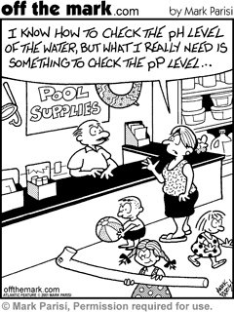
pH (power of hydronium ion)

Slide 2
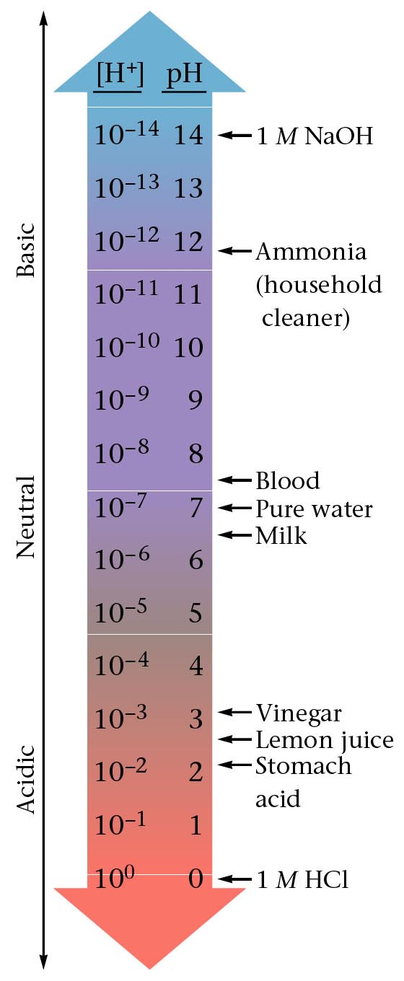
The pH scale is a way of expressing the strength of acids and bases. Instead of using very small numbers, we just use the NEGATIVE power of 10 on the Molarity of the H⁺ (or OH⁻) ion. Under 7 = acid 7 = neutral Over 7 = base

Slide 3
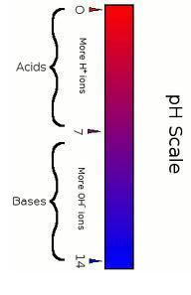
pH = -log[H⁺]
Example: If [H⁺] = 1 X 10⁻¹⁰ pH = - log 1 X 10⁻¹⁰
pH = - (- 10)
pH = 10
Example: If [H⁺] = 1.8 X 10⁻⁵ pH = - log 1.8 X 10⁻⁵
pH = - (- 4.74)
pH = 4.74

Slide 4
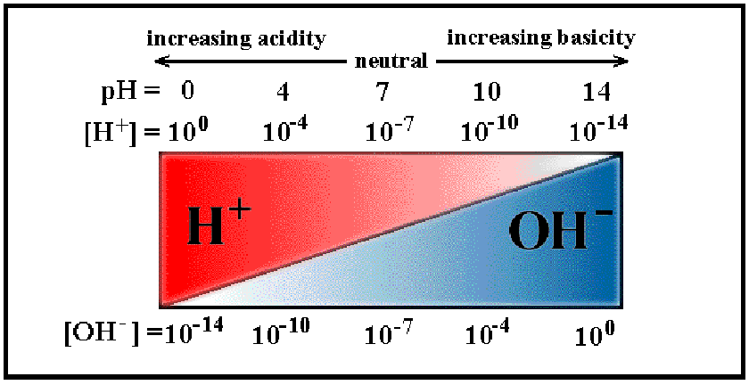
pH

Slide 5
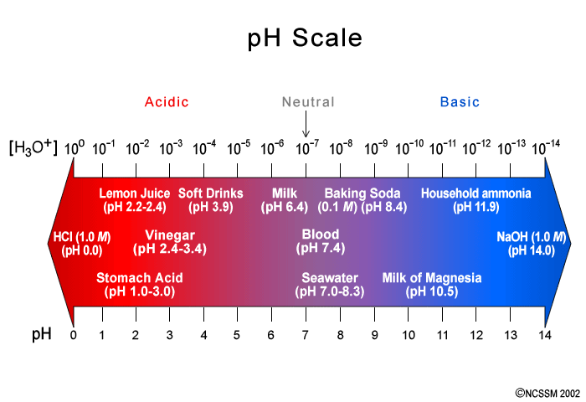
A pH change of 1, means a 10X change in [H⁺]

Slide 6
Learning Check:
What is the pH when:
[H⁺] = 1 X 10⁻²M?
pH = 2
What is the [H+] when the pH is:
3?
1 X 10⁻³
7?
1 X 10⁻⁷

Slide 7
Ionization of Water
H₂O_{(l)} ⇌ H⁺_{(aq)} + OH⁻_{(aq)}
K_{EQ} = [H⁺] [OH⁻] = 1 X 10⁻¹⁴
X X
X² = 1 X 10⁻¹⁴
X = 1 X 10⁻⁷
[H⁺] = [OH⁻] = 1 X 10⁻⁷
pH = 7

Slide 8
Ionization of Water
H₂O_{(l)} ⇌ H⁺_{(aq)} + OH⁻_{(aq)}
What happens if you add more base?
[H⁺] [ OH⁻ ]
*inverse relationship
LeChatelier:
H₂O_{(l)} ⇌ H⁺_{(aq)} + OH⁻_{(aq)}

Slide 9
Learning Check:
If [H⁺] [OH⁻ ] = 1.0 X 10⁻¹⁴, what is the pH of a solution with [OH⁻ ] = 1.0 X 10⁻⁶M?
[H⁺] [OH⁻ ] = 1.0 X 10⁻¹⁴
(X)1.0 X 10⁻⁶ = 1.0 X 10⁻¹⁴
X = 1.0 X 10⁻⁸
pH = 8
What is the pH if [OH⁻] = 1 X 10⁻²M?
pH = 12

Slide 10
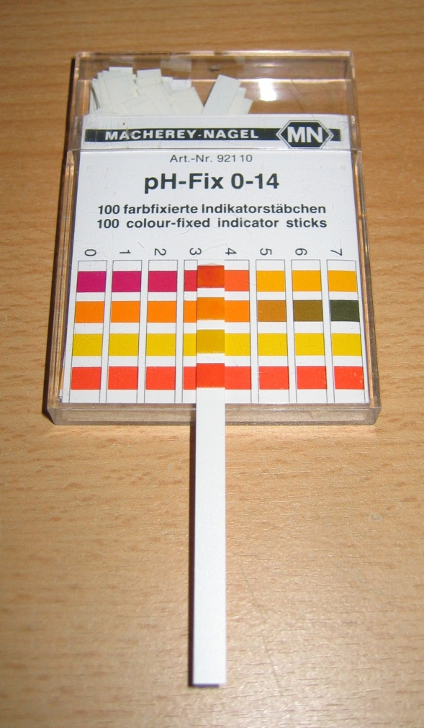
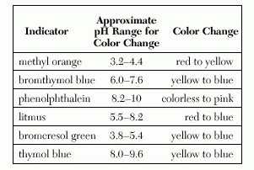
Indicators
Substance which changes color in a specific pH.
Table M

Slide 11
