Slide 1
Neutralization & Titration

Slide 2
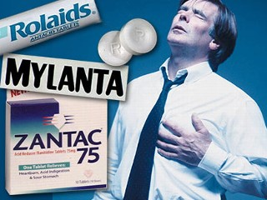
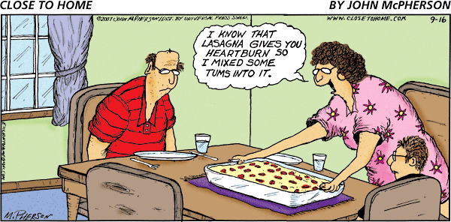
Are you familiar with “heartburn”?
It is also called acid indigestion.
Why do people take “antacids” to help relieve this condition?
Antacid
usually
contains
Mg(OH)₂

Slide 3
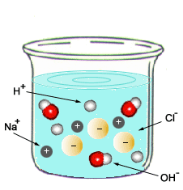
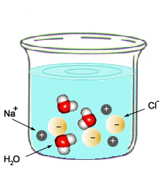
Neutralization
When an acid and a base combine to form salt water
Before Reaction After Reaction

Slide 4
Spectator ions:
Ions not involved in the reaction
Na⁺ and Cl⁻

Slide 5
Net ionic equation:
Equation with only the ions involved in the reaction

Slide 6
Neutral Solution:
When moles of H⁺ equals moles of OH⁻

Slide 7
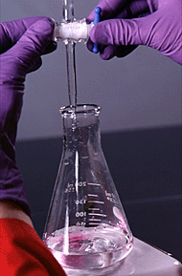
Titration
A procedure used to determine the concentration of an acid or a base.
A measured volume of acid is added to a measured volume of base until the moles of H⁺ and OH⁻ are equal → neutralization.

Slide 8
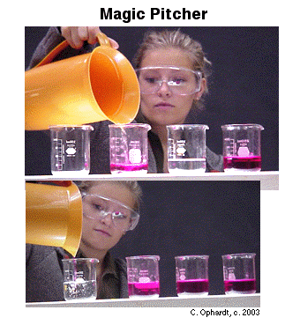
Magic Beaker Demonstration!

Slide 9
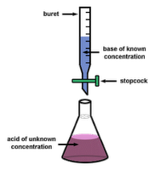
Titration Equation
Table T
M_{(H+)} X V_{A} = M_{(OH-)} X V_{B}
Molarity of Acid X Volume of Acid = Molarity of Base X Volume of Base
When moles of H⁺ = moles of OH⁻,
the pH of the solution is neutral

Slide 10
Titration:
Volumetric Analysis –
Use volumes to find an unknown
Gravimetric Analysis –
Use mass to find an unknown
End Point –
When the indicator changes color
Standard Solution –
Known concentration

Slide 11
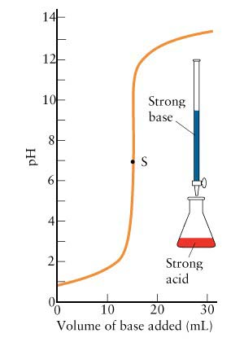
Equivalence Point
(neutral)

Slide 12
Practice:
A 25 mL solution of HCl is neutralized by
18 mL of 1.0 M NaOH. What is the concentration of HCl?
M_{(H+)} X V_{A} = M_{(OH-)} X V_{B}
M_{(HCl)} X 25 mL = 1.0 M NaOH X 18 mL
M_{(HCl)} = 1.0 M X 18 mL
25 mL
HCl = 0.72 M

Slide 13
Acid | M_{(Acid)} | M_{(H+)} | Conclusion
HCl → H⁺ + Cl⁻ | 1M | 1M | M_{(Acid)} = M_{(H+)}
H₂SO₄ → 2H⁺ + SO₄²⁻ | 1M | 2M | 2M_{(Acid)} = M_{(H+)}
H₃PO₄ → 3H⁺ + PO₄³⁻ | 1M | 3M | 3M_{(Acid)} = M_{(H+)}
For every 1 mole of H₂SO₄,
there are 2 moles of H⁺ ions.
For titrating, the molarity of H₂SO₄ will be multiplied by 2.

Slide 14
Base | M_{(Base)} | M_{(OH-)} | Conclusion
NaOH → Na⁺ + OH⁻ | 1M | 1M | M_{(Base)} = M_{(OH-)}
Ca(OH)₂→Ca²⁺+2OH⁻ | 1M | 2M | 2M_{(Base)} = M_{(OH-)}
For titrating, the molarity of Ca(OH)₂ will be multiplied by 2.

Slide 15
Practice:
How many milliliters of 0.20 M NaOH are needed to neutralize 20. mL of 0.25 M H₂SO₄?
M_{(H+)} X V_{A} = M_{(OH-)} X V_{B}
(0.25 M X 2) X 20 mL = 0.20 M NaOH X V_{(Base)}
V_{(Base)} = (0.25 M X 2) X 20 mL
0.20 M NaOH
V_{(Base)} = 50. mL NaOH

Slide 16
A 25 mL solution of H₂SO₄ is neutralized by 18 mL of 1.0 M NaOH. What is the concentration of H₂SO₄?
M_{(H+)} X V_{A} = M_{(OH-)} X V_{B}
(M_{(Acid)} X 2) X 25 mL = 1.0 M NaOH X18 mL
M_{(Acid)} X 2 = 1.0 M NaOH X18 mL
25 mL
M_{(Acid)} X 2 = 0.72 M
M_{(Acid)} = 0.72 M
2
M_{(Acid)} = 0.36 M

Slide 17
Neutralization Reaction
acid
base
salt
water
H⁺
OH⁻
ions
ions
Class Exit Ticket

