Slide 1
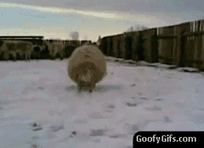
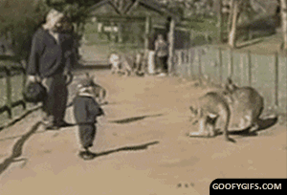
Naming Organic Compounds
If you don’t know how to name organic compounds, they will really knock you down on the test!

Slide 2
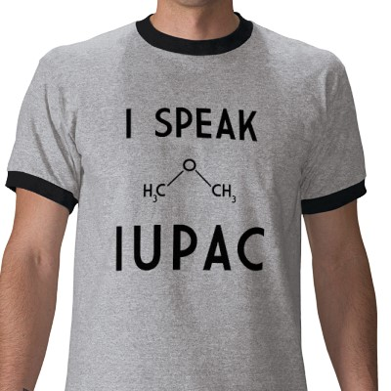
IUPAC System
International Union of Pure and Applied Chemistry
System used to name organic compounds

Slide 3
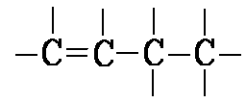
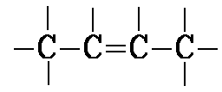
Naming Hydrocarbons:
*Table P → prefix
*Table Q → suffix
* numbers are used when there are isomers
1-butene
2-butene
How else could we write 1-butene?

Slide 4
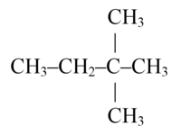
*For more than one alkyl group:
2 – di
3 – tri
4 - tetra
2,3-dimethylbutane
2,2-dimethylbutane
2,2-dimethylbutane

Slide 5
Find the longest Carbon chain
Number from the shortest end
C – C – C – C – C – C
3-methyl hexane
C – C – C – C – C –
2-methyl pentane
CH₃
CH₃

Slide 6
CH₃
CH₃
C – C – C – C – C –
2,3-dimethyl pentane
3-ethyl hexane
C – C – C – C – C –
C
C
C

Slide 7
– C – C – C – C –
2-methyl butane
2,3-dimethyl pentane
C
C
C – C – C – C – C –
C

Slide 8
3-methyl hexane
C – C – C – C – C –
C
C

Slide 9
Alkenes:
Find the longest chain with the double bond
Number to make double bond smallest possible
End in “ene”
4-methyl-1-pentene
1 2 3 4 5

Slide 10
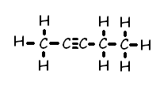
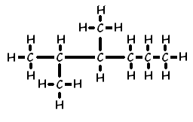
Draw molecular structures:
*start with the right part of the name and go left
2-pentyne
2,3-dimethyl hexane

Slide 11
Learning Check:
Draw the molecular structure for:
4-ethyl-2,3,4-trimethyl octane

