Slide 1
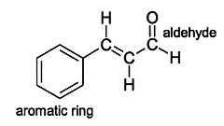
Naming Organic Compounds – Functional Groups

Slide 2
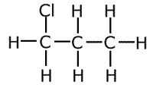
Halocarbons:
Organic compound with C, H and a halogen.
F₂
Fluoro
Cl₂
Chloro
Br₂
Bromo
I₂
Iodo
1-chloropropane

Slide 3
Halocarbons Continued:
C C = C
Br
2-bromopropene
Cl
Cl
C C C
1, 2-dichloropropane

Slide 4
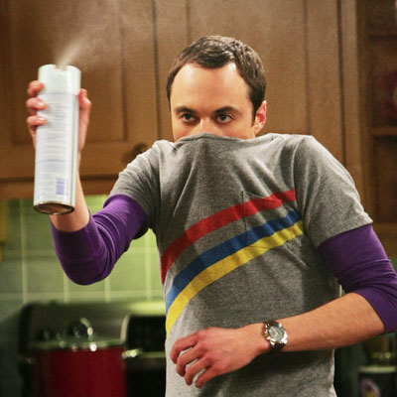
*Alphabetize halogen when more than 1:
Br
F
Cl
C C C C
1-bromo 3-chloro 2-fluorobutane
F
F
C C C
1,2-difluoropropane

Slide 5
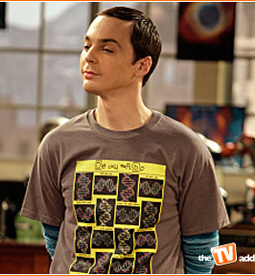
Alcohols:
* have a hydroxyl group (-OH)
* general formula → R-OH
Draw and name two isomers of propanol:
C C C OH
1-propanol
OH
C C C
2-propanol

Slide 6
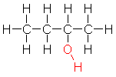
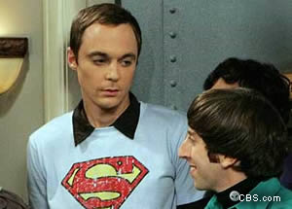
Draw and name 4 isomers of butanol:
1-butanol
2-butanol

Slide 7
C C C OH
C
2-methyl 1-propanol
OH
C C C
C
2-methyl 2-propanol

Slide 8
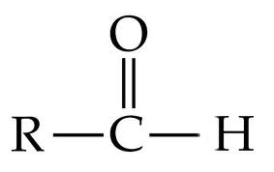
Aldehydes:
* Drop the “e” and add “al”
* -CHO functional group
* General formula:

Slide 9
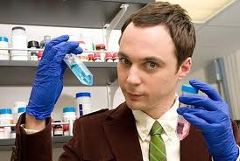
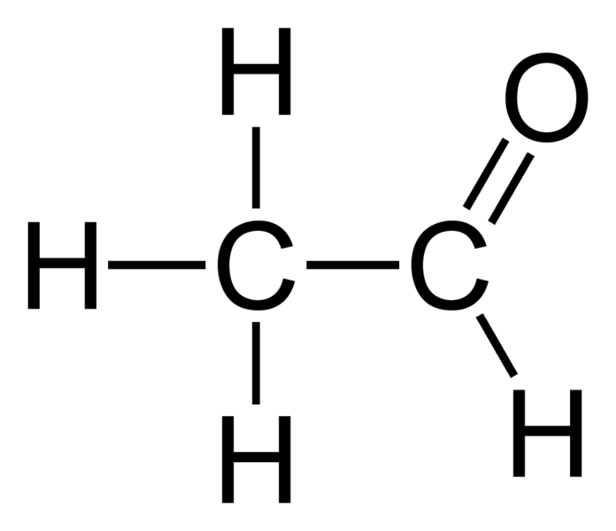
Aldehydes:
methanal
(formaldehyde)
ethanal
(acetylaldehyde)

Slide 10
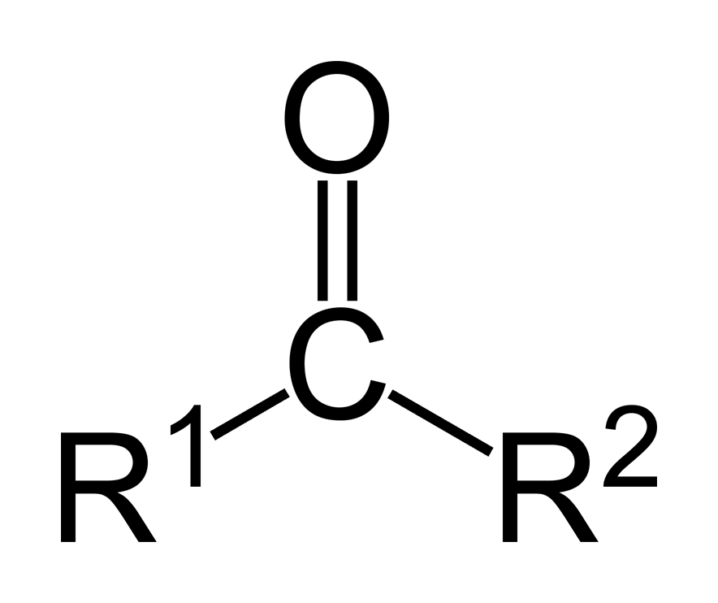
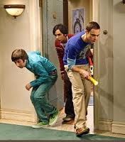
Ketones:
* Drop the “e” and add “one”
* Has a double bond inside chain – need a “key” to get in
* General formula:

Slide 11
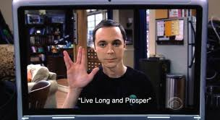
Ketones:
Propanone
(acetone)
Butanone

