Slide 1
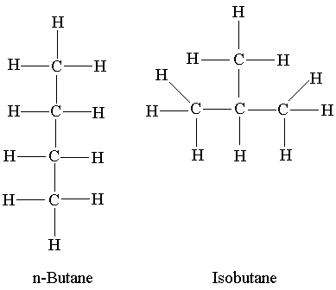
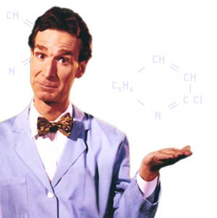
Isomers

Slide 2
Isomers:
* Molecules that have the same number and kinds of atoms (molecular formula) but different structure.
Butane (n-butane)
C C C C
C
2-methylpropane
C C C
C C
Same as C – C – C – C
C C

Slide 3
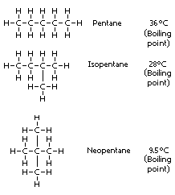
Isomers:
The compound with the continuous carbon chain is called the normal compound (n-)

Slide 4
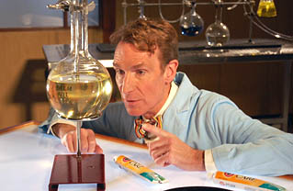
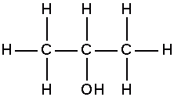
Isomers:
*Isomers may also be caused by the position of functional group or the position of a double or triple bond.
1. Functional Group:
1-propanol
2-propanol

Slide 5
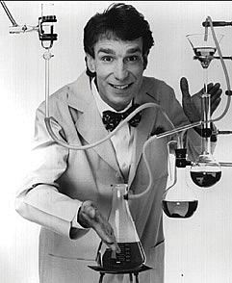
Isomers:
2. Double Bond:
C = C – C – C
1-butene
C – C = C – C
2-butene

Slide 6
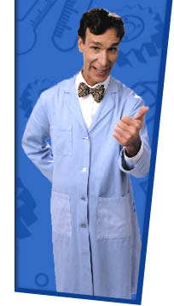
Isomers:
3. Triple Bond:
C C – C – C
1-butyne
C – C C – C
2-butyne

Slide 7
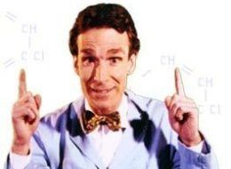
Isomers:
4. Compounds with 2 double bonds are called “dienes”:
C = C – C = C
1,3-butadiene

Slide 8
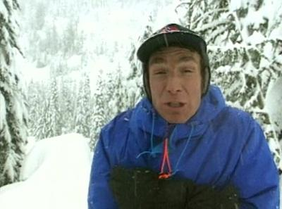
Isomers:
5. Aldehyde vs. Ketone:
Aldehyde (-CHO)
O
C – C – C
propanal
Ketone (-CO-)
O
C – C – C
2-propanone

Slide 9
Complete Classifying Organic Compounds by Functional Group Worksheet
Classifying Organic Compounds by Functional Group
Classify each of the following organic compounds as one of the following: alcohol, aldehyde, ketone, ether, carbonic acid, ester.
1. H H H
| | |
H – C – C – C – H
| | |
H OH H
2. H H OH
| | |
H – C – C – C = O
| |
H H
3. H H H
| | |
H – C – O – C – C – H
| | |
H H H
4. H
|
H – C – OH
|
H
5. H
|
H – C = O
6. OH
|
H – C = O
7. H H O
| | ||
H – C – C – O – C – H
| |
H H
8. H O H
| || |
H – C – C – C – H
| |
H H
9. H
|
H H – C – H
| |
H – C –-––- C – OH
| |
H H – C – H
|
H
10. H O
| ||
H – C – C – H
|
H

