Slide 1
Organic Reactions
Chemical reactions involving
organic compounds

Slide 2
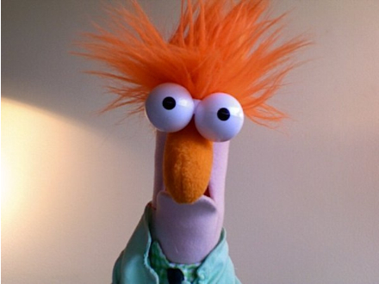
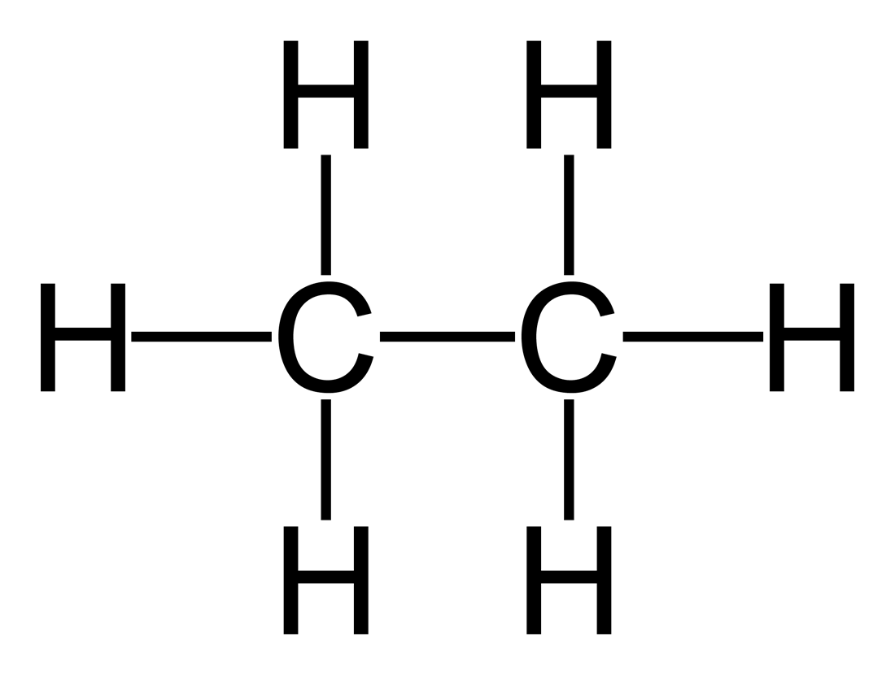
Saturated Organic Compounds:
Have only single bonds between carbons.
Compound has all the hydrogens possible.

Slide 3
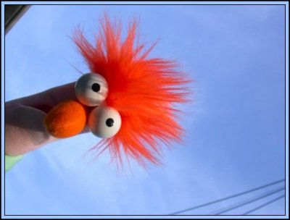
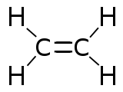
Unsaturated Organic Compounds:
Have double or triple bonds.
Can hold 2 more hydrogen
Can hold 4 more hydrogen

Slide 4
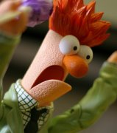
Substitution Reaction:
*Replacement of a hydrogen.
*2 reactants → 2 products
Cl
C C + Cl₂ → C C + HCl
Halogen
Saturated
Halogenation – reaction with a halogen

Slide 5
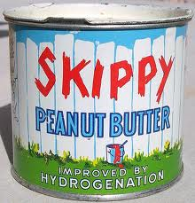
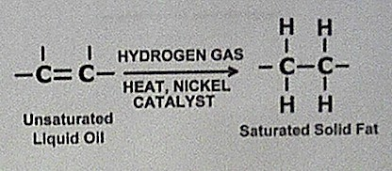
Addition Reaction:
*2 reactants → 1 product
Cl
Cl
C = C
+ Cl₂ → C C
Hydrogenation: reaction with
hydrogen.
(oil to fat)

Slide 6
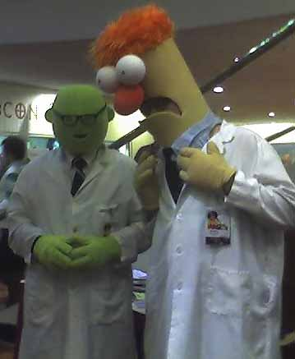
Learning Check:
Draw products, name and classify the reaction.
C C – C – C
+ Br₂ →
C C C
+ I₂ →

Slide 7
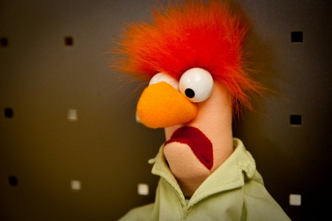
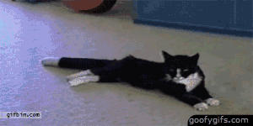
Polymerization:
*Making large molecules out of small ones.
*Have a repeating structure.

Slide 8
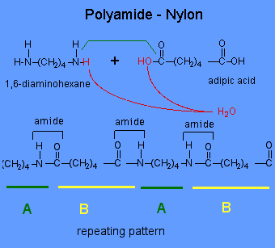
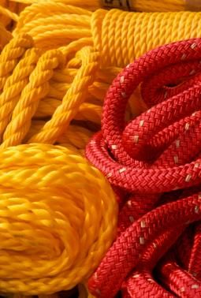
Condensation Polymerization:
Reaction forms liquid water
Process makes dacron and nylon

Slide 9
Addition Polymerization:
Many little ones
Big one

Slide 10
