Slide 1
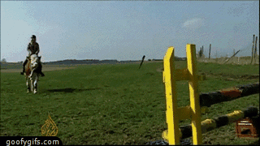
Organic Reactions - The Saga Continues

Slide 2
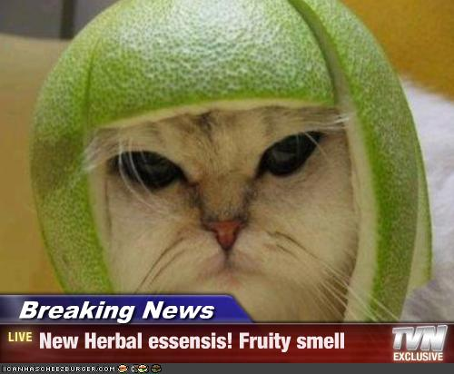
Esterification:
When an alcohol reacts with an acid, making an ester and water.
Organic Acid + Alcohol → Ester + Water
Esters have a sweet or fruity smell.

Slide 3
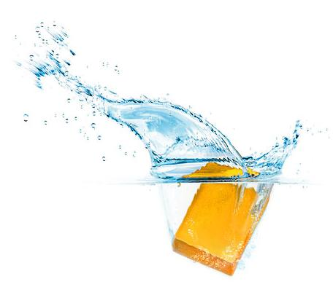
Saponification:
Making soap
Fat + Base → Soap + Glycerol
Saponification happens when vegetable oil or animal fat is introduced to a strong alkali. The vegetable oil and animal fat are esters, which when mixed with the alkali breaks down the ester bond. The alkali in this situation would be sodium hydroxide(NaOH) or potassium hydroxide(KOH). NaOH and KOH are also called bases in this reaction. The alkali is also commonly called "lye". A chemical reaction occurs when these substances are mixed together, soap and glycerin are produced.

Slide 4
Be patient, it is an animation

Slide 5
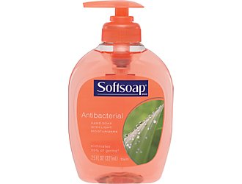
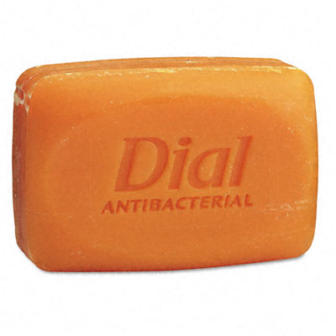
Liquid Soap: Soft Soap
Potassium hydroxide is the base for liquid soap.
Hard Soap: Bar Soap
Sodium hydroxide is used to make hard or bar soap.
In both reactions the alkali destroys the ester bond and produces glycerol and fatty acids.

Slide 6
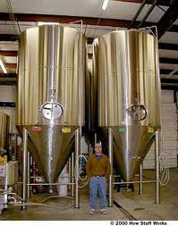
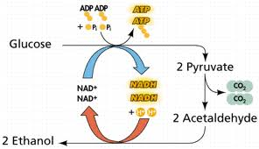
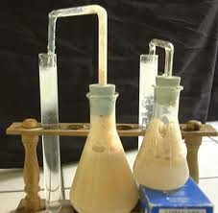
Fermentation:
Sugar + Yeast → Alcohol + CO₂
C₆H₁₂O₆ → C₂H₅OH + CO₂
Alcoholic beverages
Bread
Fuel

Slide 7
Combustion:
Fast reaction with oxygen
2C₄H₁₀ + 13O₂ → 8CO₂ + 10H₂O
Exothermic
So, I really did not think that after going through med school, I'd ever have the chance to hold a block of C4 explosive, but here I am! They showed me how to cut a wedge out of the end, embed detonation wire, and tape it up for use.

Slide 8
Next up: Organic Chemistry Review Video Plays on DVD
Amuse yourself at home with this video:
Organic Chemistry YouTube Song

