Slide 1
Chemistry
The study of matter and the changes it undergoes.

Slide 2
Matter
Anything that has mass and takes up space (volume).

Slide 3
Mass vs Weight
Mass – how much
Weight – depends on gravity

Slide 4
States (Phases) of Matter
Gas (g)
Liquid (l)
Solid (s)

Slide 5
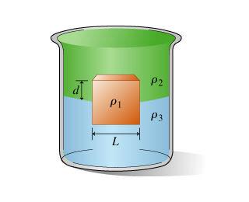
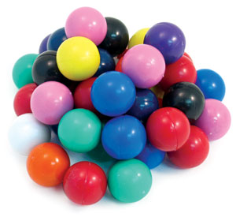
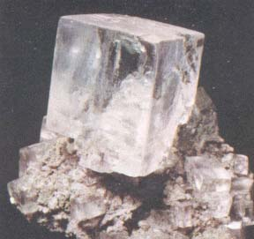
Solid
Shape and volume don’t change.
Particles are tightly packed (touching) and rigidly stuck together.
Attractive forces between particles are strong.
May have crystals.

Slide 6
Liquid
Volume is constant, but shape can change.
Takes the shape of its container.
Molecules are tightly packed but not rigidly stuck.

Slide 7
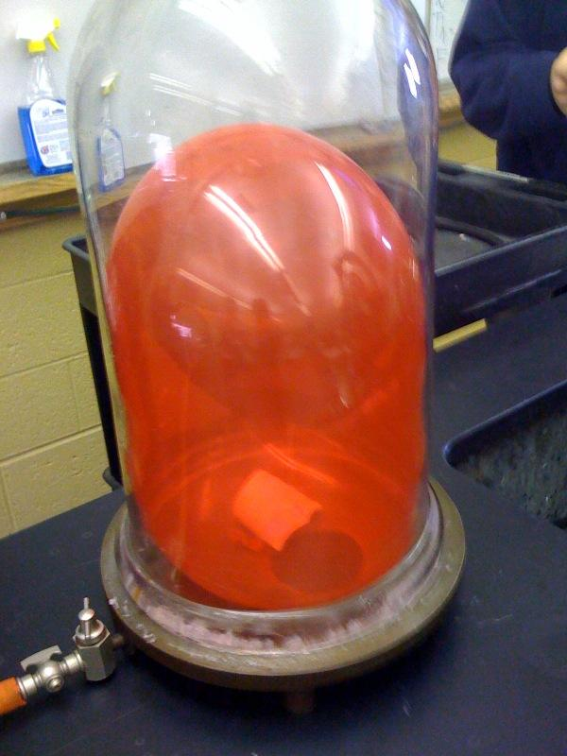
Gas
Both Volume and shape can change.
(balloon in vacuum)
Particles are not close together and not stuck.
Attractive forces between particles is weak.
Vapor – gaseous state of something that isn’t usually a gas.

Slide 8
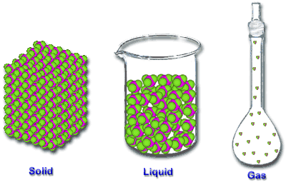

Slide 9
Physical Properties
Can be observed without chemical reactions.
Examples:
Color Brittle Conductivity
Odor Density (electrical and
Taste Melting Point chemical)
Hardness Solubility
Boiling point Phase or state

Slide 10
Chemical Properties
Describes how a substance will react.
Gold + Water →
wet gold
Iron + Oxygen →
rust

Slide 11
Physical vs. Chemical Property
Alcohol burns in air.
Chemical
Alcohol dissolves in water.
Physical
Alcohol evaporates quickly at room temp.
Physical
Alcohol reacts with sulfuric acid to form ether.
Chemical

