Slide 1
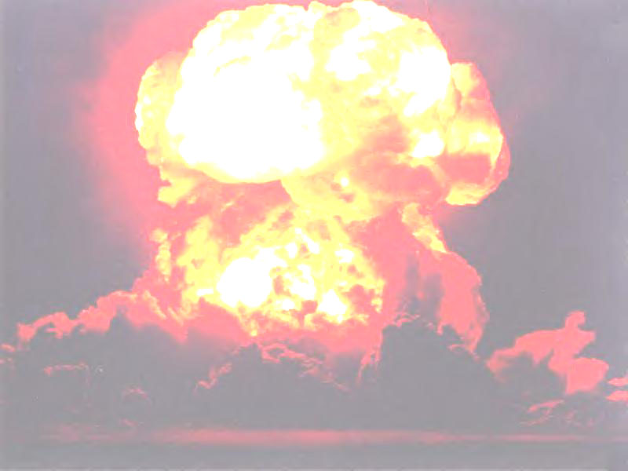
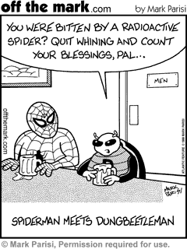
Nuclear Chemistry: Radioactivity & Types of Radiation

Slide 2
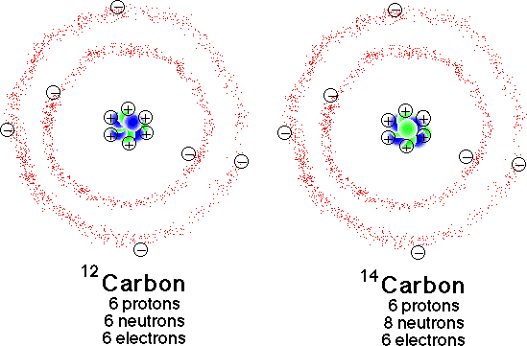
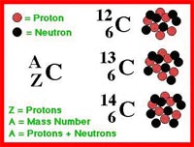
Radioactivity:
* when nuclei emit either particle or ray (radiation)
Isotopes:
* Same element different number of neutrons

Slide 3
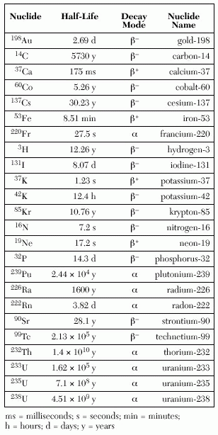
Radioisotope:
* unstable isotope (Table N)

Slide 4
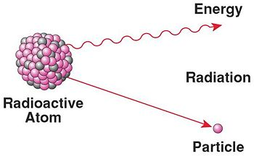
Radioactive Decay:
* nucleus changes to become more stable.
* causes an emission (radiation)

Slide 5
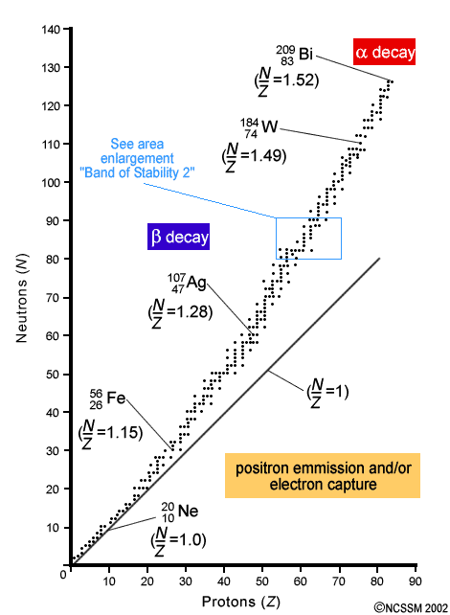
Nuclear Stability:
* under normal conditions, stable nuclei do not undergo change
* unstable nuclei undergo change spontaneously
* all elements greater than 83 are radioactive
* Page 541

Slide 6
Nuclear Stability:
Light Elements
n⁰
p⁺
*Elements #1-20
Heavy Elements
n⁰
p⁺
= 1
= 1.5

Slide 7
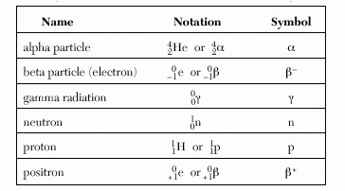
Types of Radiation:
* when an unstable nucleus undergoes change, or decays, it gives off particles
* alpha particles, beta particles,
gamma radiation
Table O

Slide 8
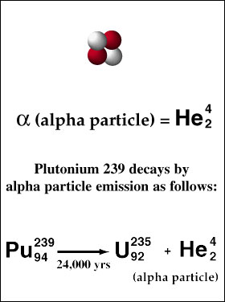
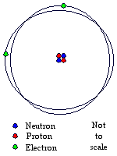
Alpha Particle: α
* have a charge of 2+
* have a mass 4X that of a hydrogen atom
* Helium nuclei
* slow moving
* stopped by paper

Slide 9
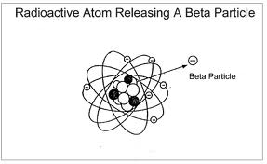
Beta Particle: β⁻
* high speed electron
mass → 0
charge → -1
* stopped by metal foil or plastic
e

Slide 10
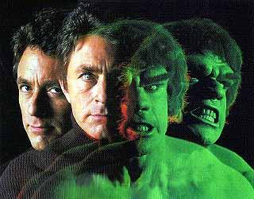
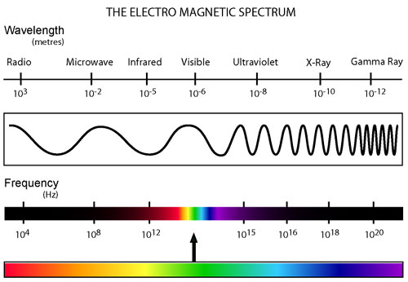
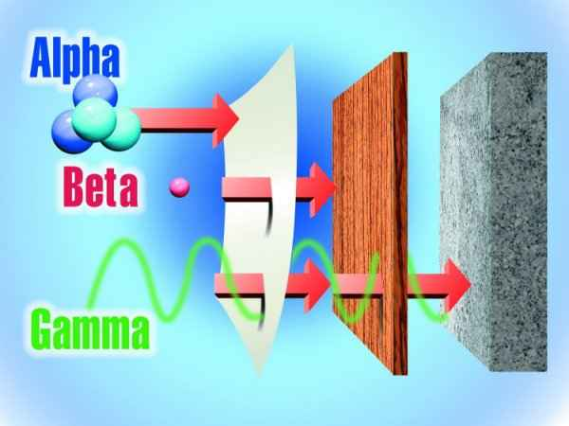
Gamma Radiation: γ
* has no charge and no mass
mass → 0
charge → 0
* short wavelength radiation
* very penetrating
* most dangerous type of emission
γ
Lead

Slide 11
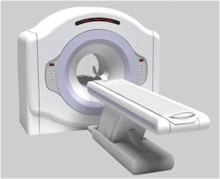
Positron: β⁺
* same mass as an electron, but has a positive charge
mass → 0
charge → +1
e

