Slide 1
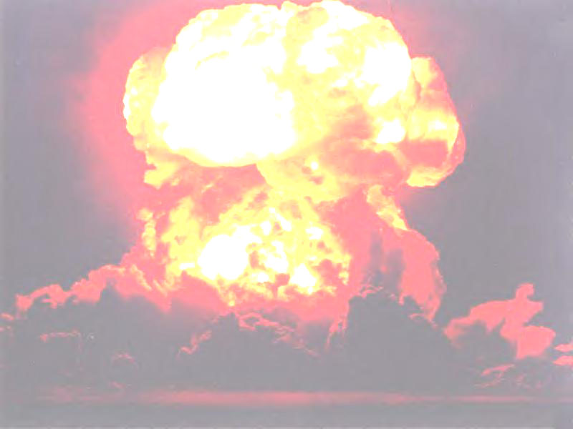
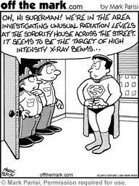
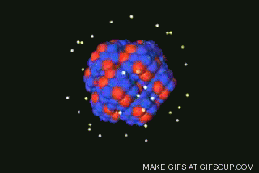
Nuclear Equations & Transmutations

Slide 2
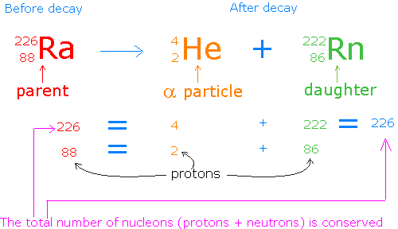
Spontaneous Nuclear Reactions:
* release of natural radioactivity to become more stable
Natural Transmutation:
* an element naturally decays to another element

Slide 3
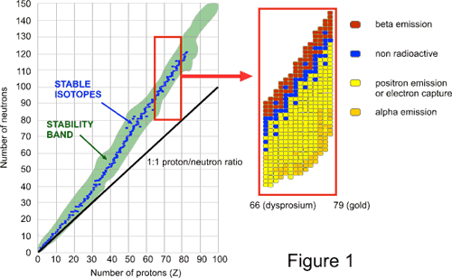
Beta Decay:
* Have too many neutrons
* Above the band of stability

Slide 4
Beta Decay:
Atomic number increases by 1
Number of protons increases by 1
Number of neutrons decreases by 1
Atomic mass remains the same

Slide 5
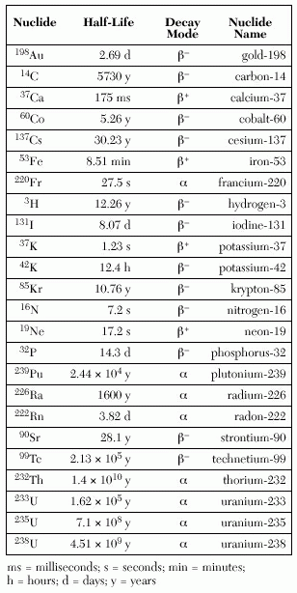
Beta Decay:
* Table N

Slide 6
Positron Decay:
* Too many protons → (converts to a neutron)
* Below the band of stability

Slide 7
Positron Decay:
p → n + e
1 1 0
1 0 1
Atomic number decreases by 1
Number of protons decreases by 1
Number of neutrons increases by 1
Atomic mass remains the same

Slide 8
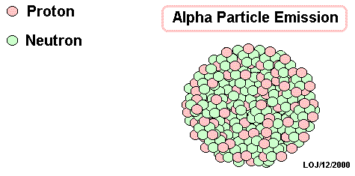
Alpha Decay:
* Nuclei is too heavy
* Alpha decay is a transmutation because the atom changes its atomic number and becomes a different element

Slide 9
Alpha Decay:
Atomic number decreases by 2
Number of protons decreases by 2
Number of neutrons decreases by 2
Atomic mass decreases by 4

Slide 10
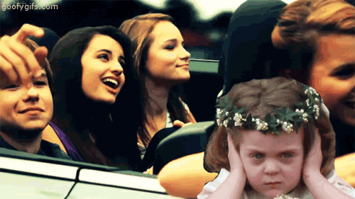
Nuclear Equations:
* charge and mass balance
It may be annoying, but you know you like it!

Slide 11
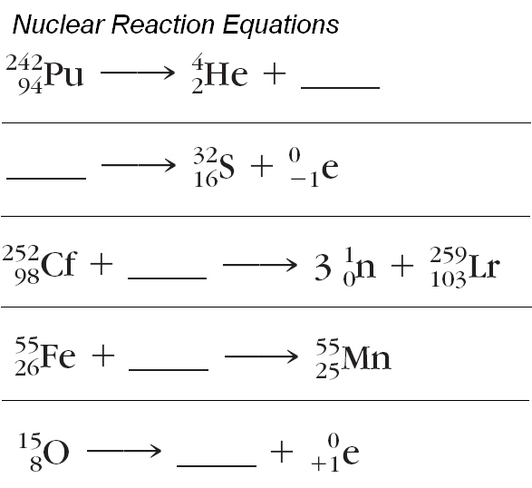
Learning Check:
238
92
Alpha
Decay
U
32
15
P
Beta
Decay
Keep Going, you can do these!
15
7
Positron
Decay
N

Slide 12
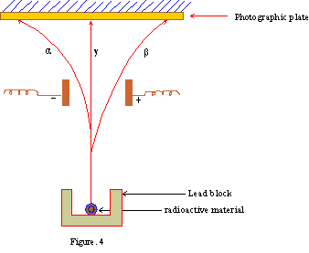
Separation of Radiation:

Slide 13
Artificial Transmutation:
* One element is forced to change to another by bombardment with a particle
* 2 particles on left side of equation
Bombarding
particle
Target

