Slide 1
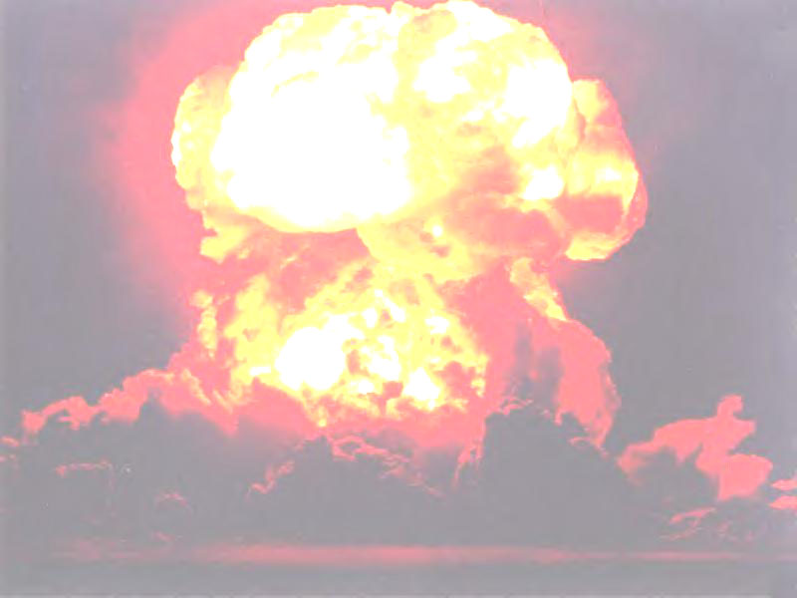
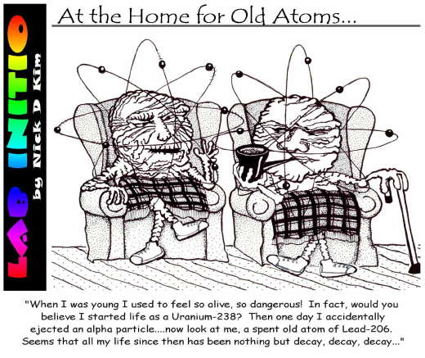
Half-Life & Radioactive Dating

Slide 2
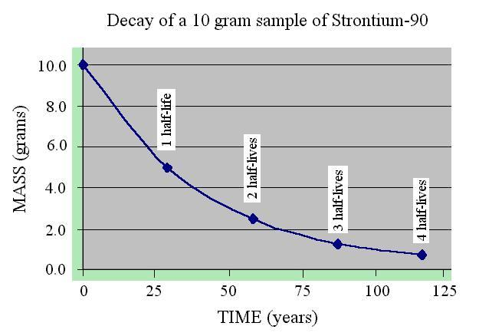
Half-Life:
* the time it takes for ½ of the radioactive material to decay

Slide 3
Half-Life:
* Table T
Number of Half-life Total
Half-lives Time time
X =

Slide 4
Learning Check:
A sample of a radioactive substance with an original mass of 16g was studied for 8 hours. When the study was completed, only 4g of the substance remained. What is the half-life?
Step 1: 4g
16g
Step 2:
1
4
Step 3: number of half- lifes (n) = 2
Step 4: t
T
=
1
4
1 ^{n}
2
= # of ½ lifes
=
8
T
= 2
T = 4 hrs

Slide 5
Learning Check:
How much time must elapse before 16g of potassium-42 decays, leaving 2g of the original isotope?
a. 8 X 12.4 hours c. 3 X 12.4 hours
b. 2 X 12.4 hours d. 4 X 12.4 hours
Answer is: C (3 half-lifes X 12.4 hours)

Slide 6
Learning Check:
Based on Reference Table N, what fraction of a sample of gold-198 remains radioactive after 2.69 days?
a. ¼ c. ¾
b. ½ d. 7/8
Answer is: b (1/2)

Slide 7
Learning Check:
What is the half-life of sodium-25 if 1.00g of a 16g sample of sodium-25 remains unchanged after 237 seconds?
a. 47.4 s c. 79.0 s
b. 59.3 s d. 118 s
Answer is: b (59.3 s)
4 half lifes = 237
T

Slide 8
Learning Check:
After 32 days, 5 milligrams of an 80 milligram sample of a radioactive isotope remains unchanged. What is the half-life of this element?
a. 8 days c. 16 days
b. 2 days d. 4 days
Answer is: a (8 days)
4 = 32
T

Slide 9
Learning Check:
If 1/8 of an original sample of krypton-74 remains unchanged after 34.5 minutes, what is the half-life of krypton-74?
a. 11.5 min c. 34.5 min
b. 23.0 min d. 46.0 min
Answer is: a (11.5 min)
3 = 34.5
T

Slide 10
Learning Check:
How many days are required for 200.g of radon-222 to decay to 50.0g?
a. 1.91 days c. 7.64 days
b. 3.82 days d. 11.5 days
Answer is: c (7.64)
½ life of Rn is 3.82 days
200g → 50g = 2 half-lifes

Slide 11
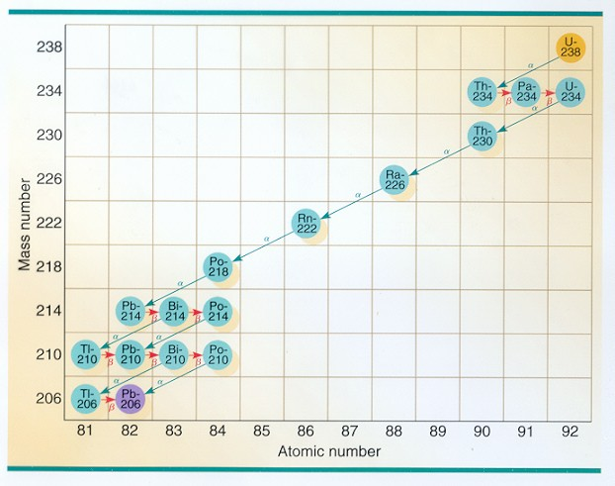
Radioactive Decay Series:
* The changes needed to become stable
Takes
5.5 X 10⁹ yrs

Slide 12
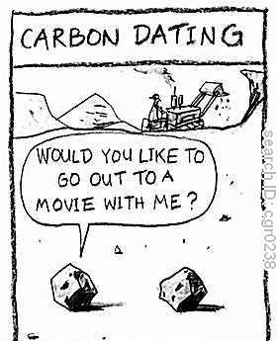
Radioactive Dating:
* Determining age using half-life
* For rocks use ²³⁸U
* For things fairly recent use ¹⁴C

