Slide 1
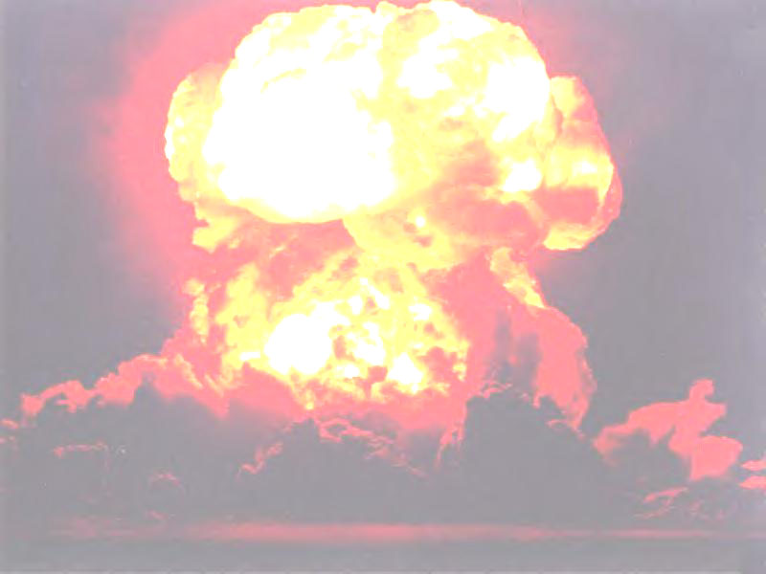
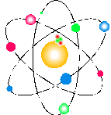
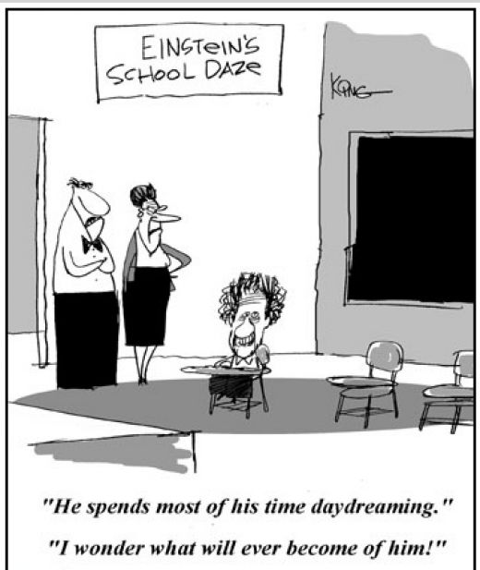
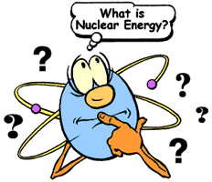
Nuclear Energy

Slide 2
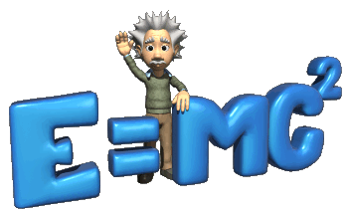
Energy Of Nuclear Changes:
* Matter can be converted into energy, and energy can be converted into matter.
E = energy
M = mass
C = speed of light (3 X 10⁸ meters/second)

Slide 3
* Nuclear energy has much more energy than from chemical reactions
1Kg Uranium = 4,000,000Kg Coal
Fission:
large nuclei is split into two or more smaller nuclei
Fusion:
small nuclei join into larger nuclei

Slide 4
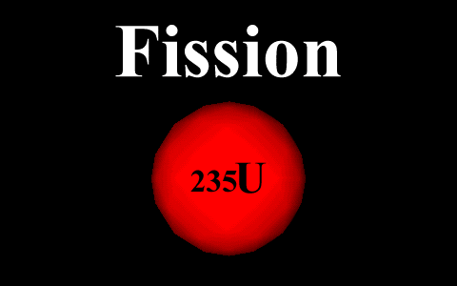
Nuclear Fission:
creates a chain reaction
* Heavy nuclei split apart

Slide 6
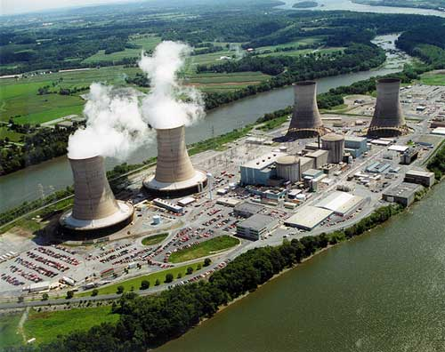
Nuclear Fission:
Advantages:
- small amount of fuel needed
- no air pollution
- reduces dependence on fossil fuels
Disadvantages:
- produces poisonous radioactive waste
- possible accidents
-Chernobyl, 3 Mile Island, Fukushima

Slide 7
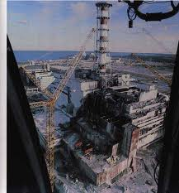
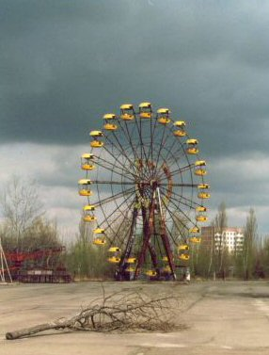
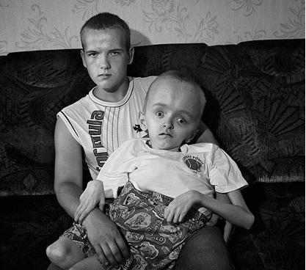
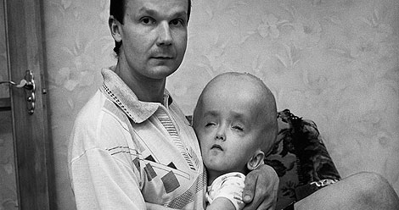
Chernobyl: 4-26-1986

Slide 8
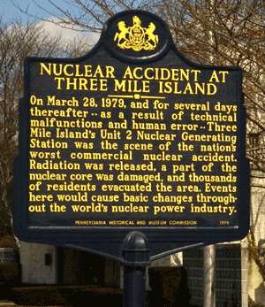
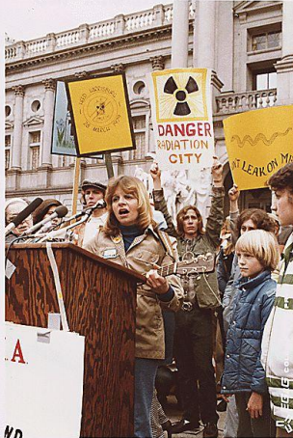
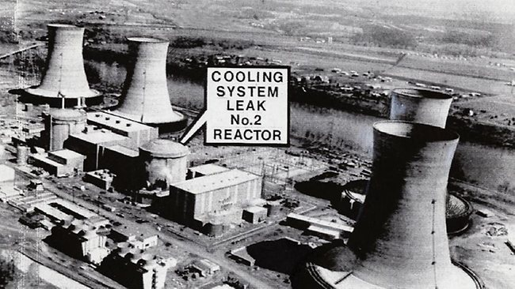
3 Mile Island: 3-28-1979

Slide 9
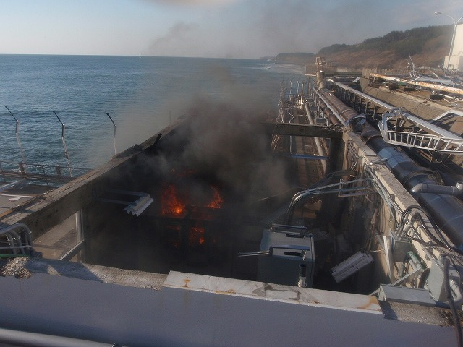
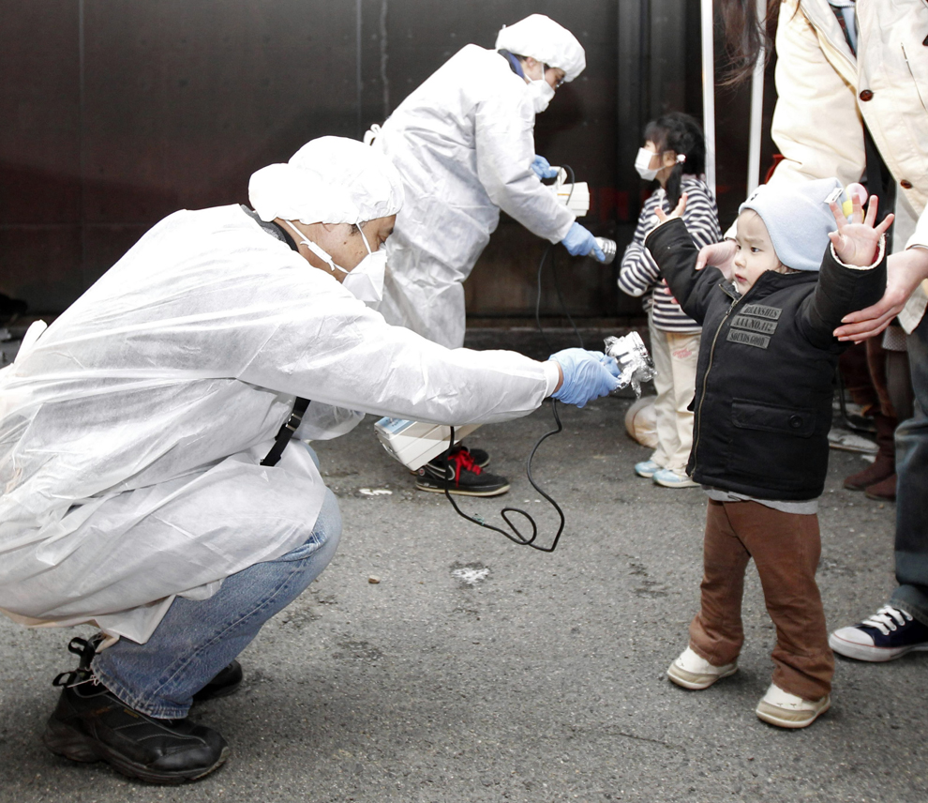
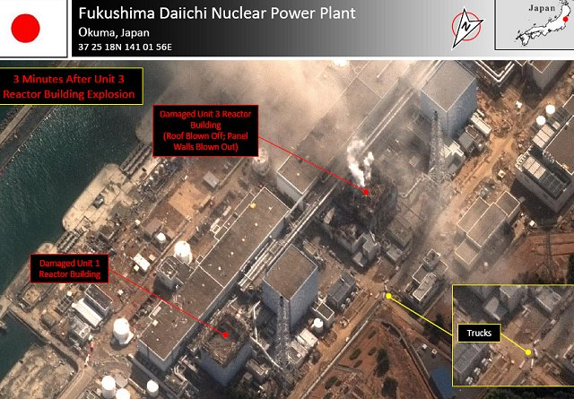
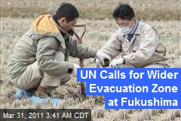
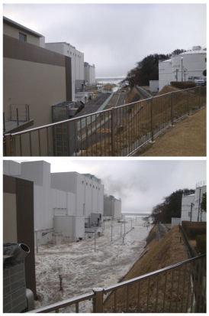
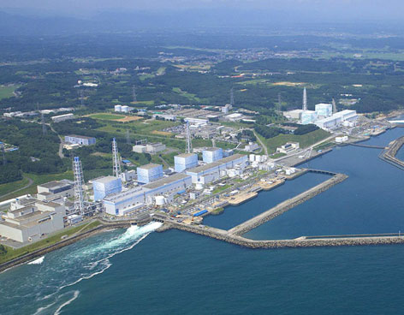
Fukushima: 3-11-2011

Slide 10
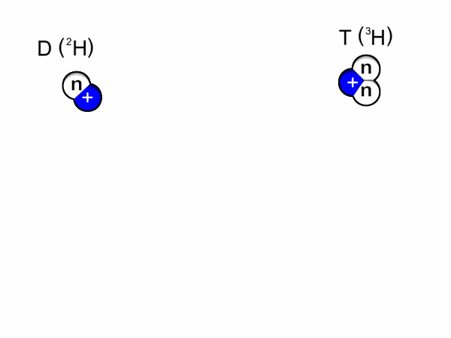
Nuclear Fusion:
*light nuclei are put together
Hydrogen → Helium + Energy

Slide 11
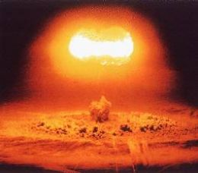
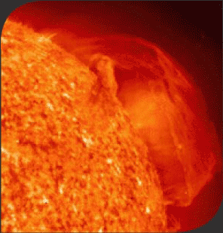
Nuclear Fusion:
*theromonuclear reaction
*stars
Advantages:
- less poisonous wastes
- fuel is inexpensive and abundant
Disadvantages:
- requires high temps.
40,000,000°C

Slide 12
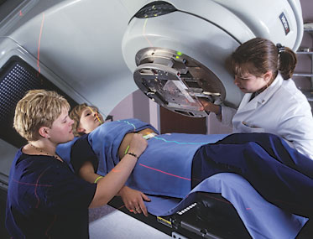
Other Uses Of Radioisotopes:
Radiation Therapy:
^{*60}Co Cobalt-60
- short half life
- quickly eliminated from the body
- kills cancerous cells without extensively damaging healthy cells.
*¹³¹I Iodine-131
- shows thyroid disorders
*⁹⁹Tc Technetium-99
- locate brain tumors and
blood flow patterns

Slide 13
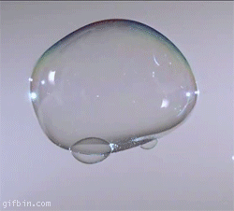
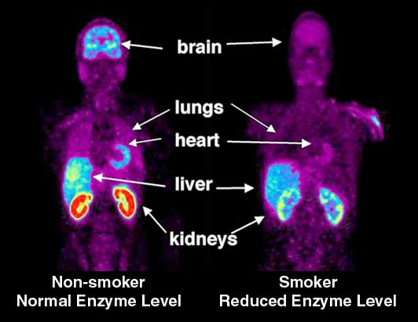
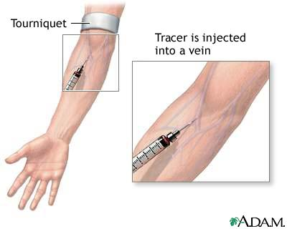
Tracers:
*show how reactions take place
*because they are radioactive, they can be traced
to show the course of a chemical reaction
*¹⁴C is used to trace organic reactions
- shows the mechanism or path of the reaction

Slide 14
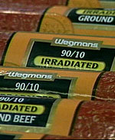
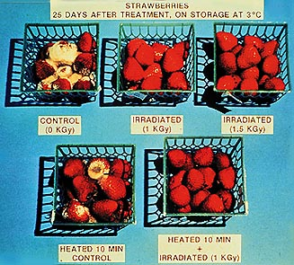
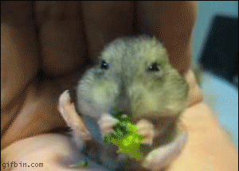
Irradiation of Food:
- kills microbes (like E. coli) in food
- food stores longer

Slide 15
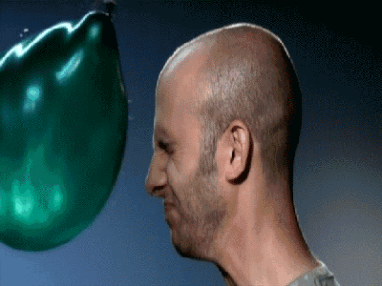
Risks:
* Radiation ionizes molecules
causes cancer and/or mutations
Penetration:
α → β → γ
Least Risk → Worst Risk

