Slide 1
Composition of Matter
Matter may be classified by its composition.
Substances – matter that has a fixed composition. (pure)
Matter can be an:
Element – made up of atoms
Compound – made up of elements
Mixture – two or more substances mixed together

Slide 2
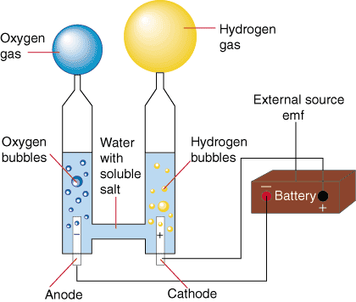
Chemical Changes
Elements → Compounds
2H₂ + O₂ → 2H₂0
Compounds → Element
Electricity + H₂O → H₂ + O₂

Slide 3
Elements
Can not be broken down chemically
Found on the Periodic Table
First letter capitalized
CO → Carbon Monoxide (compound)
Co → Cobalt (element)
Latin Pb Plumbum
Table S of Reference Table
Properties of Selected Elements

Slide 4
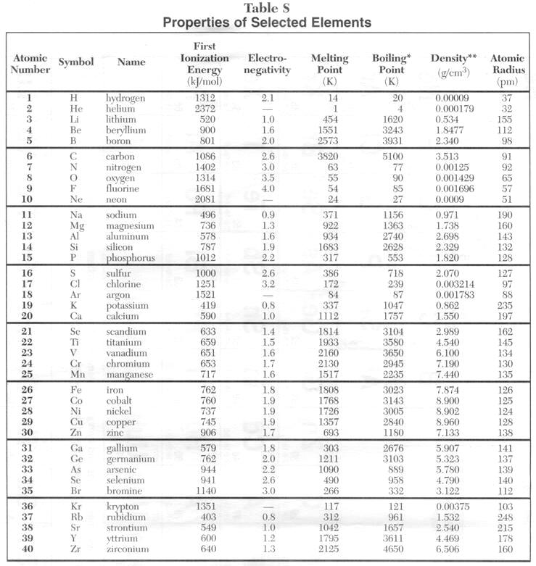

Slide 5
Compounds
Two or more elements chemically combined.
Can be broken down chemically.
Heat or electricity
Have fixed composition.
H₂0 (2 Hydrogen, 1 Oxygen)
H20 by mass (11.1% Hydrogen, 88.9% Oxygen)

Slide 6
Compounds
Elements properties change in compounds.
Na + Cl₂ → NaCl
(explosive (poisonous (Good on
in water) in water) french fries)

Slide 7
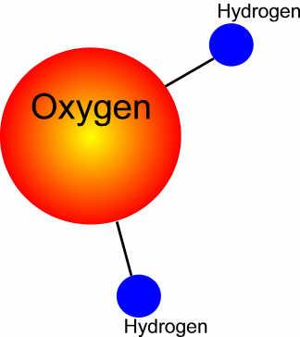
Compounds
Bonds hold atoms together to make a molecule.
Attractive forces between molecules determines phase.
Stronger bonds → liquids
Weaker bonds → gas

Slide 8
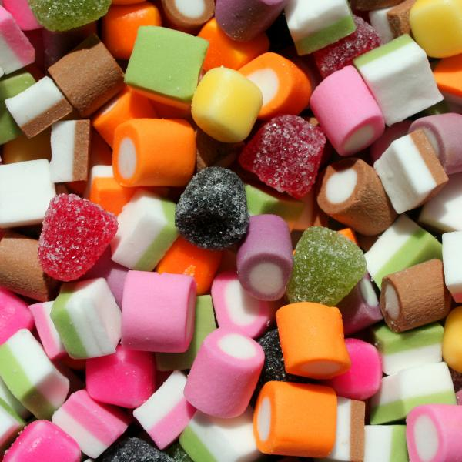
Mixtures
Two or more substances mixed together.
Not a substance
Composition can vary
(A little or a lot of salt in water makes salt water)

Slide 9
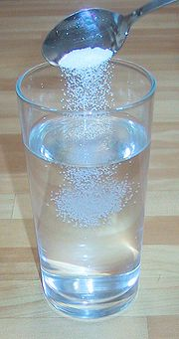
Homogeneous Mixture
Same throughout
Is in Solution – one thing dissolves in another
Salt + Water
Sugar + Water

Slide 10
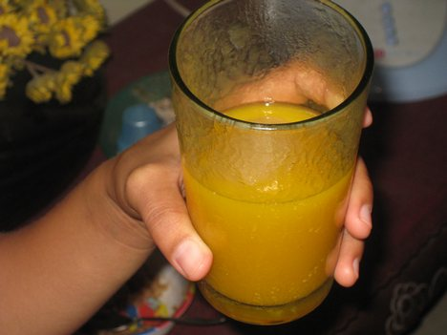
Heterogeneous Mixture
Not uniform, clumpy
Doesn’t dissolve
Orange juice
Mud puddle

Slide 11
Learning Check
Hydrogen Peroxide
Compound
Air
Homogeneous Mixture
Salad Dressing
Heterogeneous Mixture
Dirt
Heterogeneous Mixture
Gold
Element
Wild Bird Seed
Heterogeneous Mixture
Carbon Dioxide
Compound
Coffee
Homogeneous Mixture

