Slide 1
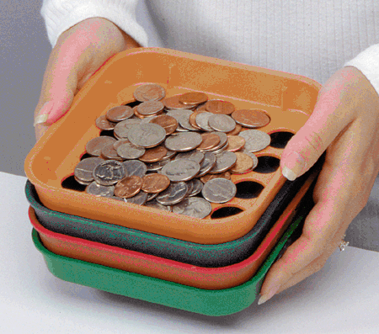
Separating Mixtures
Must be a difference in physical properties to separate a mixture.

Slide 2
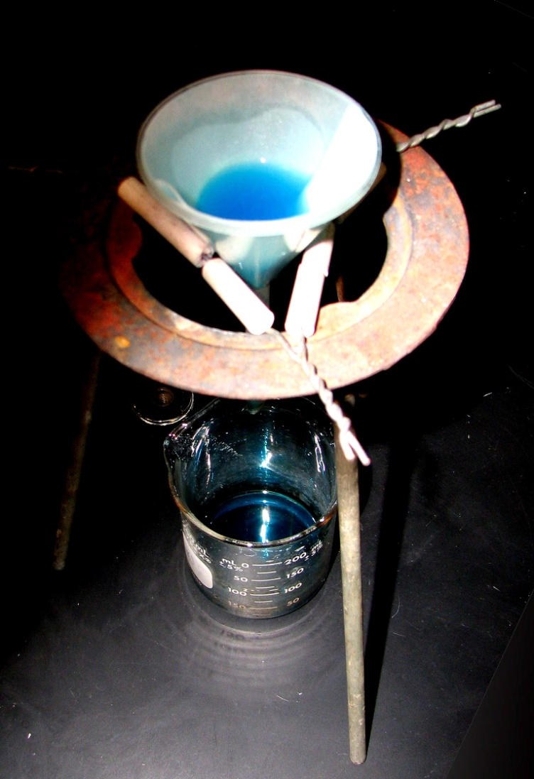
Filtration
Difference in particle size

Slide 3
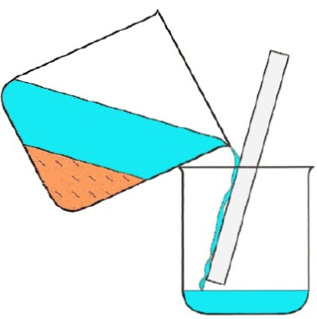
Decanting
Liquid is poured off, while the solid remains.

Slide 4
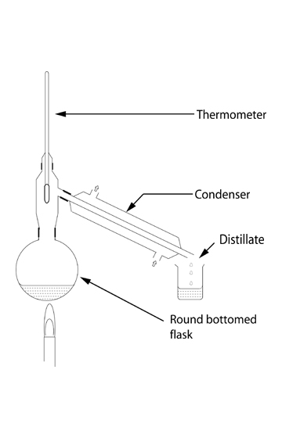
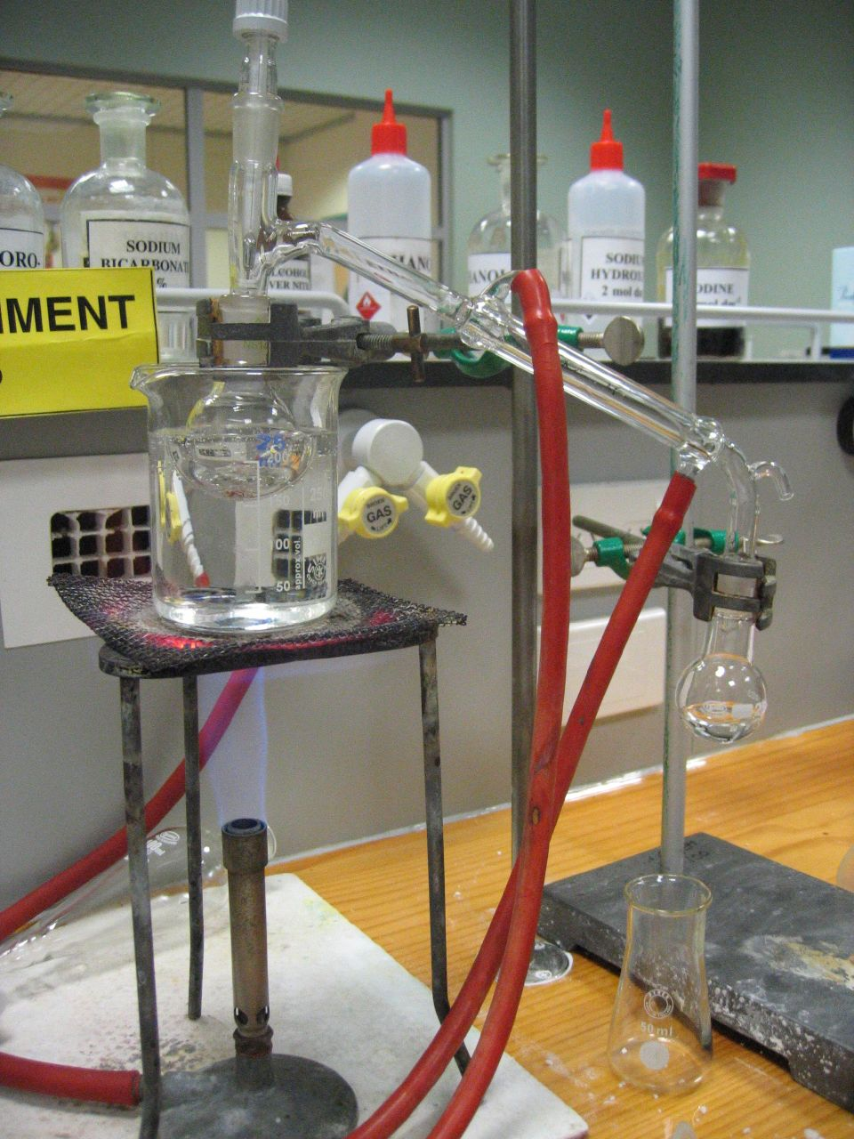
Distillation
Difference in boiling points
Allows for substance with lower boiling point to be separated and condensed into new container.

Slide 5
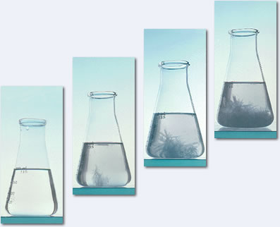
Crystallization
Crystals form when the solvent evaporates or is cooled.

Slide 6
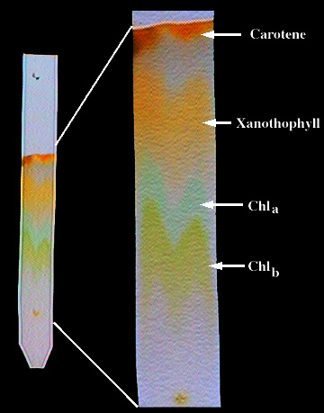
Chromatography
Differences in:
Adsorption – how well the color sticks to paper.
Solubility – how well it dissolves in water.

Slide 7
Video Link
Separating Mixtures

