Slide 1
Energy Changes in Matter
Energy:
The ability or capacity to do work.
w = f X d
Work = Force X Distance

Slide 2
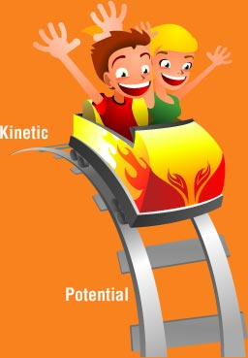

Slide 3
Potential Energy
Stored energy
Examples of potential energy:
Oil sitting in a barrel
Water in a lake behind a dam
This energy is referred to as potential energy, because if it were released, it would do a lot of work.

Slide 4
Kinetic Energy
Energy in motion
Moving water and wind are good examples of kinetic energy.
Electricity is also kinetic energy, even though you can't see it happen, electricity involves electrons moving in conductors.
KE = ¹/₂MV² M=Mass V=Velocity

Slide 5
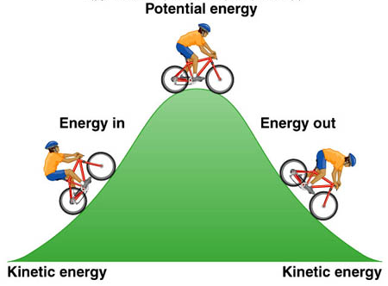

Slide 6
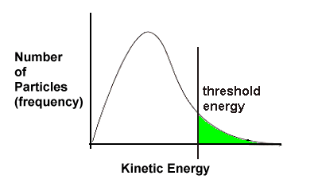
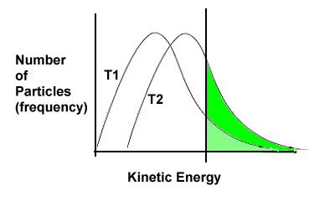
Temperature
A measure of average kinetic energy.
“A thermometer is a molecular speedometer.”
Hotter Temperature
Video Link - Temperature and Kinetic Energy

Slide 7
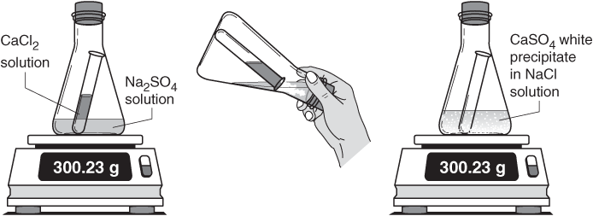
Law of Conservation of Energy
Energy can not be created or destroyed.
Energy can be converted.
PE → KE
KE → PE
Total amount of energy in a closed system is constant.
Conservation of mass:

Slide 8
Heat
A measure of the total energy of a system.
Measured in Joules (J) and Calories (cal)
A form of energy that transfers from one object to another.
What is the flow of energy when a cold pack is placed on a leg?
Chart Page 15 of text book.

Slide 9
Can two systems have the same temperature but different amounts of heat?
Yes, 5 liters and 50 liters of boiling water have the same temperature (100C) but the 50 liter sample, because it has more water, can supply more heat energy.

Slide 10
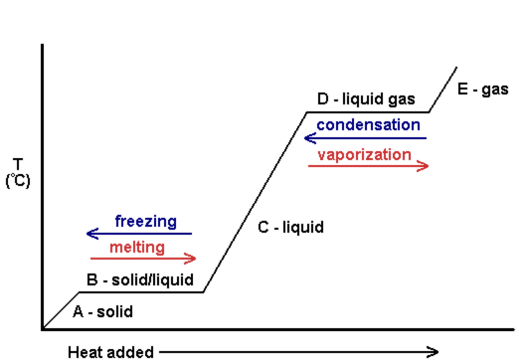
Phase Changes and Heat
Phase Change Diagram (Heating Curve)
KE Change
PE Change

Slide 11
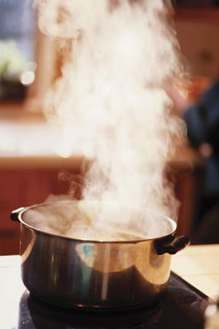
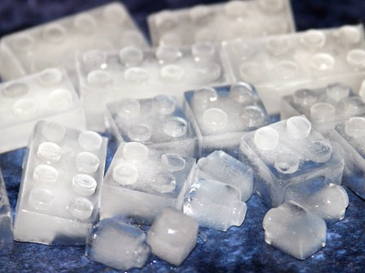
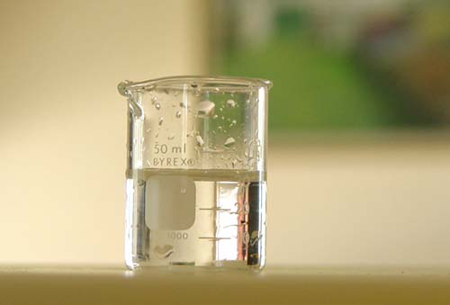
Phase Changes
Heat
Heat
Heat
Heat
Endothermic
Exothermic

Slide 12
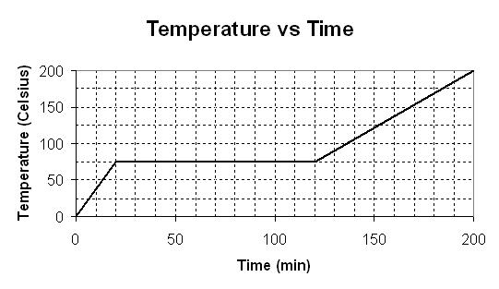
Sublimation/Deposition
Deposition
Sublimation
Gas
Solid

Slide 13
Time
Heat
Heat
Endothermic
Exothermic

Slide 14
Sublimation/Deposition
Youtube Video with Iodine

