Slide 1
Heat of Fusion
Hf
Energy needed to melt a gram of solid.
Fusion = Melting
Table B – Reference Tables
1g ice needs 334J of energy to turn to 1g liquid water.

Slide 2
Heat of Fusion Formula
Table T – Reference Tables
Heat
q = m X Hf
heat (q) = mass (m) X heat of fusion (Hf)

Slide 3
How much energy is needed to melt 100g of water at 0° celsius?
q = m X Hf
q = 100g X 334J/g
q = 3,340J
3,340J X 1KJ
1000J
Answer: 3.34KJ

Slide 4
Heat of Vaporization
Hv
Energy needed to vaporize 1gram of liquid.
Vaporization = Boiling
Table B of Reference Tables
1gram of liquid water needs 2,260J of energy to turn into 1 gram of water vapor.

Slide 5
Heat of Vaporization Formula
q = m X Hv
Heat (q) = Mass (m) X Heat of vaporization (Hv)

Slide 6
How much energy is needed to vaporize 63.7g of water at 100° celsius?
q = m X Hv
q = 63.7g X 2260J/g
q = 143962J
143962J X 1KJ
1000J
Answer: 144KJ

Slide 7
Does it take more energy to melt or vaporize water?
Answer: Vaporize
Melting requires 334J/g of energy.
Vaporizing requires 2260J/g of energy.

Slide 8
Measuring Heat
Unit for heat = Joule (J)
Specific Heat:
Heat needed to change 1g 1°C
Table B:
Specific heat of water = 4.18J/g°C
Table T:
q = m X C X ∆t
Heat (q) = Mass (m) X Specific Heat X Change in Temp (∆t)

Slide 9
How much heat is needed to change 75g water from 50°C to 75°C?
q = mc∆t
q = 75g X 4.18J/g°C X 25°C
q = 7800J
7800J X 1KJ
1000J
Answer: 7.8KJ

Slide 10
Solving for Temperature Change (∆t)
If 418J are put into 20.0g water at 20°C, what is the final temperature of the water?
∆t = q
mC
∆t = 418J
20.0g X 4.18J/g°C
∆t = 5.0°C
Final Temperature = 25°C

Slide 11
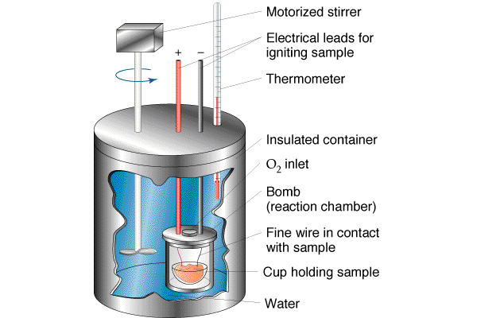
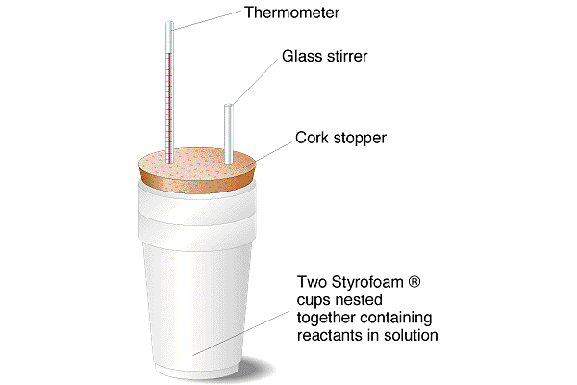
Measuring Heat in a Closed System
Calorimeter (p. 21 of text book)
When a chemical reaction takes place in a calorimeter, the energy changes from the reaction will determine the temperature changes of the water.

Slide 12
Learning Check
50.0ml of an acid and 50.0ml of a base initially at 22.5°C react in a calorimeter. The maximum temperature obtained was 26.0°C. How much heat was released?
q = mC∆t
100.0g X 4.18J/g°C X 3.5°C
1463J
1463J X 1KJ
1000J
Answer = 1.5KJ

