Slide 1
Combined Gas Law
The pressure and volume of a gas are inversely proportional to each other, but directly proportional to the temperature of that gas.
Table T of Reference Tables
Temperature must be in K (Kelvin).

Slide 2
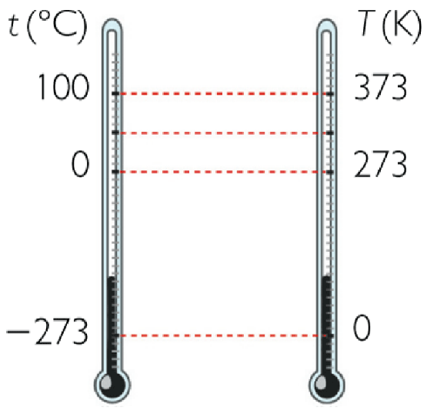
Temperature
Table T of Reference Tables
Water Boils
Water Freezes
Absolute Zero

Slide 3
Combined Gas Law
Temperature = Volume x Pressure / Constant Volume = Constant x Temperature / Pressure Pressure = Constant x Temperature / Volume Pressure x Volume/Temperature = Constant
Substituting in variables, the formula is: PV/T=K
K is a constant = n (amount) R (gas constant)

Slide 4
Combined Gas Law
Because the formula is equal to a constant, it is possible to solve for a change in volume, temperature, or pressure using a proportion:

Slide 5
Using Gas Law Equation:
At a temperature of 27°C and a pressure of 50.65 kPa, 60.0 mL of a gas is collected. What would the volume of the gas be at STP?
STP is 273 K and a pressure of 101.3 kPa
Set up the equation:

Slide 6
Using the Gas Law Equation:
Temp. must be in Kelvin, so convert:
27°C + 273 = 300 K
T₁ is 300K
V₁ is 60.0 mL
P₁ is 50.65 kPa
T₂ is standard temperature 273 K
P₂ is standard pressure 101.3 kPa
V₂ is ?

Slide 7
Solution:
(50.65 kPa)(60.0 mL) (101.3 kPa)(V₂)
=
300 K 273 K

Slide 8
Solution:
3039 kPa mL (101.3 kPa)(V₂)
=
300 K 273 K

Slide 9
Solution:
10.13 kPa mL = (101.3 kPa)(V₂)
K 273 K

Slide 10
Solution:
(273 K) 10.13 kPa mL = 101.3 kPa (V₂)(273K)
K 273 K

Slide 11
Solution:
2765.49 kPa mL = 101.3 kPa (V₂)
2765.49 kPa mL = 101.3 kPa (V₂)
101.3 kPa 101.3 kPa
V₂ = 27.3 mL

Slide 12
Learning Check
A gas has a volume of 25.0L at a temperature of 27°C and a pressure of 1.00 atm. The gas is allowed to expand to a new volume of 50.0 L. The pressure is now 0.40 atm. What is the final temperature?
T₂ = 240 K

Slide 13
Boyle’s Law
Temperature is Constant

Slide 14
Boyle’s Law
In the mid 1600's, Robert Boyle studied the relationship between the pressure p and the volume V of a confined gas held at a constant temperature. Boyle observed that the product of the pressure and volume are observed to be nearly constant.
Boyle's Law and Syringe Video

Slide 15
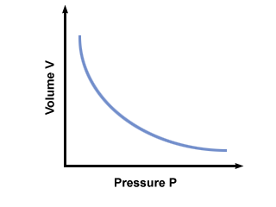
Boyle’s Law

Slide 16
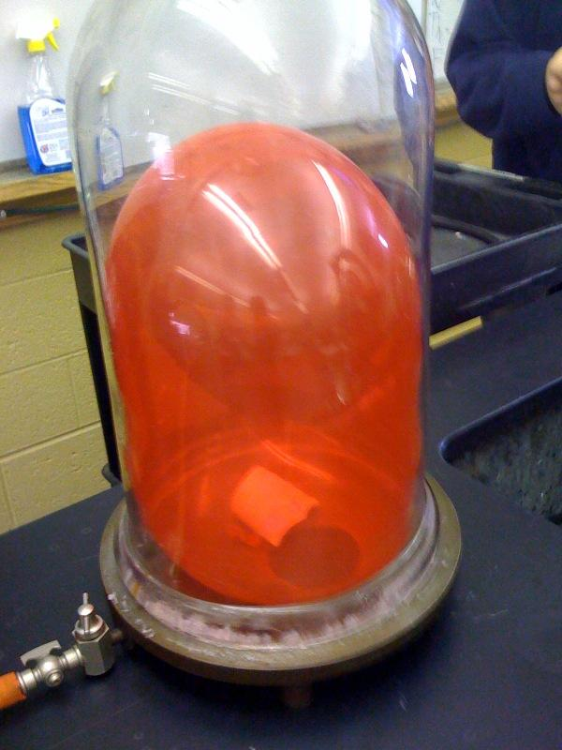
Boyle’s Law – Balloon Demo
Inflating a Sealed Balloon Video

Slide 17
Learning Check
A balloon contains 30.0 L of helium gas at 103 kPa. What will the volume be if the pressure is changed to 25 kPa at constant temperature?
P₁V₁ = P₂V₂
(103 kPa)(30.0 L) = 25 kPa (V₂)
3090 kPa L = 25 kPa (V₂)
3090 kPa L = V₂
25 kPa
V₂ = 123.6 L

Slide 18
Boyle’s Law
Pressure increases then Volume decreases
Pressure decreases then Volume increases

