Slide 1
Boyle’s Law – HW Review
1.24 A 4.0-liter sample of gas exerts a pressure of 2.0 atm. If the gas is allowed to expand to a volume of 16 L (at constant temperature), find the new pressure of the gas.
P₁V₁ = P₂V₂
Answer: 0.50 atm

Slide 2
Boyle’s Law – HW Review
1.25 A gas has a volume of 24 mL at a pressure of 405.2 kPa. Assuming no change in temperature, what would the volume of this gas be at standard pressure?
Answer: 96 mL

Slide 3
Boyle’s Law – HW Review
1.26 At constant temperature, what happens to the pressure exerted by a gas if its volume is doubled?
Answer: Pressure is halved.

Slide 4
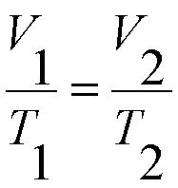
Charles’ Law – Pressure Constant
Compares the temperature and volume of a gas when the pressure remains constant.
*Temperature must be in Kelvins.

Slide 5
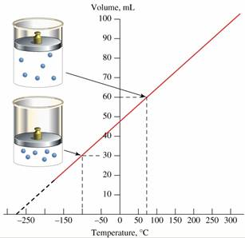
Charles’ Law:
Volume is proportional to temperature.

Slide 6
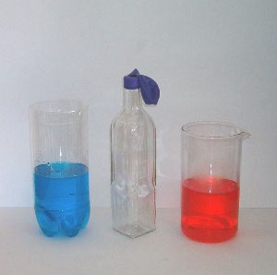
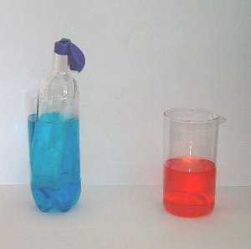
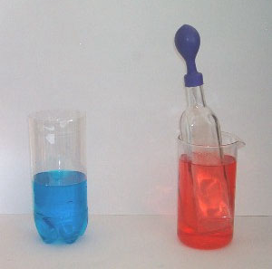
Charles’ Law Demonstration:
Cold Water
Hot Water

Slide 7
Charles’ Law:

Slide 8
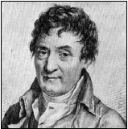
Charles’ Law:

Slide 9
Learning Check:
The temperature of 150 mL of a gas at constant pressure is increased from 20°C to 40°C. What is the new volume of the gas?
(Remember to use Kelvin)
Answer: 160 mL

Slide 10
Learning Check:
The unknown volume is of a gas is at 32°C. At 18°C the gas occupied a volume of 152 mL. What is the unknown volume?
Answer: 159 mL

Slide 11
Learning Check:
A balloon at 24°C has a volume of 4.00L. It is then heated to 58°C. What is the new volume if pressure remains constant?
Answer: 4.46L

