Slide 1
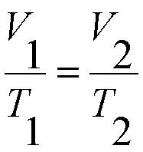
Charles’ Law – HW Review
1.27 At a temperature of 27°C, 30. mL of a gas are collected. If the gas is heated, at a constant pressure, to a temperature of 127°C, find the new volume of the gas.

Slide 2
Charles’ Law – HW Review
1.28 A student collects 40. mL of a gas at a temperature of 364 K. The gas is cooled at constant pressure, until it reaches standard temperature. What is the new volume of the gas?

Slide 3
Charles’ Law – HW Review
1.29 What would happen to the volume of a gas if both the Kelvin temperature and the pressure of the gas were doubled?

Slide 4
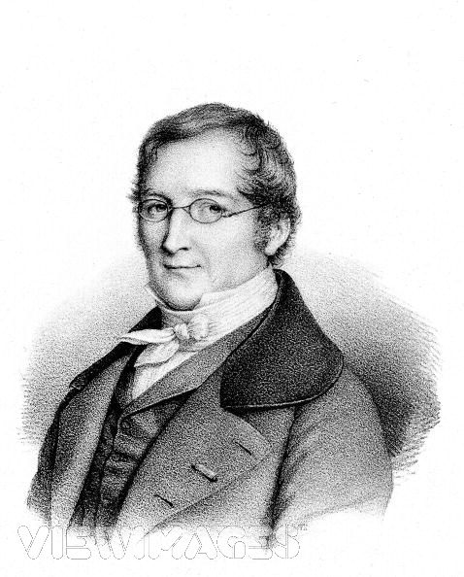
Gay-Lussac’s Law – Volume Constant
Compares the temperature and pressure of a gas when the volume remains constant.
*Temperature must be in Kelvins.

Slide 5
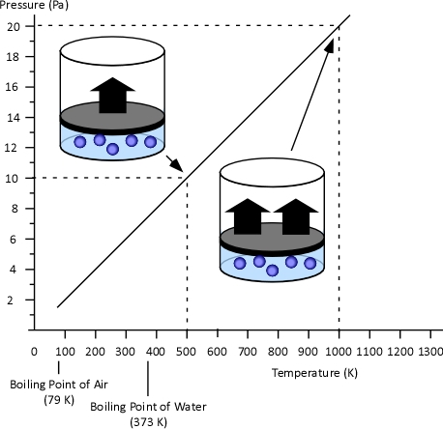
Gay-Lussac’s Law:
Pressure is proportional to temperature.

Slide 6
Example:
A used aerosol can has a pressure of 103 kPa at 25°C. What would the pressure be if thrown in a fire and the temperature reaches 928°C?
103 kPa = X kPa
298 K 1201 K
123703 kPa K = 298 K (X kPa)
Answer: 415 kPa

Slide 7
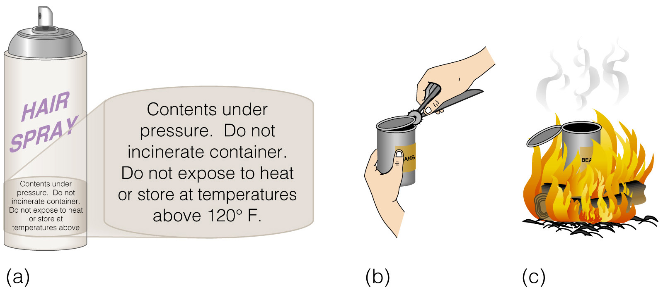
Gay-Lussac’s Law at Work

Slide 8
Combined Gas Laws:
A closed container of Dr. Pepper is in your car. The Dr. Pepper is at STP and has a volume of 2.0 L. What will the pressure of the bottle be if the temperature in the car increases to 75°C?
(Remember to use Kelvin)
Answer: 129.1 kPa

Slide 9
Learning Check:
A balloon has a volume of 30.0 L at 313 K and 153 kPa. What would the volume be at STP?
Answer: 39.5 L

