Slide 1
HW Review
1.35 A tank of gas with a total pressure of 12.0 atm contains a mixture of oxygen, nitrogen and argon. If the partial pressure of nitrogen is 10 atm, and the partial pressure of oxygen is 1.5 atm, what is the partial pressure of the argon gas?

Slide 2
HW Review
1.36 From the last problem, if the tank is found to contain 3.0 moles of argon gas, how many moles of oxygen must there be in the tank?

Slide 3
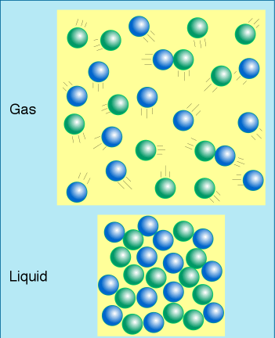
Liquids
Have attractions between particles
Density:
Liquids are more dense than gases.

Slide 4
Liquids:
Particles can NOT be compressed.
Evaporate at any temperature.
Vaporization: when a liquid goes to a gas.
Evaporation: the vaporization at the surface of the liquid.
Particles with high KE
Average KE is lower so evaporation causes cooling

Slide 5
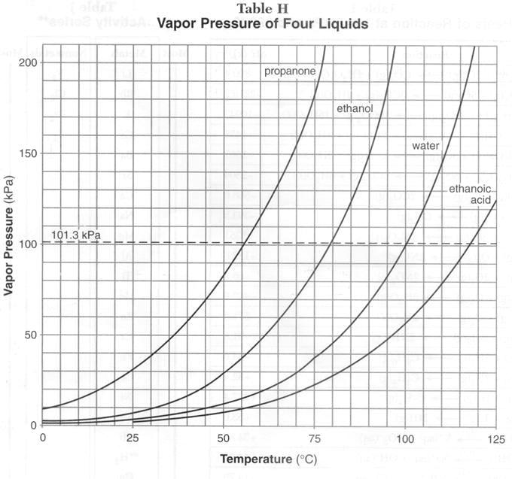
Vapor Pressure
*Force exerted by a vapor above a liquid.

Slide 6
Vapor Pressure
From Table H
As Temp Increases, Vapor Pressure Increases
As Forces of Attraction Increases, Vapor Pressure Decreases

Slide 7
Combined Gas Laws:
In a closed system:
Equilibrium:
Evaporation Rate =
Condensation Rate

Slide 8
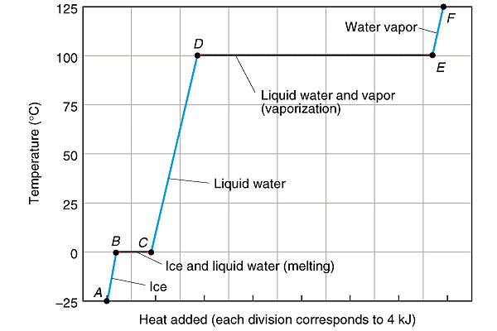
Boiling Point
When vapor pressure equals outside pressure. (Atmospheric Pressure)
Normal boiling point is at 1 atm.
Boiling is endothermic.

