Slide 1
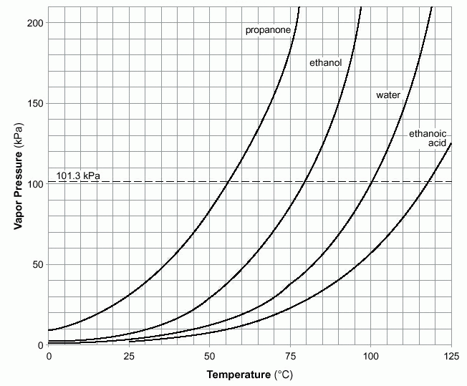
HW Review
1.37 At room temperature, which of the four liquids evaporates most rapidly?
Propanone = Acetone
Ethanoic Acid = Acetic Acid

Slide 2
HW Review
1.38 What is the normal boiling point of acetic acid?

Slide 3
HW Review
1.39 What is the external pressure, if ethanol is boiling at a temperature of 70°C?

Slide 4
HW Review
1.40 Which of these liquids has the weakest intermolecular attractions?

Slide 5
HW Review
1.41 How would you expect the surface tension in acetic acid to compare with that of water? Explain.

Slide 6
HW Review
1.42 Acetone is often used in nail polish removers. Its users eventually notice that when spilled on the hands, acetone dries very quickly, and feels quite cold. Explain these observations on the basis of the intermolecular attractions in acetone.

Slide 7
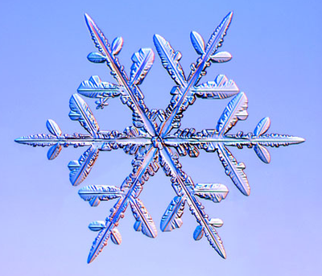
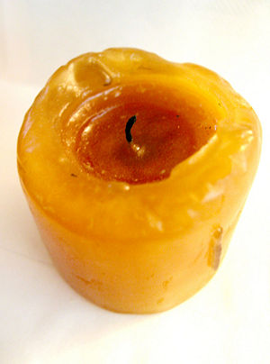
Solids
Stronger Attractive forces between solids.
Particles are stuck together. Only have vibrational movement.
Crystalline – regular geometric pattern
Ex: ice, salt, metal
Amorphous – no crystals
Ex: glass, rubber, plastic
Usually more dense than corresponding liquid.

Slide 8
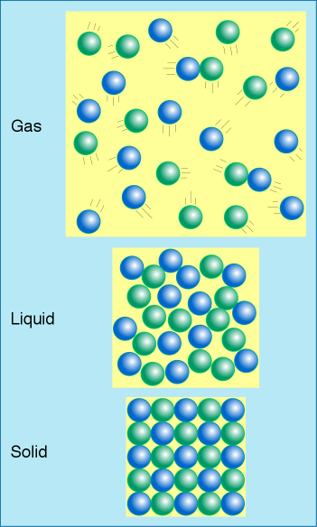
Density:

Slide 9
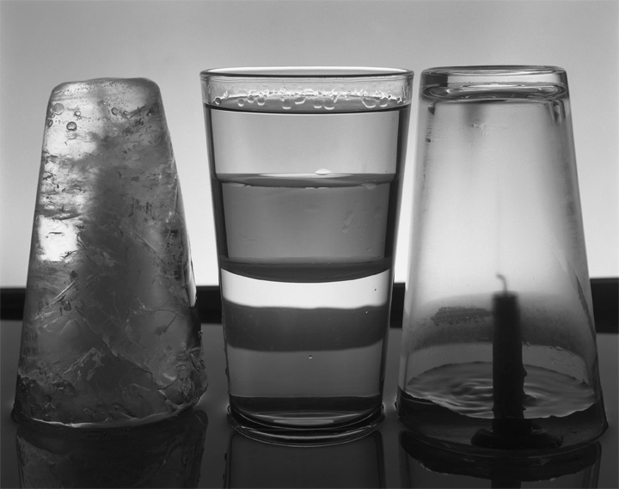
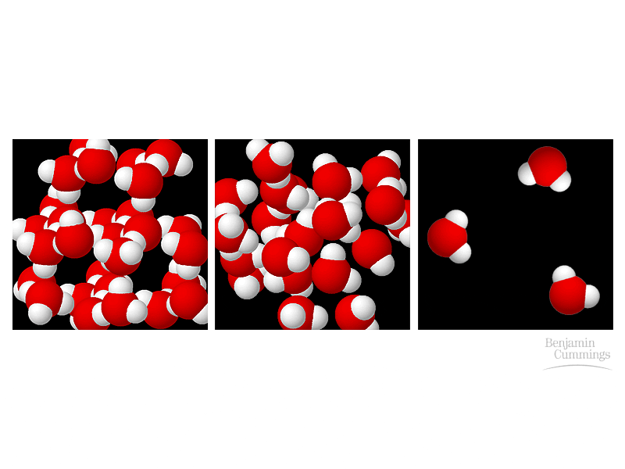
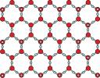
Density of Water is unusual
Solid – Less Dense Liquid – More Dense Gas – Less Dense

Slide 10
Melting Point – Freezing Point
Melting → Fusion
Freezing → Crystallization
1°C = Liquid
0°C = Liquid and Solid
-1°C = Solid

Slide 11
Video Links:
States of Matter Video
BBC Video on States of Matter

