Slide 1
Structure of an Atom

Slide 2
What are the fundamental particles of the atom?
Proton: Particle with positive electrical charge (+1).
Electron: Particle with negative charge (-1).
Neutron: Neutral charge.

Slide 3
Particle Chart (Table O)
Particle | Charge | Mass | Location | Symbol
Proton | + | 1 amu | Nucleus | (p⁺)
Neutron | 0 | 1 amu | Nucleus | (n⁰)
Electron | - | Negligible 0 | Orbitals | (e⁻)

Slide 4
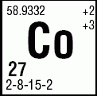
Atomic Mass
amu
1/12 of carbon-12 atom
Periodic Table
Example for Co

Slide 5
How do atoms differ?
Atomic Number:
Number of protons
If atom is neutral, atomic # = # of electrons
Defines the element
₆C

Slide 6
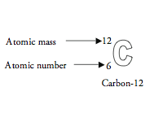
How do atoms differ?
Mass Number:
Number of protons + neutrons
p⁺ + n⁰
Number of nucleons → particles in nucleus
How do you find the number of neutrons?
Atomic mass – atomic number
p⁺ + n⁰ →
p⁺ →

Slide 7
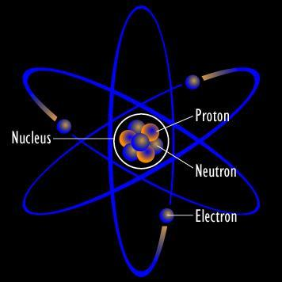
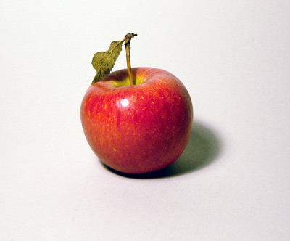
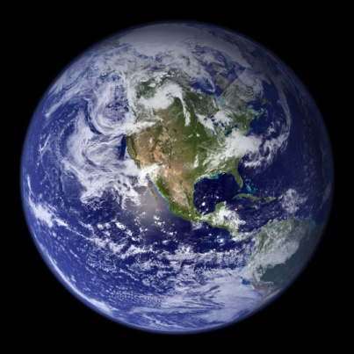
How big is an atom?
Average atom has a radius of 1 X 10⁻⁸cm
100,000,000 atoms of Cu = 1cm
If you expand a Hydrogen atom to the size of an apple, the apple would expand to the size of the earth!

Slide 8
Molecular Mass
Sum of all the atomic masses in a molecule
Example:
H₂O
H₂ X 1 = 2
O₁ X 16 = 16
18 amu

Slide 9
CHEMICAL COMPOSITION SHORTHAND
# OF PROTONS
+
# OF NEUTRONS
MASS NUMBER
Cl
35
ATOMIC NUMBER
17
NUMBER OF PROTONS

Slide 10
THE 1ST TEN ATOMS
Hydrogen | H | 1 | 1 | 0 | 1 | 1
Helium | He | 2 | 2 | 2 | 4 | 2
Lithium | Li | 3 | 3 | 4 | 7 | 3
Beryllium | Be | 4 | 4 | 5 | 9 | 4
Boron | B | 5 | 5 | 6 | 11 | 5
Carbon | C | 6 | 6 | 6 | 12 | 6
Nitrogen | N | 7 | 7 | 7 | 14 | 7
Oxygen | O | 8 | 8 | 8 | 16 | 8
Fluorine | F | 9 | 9 | 10 | 19 | 9
Neon | Ne | 10 | 10 | 10 | 20 | 10
NAME
SYMBOL
ATOMIC #
PROTONS
NEUTRONS
MASS #
ELECTRONS

