Slide 1
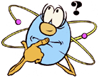
Atomic Mass and Isotopes

Slide 2
Review Quiz
Particle | Charge | Mass | Location | Symbol
Electron
Proton
Neutron

Slide 3
HW Review
2.1
How did Thomson’s view of the atom differ from that of Democritus?
2.2
When alpha particles are shot at a thin gold leaf, only one particle in about 20,000 bounces back. How would Rutherford explain this observation?

Slide 4
HW Review
2.3
What is the atomic number of a neutral atom that contains 14 electrons? Explain.
2.4
A certain atom contains 6 protons, 8 neutrons, and 6 electrons. How many and which of these particles are in the nucleus of the atom?

Slide 5
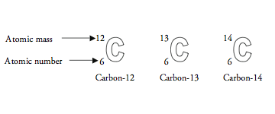
Isotopes
Same # of p⁺, different # of n⁰
Same element, different mass
Same element, different mass #

Slide 6
EXAMPLE OF AN ISOTOPE
ATOMIC MASS
Cl
Cl
35
37
17
17
18
20
NEUTRONS
NEUTRONS
ATOMIC NUMBER

Slide 7
Finding Atomic Mass
Weighted average of the naturally occurring isotopes
If 75.4% of chlorine atoms have a mass of 35 amu, and 24.6% have a mass of 37 amu, calculate the mass of an average Cl atom.
Multiply the mass by the abundance in decimal form, then add.
35 amu X .754 = 26.39
37 amu X .246 = 9.10
35.49 amu

Slide 8
Problem
69% of copper atoms weigh 63 amu.
31% weigh 66 amu. What is the average?
63 X .69 = 43.5
66 X .31 = 20.5
64 amu

Slide 9
Problem
Silver has two isotopes, 104-47 Ag has a mass of 106.905 amu ( 52.00% ), and 109-47 Ag has a mass of 108.905 amu (48.00%). What is the atomic mass of silver?
106.905 X .52 = 55.59
108.905 X .48 = 52.27
Answer:
107.86

Slide 10
Gram-Atomic Mass
Gram-atomic mass of an element is the atomic mass expressed in grams.
When using moles, just change amu to grams
1 atom of ¹²C = 12 g
1 mole ¹²C = 12 g
1 mol carbon =
1 mol copper =
12.01 g
63.5g

Slide 11
Gram-atomic mass
How do you compute the mass of a single atom?
Sodium (Na)
gram-atomic mass = 23.0g
# of atoms in any element’s gram-atomic mass = 6.02 X10²³
23.0 grams
6.02 X 10²³ atoms
= 3.82 X 10⁻²³ gram/atom

Slide 12
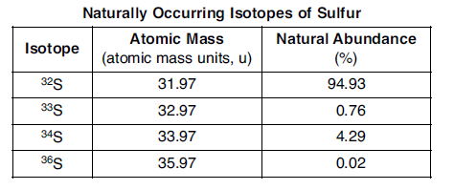
Review Problem

