Slide 1
Bohr and Quantum Mechanical Model

Slide 2
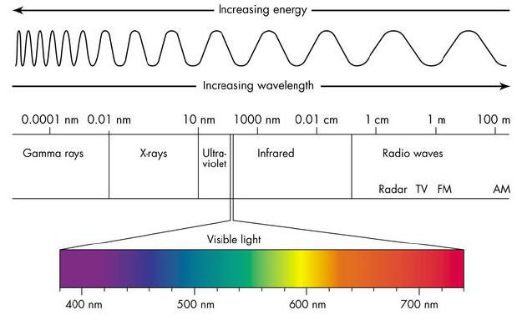
HW Review
2.7
Which color of visible light contains the smallest amount of energy?

Slide 3
HW Review
2.8
A student, in explaining the difference between “continuous” and “ quantized” says: “A piano is quantized, while a violin is continuous.” Do you think this is a good analogy? Explain.
Click for Piano Click for Violin

Slide 4
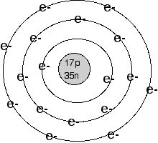
Bohr Model
7 fixed energy levels. (7 rows on Periodic Table)
# electrons in each shell = 2n² (n= shell #)

Slide 5
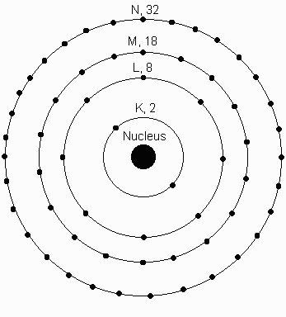
Bohr Model
Could determine bright lines for hydrogen.
Did not work for heavier elements.

Slide 7
Wave Mechanical Model
Modern Model of Atom
electrons behave like particles and waves (light)
electrons are in orbitals
Orbital: a cloud around the nucleus defining the most probable location of electrons.

Slide 8
In the 1920s, Werner Heisenberg put forth his uncertainty principle, which states that, at any one time, it is impossible to calculate both the momentum and the location of an electron in an atom; it is only possible to calculate the probability of finding an electron within a given space. This meant that electrons, instead of traveling in defined orbits or hard, spherical “shells,” as Bohr proposed, travel in diffuse clouds around the nucleus.

Slide 9
The Electron Cloud for Hydrogen
90% probability
of finding the electron within this space

Slide 10
Electrons in Wave Mechanical Model
Described by four quantum numbers:
Principal Energy Level
Sublevels
Orbitals
Electron Spin

Slide 11
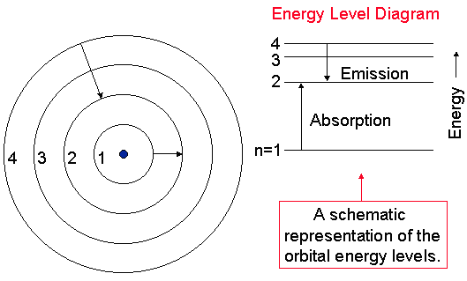
Principal Energy Level
Same as Bohr’s model
Higher Energy

Slide 12
Sublevels
Heavier elements needed more energy levels – Bright line spectrum
Principal Energy Level | Number of Sublevels | Names
1st | 1 | s
2nd | 2 | s, p
3rd | 3 | s, p, d
4th | 4 | s, p, d, f

Slide 13
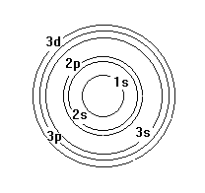
Sublevels

Slide 14
Orbitals
Most probable location for electrons.
Shape of the region electrons may occupy.
There is 1 s - orbital, spherical, up to 2 electrons.

Slide 15
p - orbitals –
There are 3 different types of p orbitals, designated p_{x}, p_{y}, and p_{z}.

Slide 16
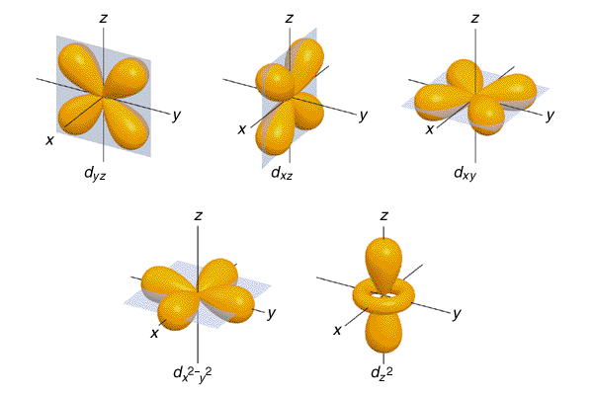
d - orbitals –
There are 5 different probability regions of d orbitals.

Slide 17
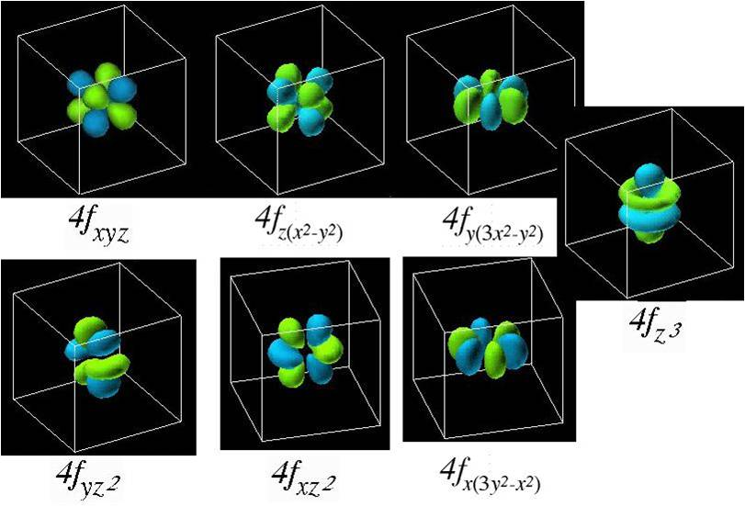
f – orbitals
There are 7 possible f -orbitals, each being able to contain 2 electrons, for a maximum total of 14 electrons. Only shells with principal quantum numbers of 5 or greater can contain f -orbital electrons.

Slide 18
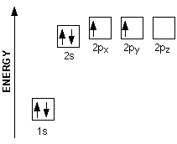
Electron Spin
Up or Down
Carbon

Slide 19
Summary:
Energy Level
Sublevels (s, p, d, f)
Orbitals
Spin

Slide 20
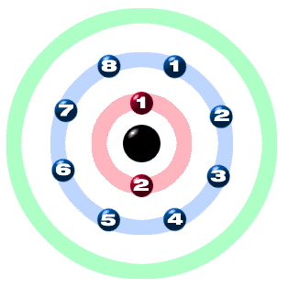
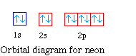
Summary
Neon
Electrons: 2-8

Slide 21
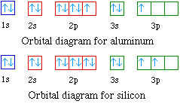
Rules:
Electrons fill lowest level first – .
s, p, d, f
2. Electrons in an orbital differ by spin.
3. In a sublevel, each orbital needs one electron before pairing.

Slide 22
Examples:
Hydrogen Helium
Berylium Oxygen

Slide 23
Learning Check:
Sulfur:
Carbon

Slide 24
Diagonal Rule
Steps:
Write the energy levels top to bottom.
Write the orbitals in s, p, d, f order. Write the same number of orbitals as the energy level.
Draw diagonal lines from the top right to the bottom left.
To get the correct order, follow the arrows!
1
2
3
4
5
6
7
s
s 2p
s 3p 3d
s 4p 4d 4f
By this point, we are past the current periodic table so we can stop.
s 5p 5d 5f 5g?
s 6p 6d 6f 6g? 6h?
s 7p 7d 7f 7g? 7h? 7i?

Slide 25
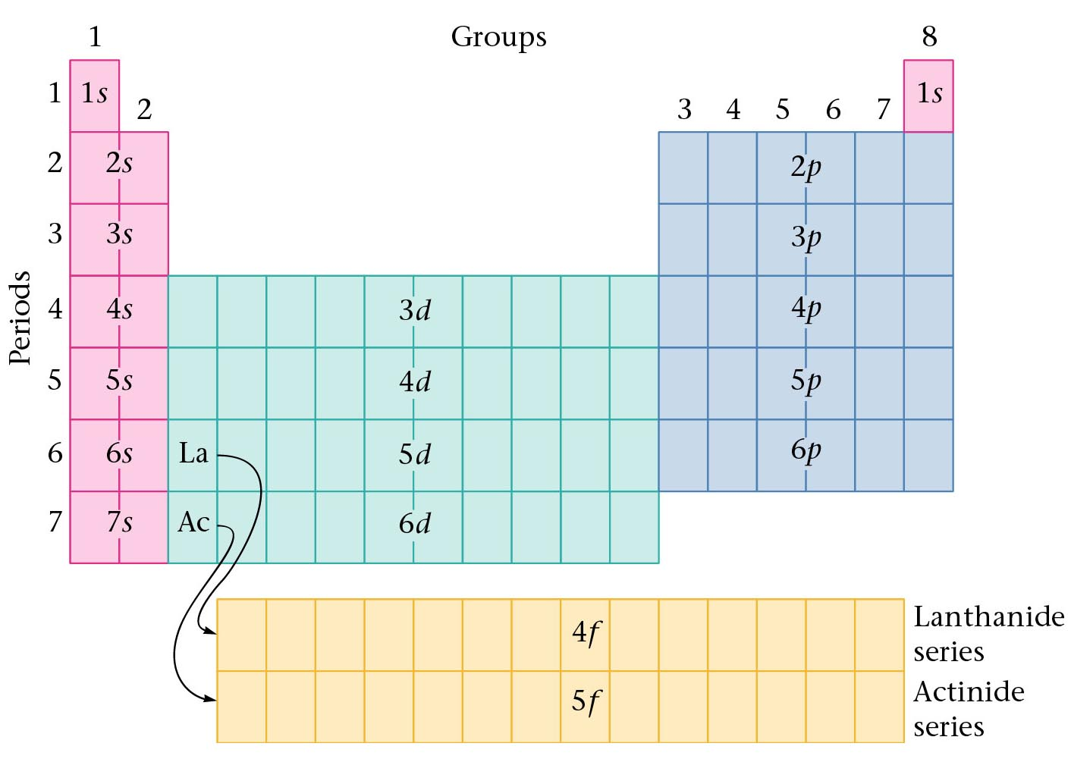
Orbitals and the Periodic Table
Orbitals grouped in s, p, d, and f orbitals (sharp, proximal, diffuse, and fundamental)
s orbitals
d orbitals
p orbitals
f orbitals

