Slide 1
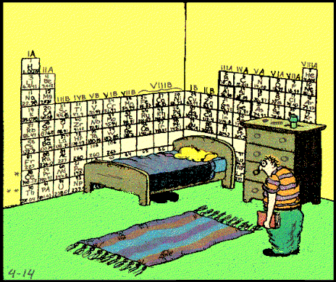
Valence Electrons and Ionization Energy

Slide 2
HW Review
2.9
Draw structures for the following atoms, showing the protons and neutrons in the nucleus, and the electrons in the energy levels:
a) Al b) Cl c) Ar
²⁷
³⁵
⁴⁰
₁₃
₁₇
₁₈

Slide 3
HW Review
2.10
How many electrons would there be in the second principal energy level of silicone?
Notes:
8

Slide 4
HW Review
2.11
Using arrows to represent electrons, draw the orbital configurations of the following atoms in the ground state.
a) N b) Si c) Mn d) Zn
Notes:
N = 1s2 2s2 2p3 Si = 1s2 2s2 2p6 3s2 3p2
Mn = 1s2 2s2 2p6 3s2 3p6 3d5 4s2 Zn = 1s2 2s2 2p6 3s2 3p6 3d10 4s2

Slide 5
HW Review
2.12
How many unpaired electrons are there in each of the following elements, in the ground state?
a) O b) P c) Ar d) Cr
8
15
18
24
Notes:
a) 2 b) 3 c) 0 d) 6

Slide 6
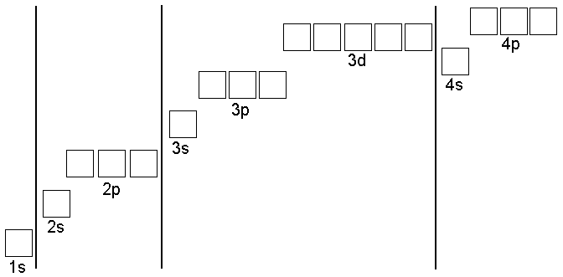
HW Review
2.13
Each of the four elements is shown with an incorrect electron configuration. In each case, indicate why the configuration is incorrect, and draw the correct configuration.
₆C
₉F
₁₂Mg
₇N
Notes:
8

Slide 7
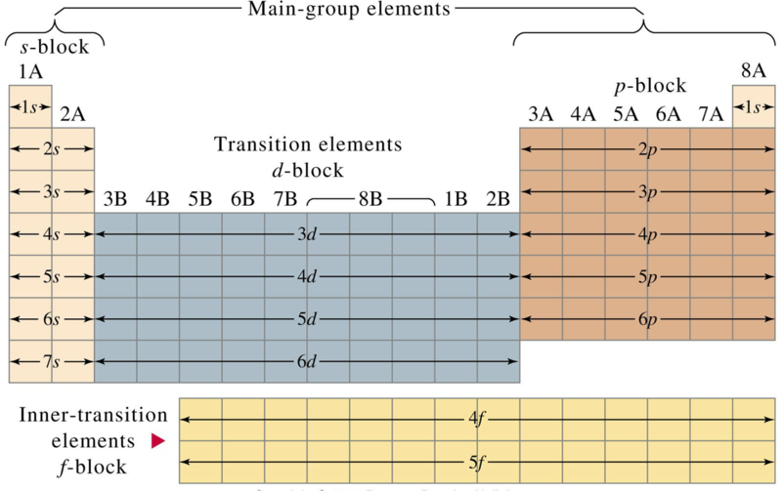
Periodic Table
Same number of energy levels
Same number of electrons in outer shell → makes similar for properties

Slide 8
Valence Electrons
Electrons in the outer shell
Determines chemical properties
Same group has same # of valence electrons
Group 1 = 1 valence electron
Group 2 = 2 valence electrons
Group 13 = 3 valence electrons
Group 14 = 4 valence electrons
Group 15 = 5 valence electrons
Group 16 = 6 valence electrons
Group 17 = 7 valence electrons
Group 18 = 8 valence electrons

Slide 9
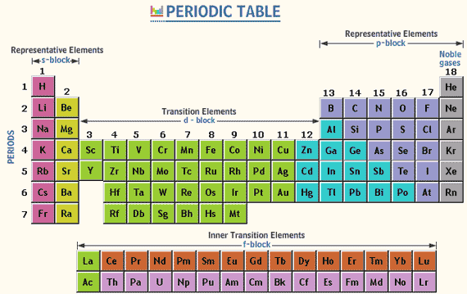

Slide 10
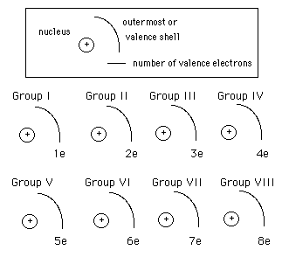
Valence Electrons

Slide 11
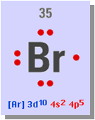
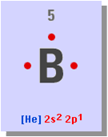
Valence Electrons
Shown with Electron Dot Diagrams
imagine a circle around the atom
put a dot (electron) in each “corner” before pairing

Slide 12
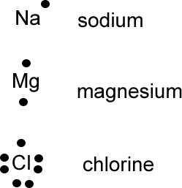
Valence Electrons – Electron Dot
You Try:
Oxygen – O
Hydrogen - H

Slide 13
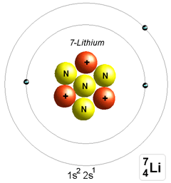
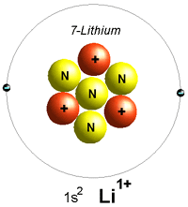
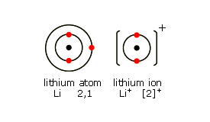
Ion
Ion – charged particle formed when electrons are lost or gained.
Lose electron = ⁺
Gain electron = ⁻

Slide 14
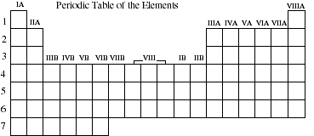
Ionization Energy
Ionization Energy – energy needed to remove a valence electron (Table S)
increases
decreases

Slide 15
increases
Down:
Farther Apart =
Easier to
Remove
Across: Metals (giving) Nonmetals (greedy)
Harder to Remove
decreases
+
-
+
-

Slide 16
Table S – Ionization Energy
H →
Li → B → F →
Na →
1312 kJ/mol
520
801
1681
496

Slide 17
Electronegativity
Electronegativity – desire of an atom for an electron. (Table S)
Down:
Higher Desire – closer
desire decreases
Lower Desire - farther
Across: metal giving nonmetal greedy desire decreases
+
e⁻
+
e⁻
+
e⁻

Slide 18
Ion Electron Configuration
**Ions have a noble gas configuration
 | atom | ion | same as
sodium | 2-8-1 | 2-8 | neon
flourine | 2-7 | 2-8 | neon
calcium
sulfur
Notes:
2-8-8-2 2-8-8 argon
2-8-6 2-8-8 argon

Slide 19
Ion Electron Configuration
Element | Electrons | Atom | Ion
Li | 2-1 | Li | [Li]⁺
F
O
Ca

Slide 20
IONS
AN ELEMENT’S ATOMS ARE NOT ALWAYS NEUTRAL IN CHARGE.
WHEN AN ATOM LOSES OR GAINS ONE OR MORE OF ITS ELECTRONS IT BECOMES ION.
AN ION THAT HAS MORE ELECTRONS THAN PROTONS HAS A NEGATIVE ELECTRICAL CHARGE
AN ION THAT HAS FEWER ELECTRONS THAN PROTONS HAS A POSITIVE ELECTRICAL CHARGE
NOTE: IT’S THE PROTONS THAT DEFINE THE TYPE OF ATOM IT IS, BUT THE ELECTRONS DEFINE THE ATOM’S CHARGE.

Slide 21
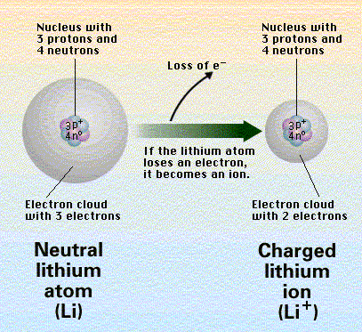

Slide 22
SOME ATOMS
GAIN ELECTRONS
ATOM’S IONIC CHARGE =
# PROTONS - # ELECTRONS
-
-
-
-
-
-
-
-
-
-
-
-
-
-
-
-
-
-
O
O⁻²

Slide 23
ATOMS, IONS, AND ISOTOPES
ATOMS | NEUTRAL AND ARE DEFINED BY THE # OF PROTONS IN THEIR NUCLEUS
 | 3 p⁺ = Li ATOM, ETC.
IONS | HAVE AN ELECTRICAL CHARGE DETERMINED BY # PROTONS - # ELECTRONS
 | N⁻² = 7 p⁺ - 9 e⁻ ; ETC.
ISOTOPES | TWO ATOMS WITH THE SAME # OF PROTONS, BUT DIFFERENT #’S OF NEUTRONS OR MASSES
 | CALCIUM-40 & CALCIUM-44

