Slide 1
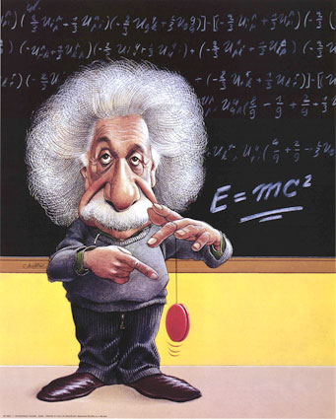
Bonding

Slide 2
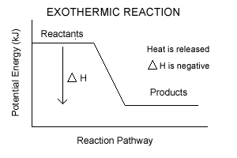
Bond
The force that holds two atoms (ions) together.
Bonding releases energy – Exothermic.
more stable

Slide 3
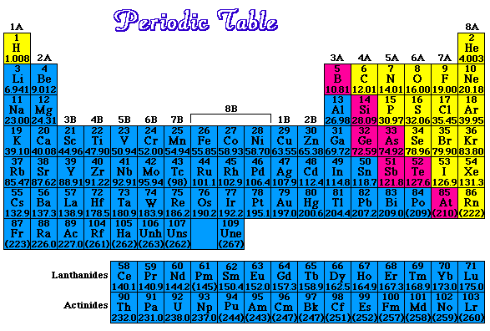
Covalent Bond
Sharing electrons between two nonmetals.
Makes a molecule.
Metals = Blue
Nonmetals = Yellow

Slide 4
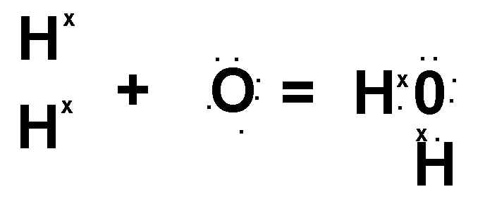
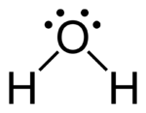
Bond
Bond

Slide 5
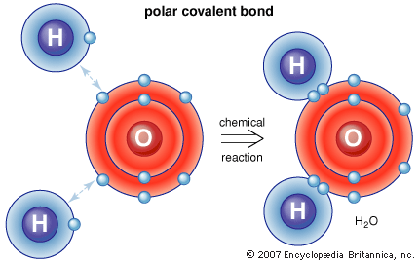
Covalent Bond
Octet Rule – elements generally bond to attain 8 valence electrons.
Noble gas configuration – very stable.
Stable
Octet

Slide 6
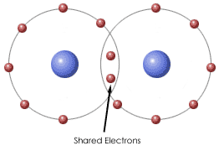
Covalent Bond

Slide 7
Covalent Bond Polarity
Polar Covalent Bond
Has 2 poles → dipole
Unequal sharing (one element is more electronegative than another)
A bond between 2 different nonmetals.
H - O
more electronegative

Slide 8
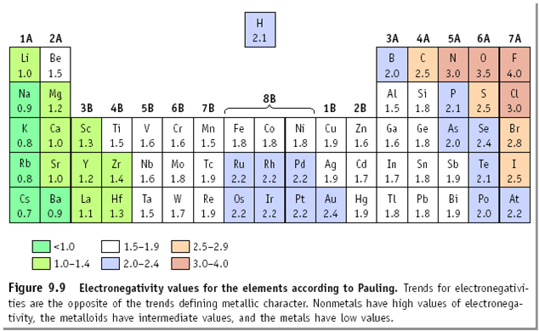
Electronegativity of Atoms

Slide 9
Polar Covalent Bond
Chlorine | Hydrogen | Difference
3.0 | 2.1 | 0.9
This is more than the 0.5 minimum needed for a polar bond. There is a relatively + charge at the hydrogen end and a relatively negative - charge at the chlorine end. The polarity of bonds is indicated by an arrow. The arrow points at the more electronegative atom the pair. The more different the electronegativity the more polar the bond.

Slide 10
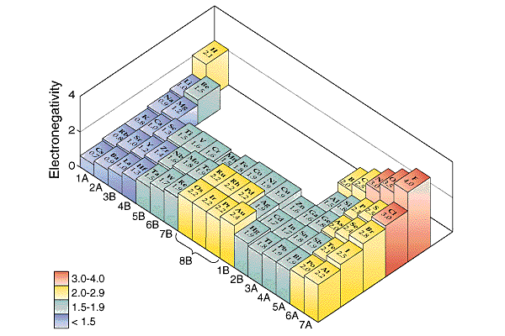

Slide 11
Covalent Bond Polarity
Nonpolar Covalent Bond
No poles
Equal sharing
Diatomic Molecules
H₂, N₂, O₂, F₂, Cl₂, Br₂, I₂
same electronegativity

Slide 12
Multiple Covalent Bonds
Single Bond
F₂
F – F
Single Bond
F F → F F

Slide 13
Multiple Covalent Bonds
Double Bond
O₂
O O
Double Bond
O O → O O

Slide 14
Multiple Covalent Bonds
Triple Bond
N₂
N N
Triple Bond
N N → N N

Slide 15
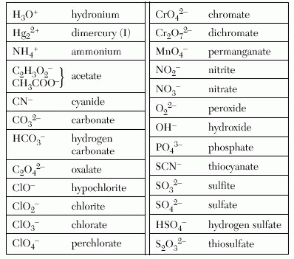
Polyatomic Ions
Polyatomic ions
Table E
Ions (charged particle) held together by covalent bonds.

