Slide 1
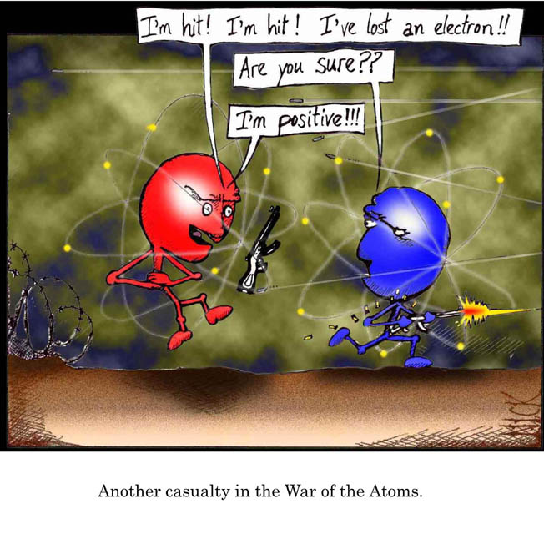
Metallic Bonds & Ionic Bonds

Slide 2
Homework Review
3.1
Draw dot structures of the following molecules, which obey the octet rule. Remember that hydrogen, with only one energy level, will acquire 2 valence electrons.
NH₃ H₂CO SO₃ BrCl O₃ N₂

Slide 3
Homework Review
3.2
Arrange the following bonds, from most highly polar to least polar.
a) H-I
b) Br-Cl
c) N-I
d) H-O

Slide 4
Homework Review
3.3
Hydrogen cyanide, the gas used in the gas chambers in some states of the United States, has the structure
H C N
What is the total number of electrons represented by the lines connecting the C to the N?

Slide 5
Homework Review
3.4
What atom would form a nonpolar covalent bond with a flourine atom?

Slide 6
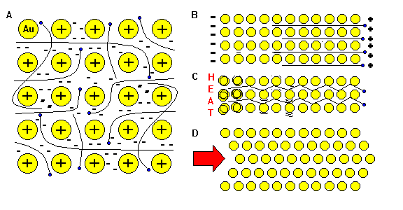
Metallic Bonds
A. Outermost electrons wander freely through metal.
B. Free electrons can move rapidly in response to electric fields →metals are good conductors of electricity.
C. Free electrons can transmit kinetic energy rapidly →metals are good conductors of heat.
D. The layers of atoms in metal are hard to pull apart because of the electrons holding them together →metals are tough. Individual atoms are not held to any other specific atoms →atoms slip easily past one another. Thus metals are ductile. Metallic Bonding is the basis of our industrial civilization.
Positive ions immersed in a sea of mobile electrons.

Slide 7
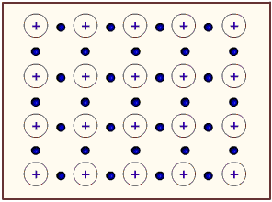
Metallic Bonds
Found in any metal or alloy
Solid – have high melting point
Conduct electricity and heat
Luster – silvery shine
Malleability – shaped by hammering
Ductility – draw into wire

Slide 8
Ionic Bonds
Transfer of electrons between a metal and a nonmetal.
Causes a positive atom and a negative atom which attract. (electrostatic attraction)
Metal gives the electron → becomes positive
Nonmetal accepts electron → becomes negative

Slide 9
Size of Ions
Metals → smaller
Lose shell
Nonmetals → larger
more repulsion between electrons

Slide 10
Electron dot structure for ionic bonds
No molecules → show ions
atoms ions
LiF Li F [ Li ]⁺ [ F ]⁻
ionic bond

Slide 11
Electron dot structure for ionic bonds
Metals → giving
Nonmetals → accepting
atoms ions
CaO Ca O [Ca]²⁺ [ O ]²⁻

Slide 12
Electron dot structure for ionic bonds
atoms ions
CaF₂ Ca F F [ Ca ]²⁺ 2[ F ]⁻

Slide 13
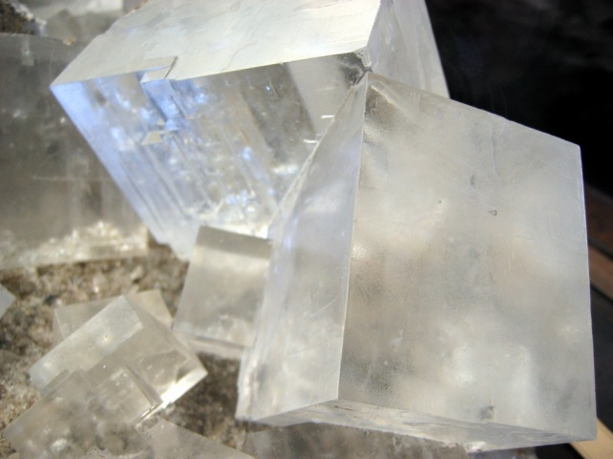
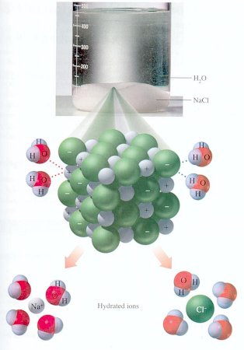
Properties of Ionic Compounds
Crystalline
Hard
High melting point – solid
Conduct in water – electrolytes
Conducts when melted
Stuck – doesn’t conduct
Unstuck (mobile ions) - conducts

Slide 14
Electronegativity Difference
F 4.0
Fr 0.7
3.3 → greatest possible difference
covalent ionic
0 1.7 3.3
nonpolar more polar
H₂0 3.5 NaCl 3.2
- 2.1 - 0.9
1.4 2.3

Slide 15
Type of bond? – ionic or covalent
0-1.7 = covalent 1.7-3.3 = ionic
TiO₂
CH₄
NaI
2.0 – ionic 0.5 – covalent 1.8 - ionic
CS₂
CO₂
KCl
0 – covalent 0.9 – covalent 2.4 - ionic
AlCl₃
CsF
HBr
1.6 – covalent 3.2 – ionic 0.9 - covalent

Slide 16
Ionic Bonds: One big greedy thief dog! Ionic bonding can be best imagined as one big greedy dog steeling the other dog's bone. If the bone represents the electron that is up for grabs, then when the big dog gains an electron he becomes negatively charged and the little dog who lost the electron becomes positively charged. The two ions (that's where the name ionic comes from) are attracted very strongly to each other as a result of the opposite charges.

Slide 17
Covalent Bonds: Dogs of equal strength. Covalent bonds can be thought of as two or more dogs with equal attraction to the bones. Since the dogs (atoms) are identical, then the dogs share the pairs of available bones evenly. Since one dog does not have more of the bone than the other dog, the charge is evenly distributed among both dogs. The molecule is not "polar" meaning one side does not have more charge than the other.

Slide 18
Polar Covalent Bonds: Unevenly matched but willing to share. These bonds can be thought of as two or more dogs that have different desire for bones. The bigger dog has more strength to possess a larger portion of the bones. Sharing still takes place but is an uneven sharing. In the case of the atoms, the electrons spend more time on the end of the molecule near the atom with the greater electronegativity (desire for the electron) making it seem more negative and the other end of the molecule seem more positive.

Slide 19
Metallic Bonds: Mellow dogs with plenty of bones to go around These bonds are best imagined as a room full of puppies who have plenty of bones to go around and are not possessive of any one particular bone. This allows the electrons to move through the substance with little restriction. The model is often described as the "kernels of atoms in a sea of electrons."

