Slide 1
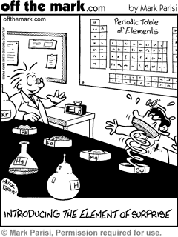
Shapes & Polarity of Molecules

Slide 2
Homework Review
3.5
Based on the information in Fig. 2-14 on p. 103, state whether each of the following compounds is ionic or covalent.
a) BrCl
b) HCl
c) KCl
d) CaBr₂

Slide 3
Homework Review
3.6
Sodium metal bonds readily to each of the elements in group 17 of the Periodic Table. Of the bonds formed between sodium and the Group 17 elements, which would have the greatest ionic character?

Slide 4
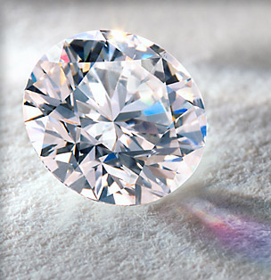
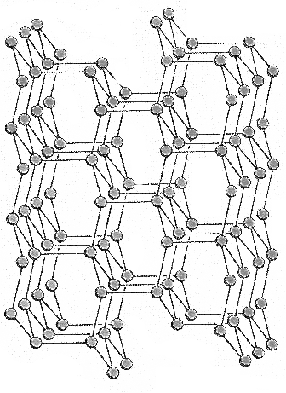
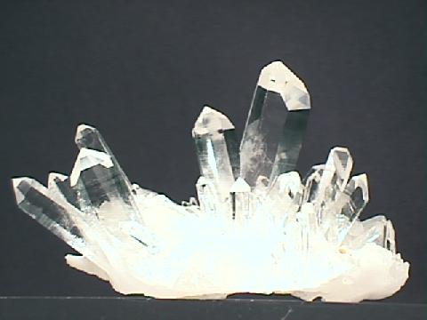
Network Solids
One big molecule
Covalent bonds between carbons → diamond
Silicon carbide
Silicon dioxide - quartz
Properties:
Very hard
High melting point
Diamonds → 3,500°C
Poor Conductor

Slide 5
Shapes of Molecules
Asymmetric:
Central atom has electrons not shared
2. Symmetric:
No free electrons on central atom

Slide 6
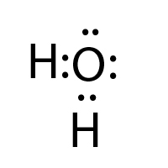
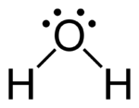
Asymmetric Molecules
Water (H₂O) O H
Ammonia (NH₃) N H
Electrons not being shared -
Pushes bonds away

Slide 7
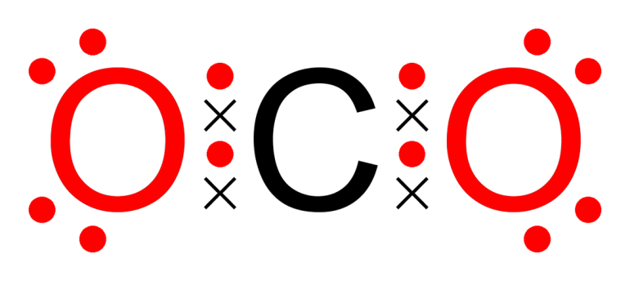
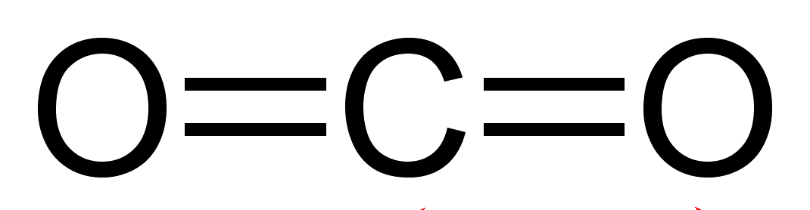
Symmetric Molecules
Methane (CH₄) C H
Carbon Dioxide (CO₂) C O

Slide 8
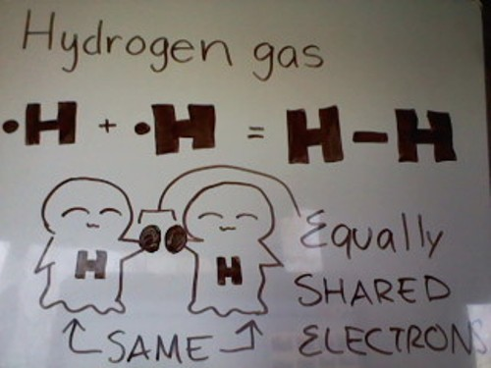
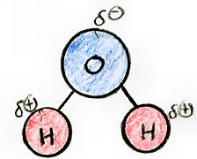
Polarity in Molecules
Symmetrical → nonpolar
Asymmetrical → polar

Slide 9
Nonpolar - symmetrical
Diatomic molecules:
nonpolar bond → nonpolar molecule
Hydrocarbons
polar bond
nonpolar molecule
Carbon dioxide
polar bond
nonpolar molecule

Slide 10
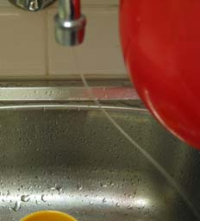
Polar - asymmetrical

Slide 11
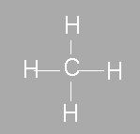
 | Bond | Molecule
Nonpolar | H – H diatomic molecules | symmetrical
Polar | C – H N – O different elements | asymmetrical

