Slide 1
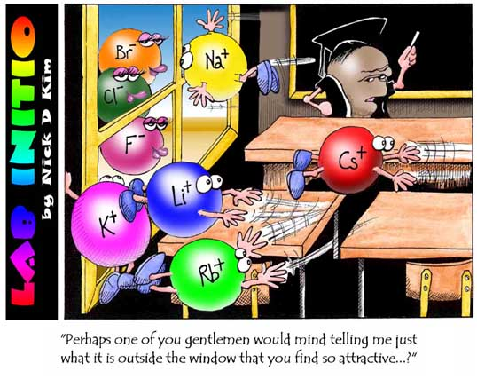
Attractions Between Molecules

Slide 2
Homework Review
3.7
Predict the shapes of the following molecules and indicate whether they are polar covalent or nonpolar covalent.
a) I₂
b) HCl
c) PH₃
d) SiCl₄
e) CS₂

Slide 3
Homework Review
3.8
Figure 3-9 on p. 129 shows how a thin stream of water is attracted by a charged rod. Which of the substances listed in question 3.7, when in the liquid state, would behave in a manner similar to that of water?

Slide 4
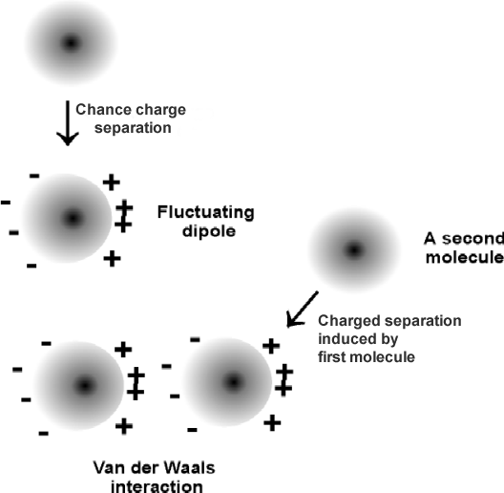
Van der Waals Forces
Attractions between molecules
Dispersion Forces – the weak intermolecular forces of attractions between nonpolar molecules.
P⁺ P⁺
dispersion forces
Very weak
e⁻
e⁻

Slide 5
Dispersion Forces
Increase as protons and electrons increase
CH₄ CH₄
weaker
C₃H₈ C₃H₈
stronger

Slide 6
Dipole – Dipole Forces
Between polar molecules
⁺ H – Cl ⁻ ⁺ H – Cl ⁻
Dipole attraction

Slide 7
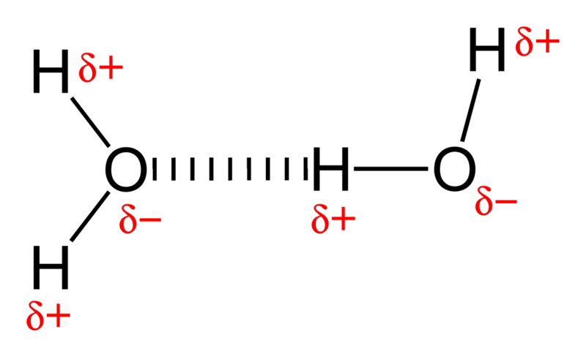
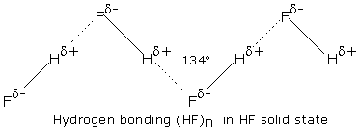
Hydrogen Bonds
Very strong dipole attraction between molecules
Need hydrogen and either nitrogen, oxygen or flourine
hydrogen bond
⁺ H – N ⁻ ⁺ H – N ⁻

Slide 8
Which is Stronger?
B (hydrogen bond)
A or B ?
Answer: A (covalent bond)
A (covalent bond)
Which will have a lower melting point?
Water
NaCl
Answer: Water
B or C ?
Answer: C(ionic bond)
⁺ Na – Cl ⁻
C (ionic bond)

Slide 9
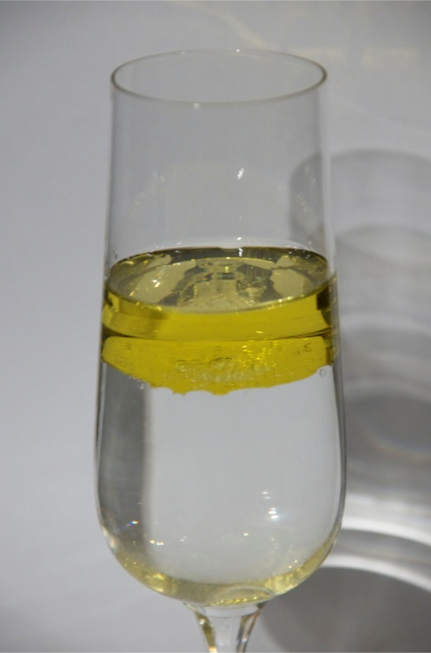
Properties of Covalent Substances
Melting point → low
Conductivity → no
Hardness → soft
*except for network solids
“like dissolves like”
*polar dissolves polar
*nonpolar dissolves nonpolar
Covalent | Ionic
Wax | Salt
Water
Youtube Video

Slide 10
Attractions Summary
Covalent lower attractions
nonpolar – symmetrical
H – H H – H
polar – asymmetrical
⁺ H – Br ⁻ ⁺ H – Br ⁻
hydrogen bond
H – F H – F
ionic
⁺ Na – Cl ⁻
network solids higher attractions
diamonds, SiO2

