Slide 1
Chemical Formulas and Naming Compounds

Slide 2
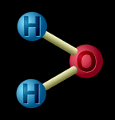
What is a chemical formula?
Chemical Formulas tell what and how many atoms are in a compound.
Also tells how many moles.
H₂O → 2 hydrogen atoms
1 oxygen atom
or
2 moles hydrogen
1 mole oxygen

Slide 3
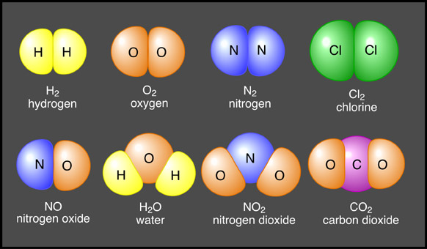
What and how many atoms are in each compound?
H₂
O₂
N₂
Cl₂
NO
H₂O
NO₂
CO₂

Slide 4
Learning Check:
What and how many atoms are in CH₃COOH?
2 Carbon
4 Hydrogen
2 Oxygen

Slide 5
Molecular Formula
Shows the molecule as it actually exists.
Is the formula for covalent compounds.
Formula for the actual molecule.
Formula | Composition
H₂O | Total of 3 atoms in each molecule - 1 oxygen and 2 hydrogen
O₂ | Total of 2 atoms in each molecule - 2 oxygen atoms
CO₂ | Total of 3 atoms in each molecule - 1 carbon and 2 oxygen
C₆H₁₂O₆ | Total of 24 atoms in each molecule - 6 carbon, 12 hydrogen, and 6 oxygen.

Slide 6
Empirical Formula
Shows the simplest whole number ratio for the elements in the compound.
Compound | Molecular Formula | Empirical Formula
Water | H₂O | H₂O
Hydrogen Peroxide | H₂O₂ | HO
Glucose | C₆H₁₂O₆ | CH₂O
Methane | CH₄ | CH₄
Ethane | C₂H₆ | CH₃
Octane | C₈H₁₈ | C₄H₉

Slide 7
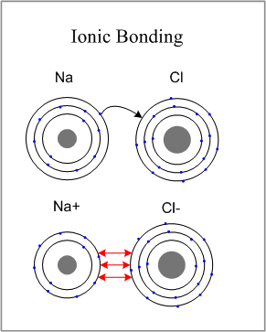
Formula Unit
Formula for ionic compounds. Ex: NaCl
Always the empirical formula.
Ionic compounds do not exist as individual molecules.
The formula unit indicates the lowest reduced ratio of ions in the compound.

Slide 8
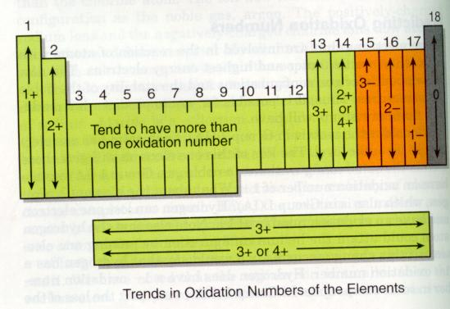
Writing Formulas:
Oxidation Numbers are used to determine the ratio in which elements combine to form compounds.

Slide 9
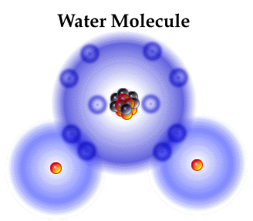
Understanding Chemical
Formulas
Chemical formulas are composed of a positive half and a negative half.
H⁺¹
O⁻²
Ex. - Water is a compound you know to have a formula of H₂O.

Slide 10
CrissCross Method
The easiest way to think of writing chemical formulas is to use the oxidation number (without the + or -) of one element as the subscript of the other element.
+2
-1
Ca Cl

Slide 11
Cross over the oxidation numbers without the charges!!!
+2
-1
Ca Cl

Slide 12
Ca Cl
2
REMINDER: DO NOT write a subscript of 1. Reduce the subscripts if needed.

Slide 13
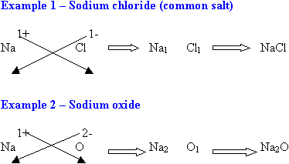

Slide 14
Naming Compounds
IUPAC System
Binary Compounds – 2 Elements
 | Ionic | Covalent
1st | Name Metal | Name Positive Nonmetal (less electronegative)
2nd | Name Nonmetal | Name Nonmetal (more electronegative)
3rd | End with “ide” | End with “ide”

Slide 15
Learning Check:
BaS
Barium Sulfide
MgBr₂
Magnesium Bromide
CaI₂
Calcium Iodide

Slide 16
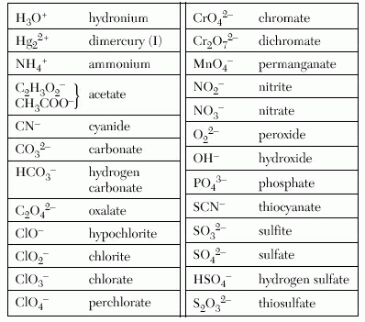
Naming Compounds with More Than 2 Elements
Name the metal
Name the polyatomic ion (Table E)
polyatomic ions –
an ion made up of more than one atom.
Memorize:
OH⁻ = hydroxide
CO₃²⁻ = carbonate
NH₄⁺ = ammonium

Slide 17
Learning Check:
(NH₄)₂CO₃
ammonium carbonate
Ca₃(PO₄)₂
calcium phosphate
Mg(NO₃)₂
magnesium nitrate
(NH₄)₂S₂O₃
Ammonium thiosulfate

