Slide 1
Stock System & Writing Formulas

Slide 2
Homework Review
4.1
Write the formulas for the following substances:
Barium oxide
Calcium iodide
Aluminum sulfide
Sodium nitride
Potassium sulfide

Slide 3
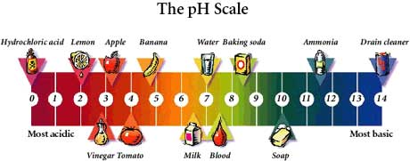
Acids and Bases
Bases:
Compounds without carbon ending with –OH
Hydroxide – Table L or E
NaOH – sodium hydroxide
Acids:
Compounds that start with H – Table K
HCl – hydrochloric acid
use when 2 elements
H₂SO₄ – sulfuric acid
SO₄ “ate” ion → “ic” acid
H₂SO₃ – sulfurous acid
SO₃ “ite” ion → “ous” acid

Slide 4
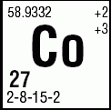
Stock System
Stock System:
Used when a metal has more than one oxidation state.
Oxidation State:
The apparent charge on an atom
Found on Periodic Table
Cobalt (II)
Cobalt (III)

Slide 5
Problem:
How would you name the following ionic compounds? Use Table E and Periodic Table
Oxidation states of Cu are either +1 or +2
SO₄ has a charge of -2
CuSO₄
copper (II) sulfate
Cu₂SO₄
copper (I) sulfate
+2 -2
+1 -2

Slide 6
Naming Covalent Compounds
Always use prefixes:
mon (1), di (2), tri (3), tetra (4), penta (5)
N₂O₃ →
NO₂ →
CO₂ →
CO →
H₂O →
dinitrogen trioxide
nitrogen dioxide
carbon dioxide
carbon monoxide
dihydrogen monoxide

Slide 7
Writing Formulas
Binary Compounds
Find the oxidation state
Na → Na⁺
Cl → Cl⁻
Use subscripts to make oxidation numbers add to zero
H₂O MgCl₂ Al₂O₃
+1 -2 +2 -1 +3 -2
+1 -1 +3 -2
+1 -1 +3 -2
+2 -2= 0 +2 -2 = 0 -2
+6 -6 = 0

Slide 8
Compounds with more than 2 elements
Use Table E
Treat the polyatomic ion as a single unit
Aluminum nitrate
Al(NO₃)₃
Al⁺³ NO₃⁻¹
-1
-1
+3 -1
-3 +3 -3 = 0

Slide 9
Learning Check:
Name:
Binary
NaBr
Cs₂O
SrF
Stock
CuO
SnS₂
Cu₂O
Write:
potassium oxide
calcium bromide
iron (III) oxide
calcium sulfide
Sodium bromide
Cesium oxide
Strontium fluoride
Tin (IV) sulfide
Copper (I) oxide
Copper (II) oxide
K₂O
CaBr₂
Fe₂O₃
CaS

