Slide 1
Oxidation Numbers and Gram Molecular Mass

Slide 2
Homework Review
4.2
Write the correct formulas for the following substances:
Iron (III) oxide
Cobalt (II) chloride
Lead (IV) sulfide
Nickel (II) oxide

Slide 3
Homework Review
4.3
Write the formulas for the following substances:
Aluminum phosphate
Sodium carbonate
Barium nitrate
Nickel (III) hydroxide
Ammonium sulfate

Slide 4
Homework Review
4.4
Name the following substances:
Ba₃(PO₄)₂
Ca(OH)₂
NH₄Cl
Na₂S
Na₂SO₃
Na₂SO₄
FeSO₄

Slide 5
Homework Review
4.5
Give the formulas for the following compounds:
Silicon tetrabromide
Dinitrogen monoxide
Carbon disulfide
Phosphorus trichloride

Slide 6
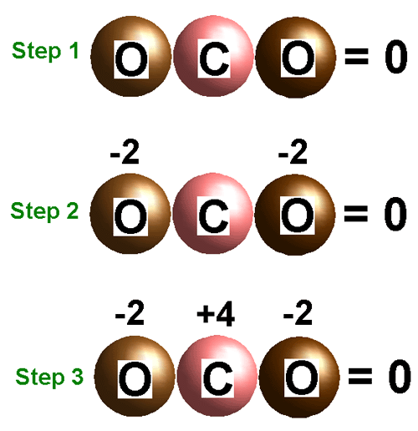
Assigning Oxidation Numbers
Oxidation number, or oxidation state is the charge an atom would acquire if all its bonds were treated as ionic bonds.
CO₂

Slide 7
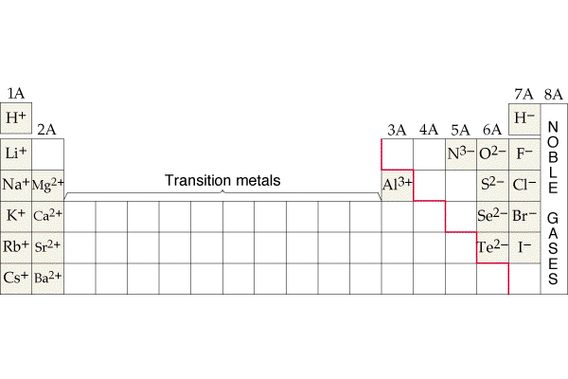
To find oxidation states of elements from chemical formulas:
In compounds use the periodic table to find the oxidation state for each element
Memorize:
O⁻²
except H₂O₂⁻¹
H⁺¹
except after a metal →NaH⁻¹

Slide 8
To find oxidation states of elements from chemical formulas:
The sum of the oxidation states in any substance = 0
FeO
Fe₂O₃
H₂O
NO₂
*Oxidation state of free elements = 0
Fe⁰ O₂⁰
+2 -2
+2 -2 = 0
+3 -2
+1 -2
+6 -6 = 0
+4 -2
+2 -2 = 0
+4 -4 = 0

Slide 9
To find oxidation states of elements from chemical formulas:
Polyatomic ions add up to the charge of the ion
(OH)⁻
-2+1= -1
(NH₄)⁺
-3+4= +1
-2 +1
-3 +1

Slide 10
Gram molecular mass:
Mass for a mole of a covalent compound
Gram formula mass:
Mass for a mole of an ionic compound
H₂O
Element | Amount | (X) Mass | =Total
H | 2 | 1g | 2g
O | 1 | 16g | + 16g
 |  | Answer: | 18 g/mol

Slide 11
Learning Check:
Gram molecular mass for:
Al(NO₃)₃
213 g/mol
Element | Amount | Mass | Total
Al
N
O

Slide 12
Learning Check:
Gram molecular mass for:
Sodium hydrogen carbonate
NaHCO₃
Na 1 X 23 = 23
H 1 X 1 = 1
C 1 X 12 = 12
O 3 X 16 = 48
84 g/mol

Slide 13
Learning Check:
Gram formula mass for:
Iron (III) oxide
Fe₂O₃
Fe 2 X 56 = 112
O 3 X 16 = 48
160 g/mol

Slide 14
Learning Check:
Gram molecular mass for:
Ammonium phosphate
(NH₄)₃PO₄
N 3 X 14 = 42
H 12 X 1 = 12
P 1 X 31 = 31
O 4 X 16 = 64
149 g/mol

