Slide 1
Evidence of Chemical Reactions

Slide 2
Homework Review
4.6
Find the oxidation number of the underlined element in each compound:
KMnO₄
CaCO₃
FeSO₄
H₂C₂O₄

Slide 3
Homework Review
4.7
Find the oxidation number of the underlined element in each of the following ions:
NO₂⁻
PO₄³⁻
MnO₄⁻
Cr₂O₇²⁻

Slide 4
Homework Review
4.9
Find the molar mass to the nearest whole number of each of the following compounds:
NH₄Cl
Fe₂(SO₄)₃
Sodium sulfate
Calcium carbonate
(NH₄)₂Cr₂O₇

Slide 5
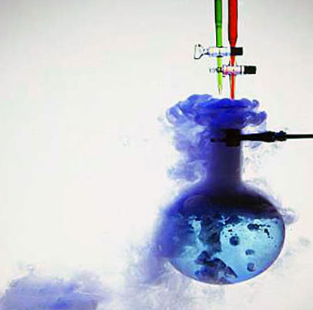
Evidence of Chemical Reactions
Change in color
Change in temperature
Bubbles
Odor
Cloudy
Formation of a precipitate (little solid particles)

Slide 6
Minilab – Observing Change
An indicator is a chemical that shows when change occurs during a chemical reaction.
Measure 10.0 mL distilled water in a graduated cylinder and pour it into the 100 mL beaker. Add one drop of 0.1 M ammonia to the water.
Stir 15 drops of indicator into the solution with the stirring rod. Observe the solution’s color. Measure its temperature with the thermometer.
Drop the effervescent tablet into the solution. Observe what happens. Record your observations, including any temperature change.

Slide 7
Activity – Modeling Chemical Reactions
Obtain a model kit. Use the following key:
Red – Oxygen
Yellow – Hydrogen
Black – Carbon
Springs – Bond
Make two molecules of hydrogen (H₂), and one of oxygen (O₂)
“React” one H₂ with one O₂ by splitting the molecules and joining one oxygen atom to two hydrogen atoms. Because there is an unreacted oxygen atom, you must react it with another hydrogen molecule to form a second water molecule.

Slide 8
Summarize what happened in this reaction by placing the number of each molecule reacted or formed in front of its formula.
___ H₂ + ___ O₂ → ___ H₂O
Make one methane (CH₄) molecules and 2 molecules of oxygen (O₂).
Now “react” one methane (CH₄) with two oxygen (O₂) to produce carbon dioxide (CO₂) and water (H₂O). Continue reacting molecules of CH₄ and O₂ until all the reactant atoms have been used to form products.
Summarized what happened in this reaction.
___ CH₄ + ___ O₂ → ___ CO₂ + ___ H₂O
Return you pieces to the model kits and return the model kits.
2 2
2 2

