Slide 1
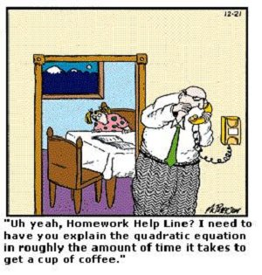
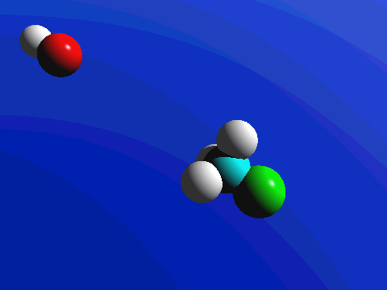
Chemical Equations

Slide 2
A Chemical Reaction
Reactants Products
Yields (produces)

Slide 3
Writing a Chemical Equation
Chemical symbols give a “before-and-after” picture of a chemical reaction
Reactants Products
MgO + C CO + Mg
magnesium oxide to yield carbon monoxide
reacts with carbon and magnesium

Slide 4
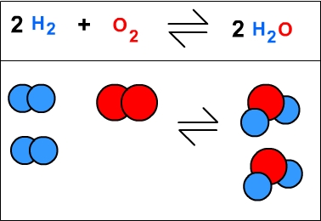
Ways to represent a chemical reaction:
Word Equation
  hydrogen + oxygen → water
Skeleton Equation
  H₂ + O₂ → H₂O
Balanced Equation
2H₂ + O₂ → 2H₂O

Slide 5
Balancing Equations
Write the skeleton equation
Make sure compound adds to zero using subscripts
Mg + O₂ → MgO
2. Start counting on the left and balance using coefficients
___ Mg + ___ O₂ → ___ MgO
3. At arrow repeat until done
  You can make odd numbers even ( X 2)
+2 -2
2 2

Slide 6
Steps in Balancing An Equation
Fe₃O₄ + H₂ Fe + H₂O
Fe: Fe₃O₄ + H₂ 3 Fe + H₂O
O: Fe₃O₄ + H₂ 3 Fe + 4 H₂O
H: Fe₃O₄ + 4 H₂ 3 Fe + 4 H₂O

Slide 7
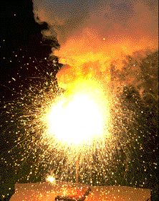
What does it mean?
4 Al(s) + 3 O₂(g) ---> 2 Al₂O₃(s)
This equation means
4 Al atoms + 3 O₂ molecules ---produces--->
2 molecules of Al₂O₃
_{AND/OR}
4 moles of Al + 3 moles of O₂ ---produces--->
2 moles of Al₂O₃

Slide 8
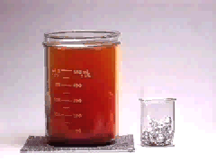
Balancing Equations
2
3
___ Al(s) + ___ Br₂(l) ---> ___ Al₂Br₆(s)

Slide 9
Learning Check:
Fe₃O₄ + 4 H₂ 3 Fe + 4 H₂O
A. Number of H atoms in 4 H₂O
1) 2 2) 4 3) 8
B. Number of O atoms in 4 H₂O
1) 2 2) 4 3) 8
C. Number of Fe atoms in Fe₃O₄
1) 1 2) 3 3) 4

Slide 10
Practice
__N₂ + __H₂ → __NH₃
__NH₃ + __O₂ → __HNO₃ + __H₂O
__H₂ + __Fe₂O₃ → __Fe + __H₂O
__C₂H₄ + __O₂ → __CO₂ + __H₂O
3 2
2
3 2 3
3 2 2

Slide 11
Harder Practice!
__Na + __H₂O→ __NaOH + __H₂
__NH₃ + __O₂ → __NO + __H₂O
Copper (II) sulfide + nitric acid →
copper (II) sulfate + nitrogen dioxide + water
__CuS + __HNO₃ → __CuSO₄ + __NO₂ + __H₂O
2 2 2
4 5 4 6
8 8 4

