Slide 1
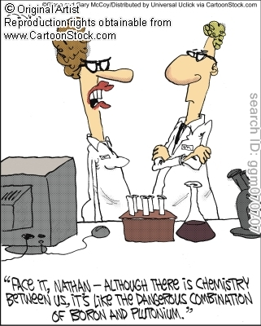
Types of Chemical Reactions

Slide 2
Combination Reaction
*Also known as Synthesis
A + B → AB
Putting together elements (or compounds) to make a compound.
2Mg + O₂ → 2MgO
NH₃ + HCl → NH₄Cl
Exothermic

Slide 3
Decomposition Reaction
AB → A + B
One substance produces 2 or more simpler substances.
Breaking a compound apart.
2H₂O → 2H₂ + O₂
2H₂O₂ → 2H₂O + O₂
Endothermic

Slide 4
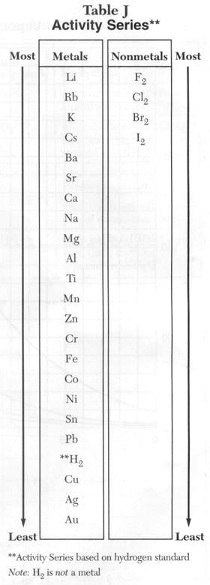
Single Replacement Reaction
A + BC → AC +B
The more active element replaces the element in the compound.
Takes place if A is more active than B
– Table J (Activity Series)
Fe + CuSO₄ → FeSO₄ + Cu

Slide 5
Will a single replacement reaction occur?
Try:
Fe + PbSO₄ → Yes or No
Cl₂ + NaI → Yes or No

Slide 6
Double Replacement Reaction
AB + CD → CB + AD
AgNO₃ + NaCl → AgCl + NaNO₃
** Takes place if solid, liquid or gas form

Slide 7
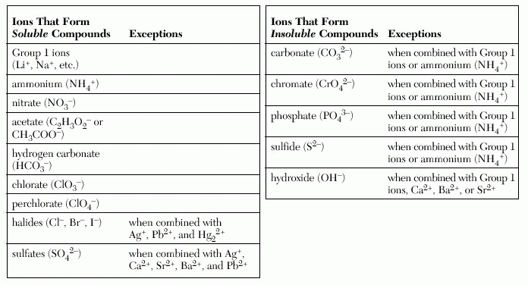
Double Replacement Reaction
Solid:
Insoluble on Table F – forms precipitate
Little solid particles - cloudy
Soluble:
Dissolves in water
Insoluble:
Does not dissolve in water

Slide 8
Double Replacement Reaction
Solid:
From Table F
NaCl –
CaCO₃ –
Na₂CO₃ –
BaSO₄ –
FeCl₃ –
Soluble
Insoluble
Soluble
Insoluble
Soluble

Slide 9
Double Replacement Reaction
Solid:
2NaOH(aq) + CuCl₂(aq) → Cu(OH)₂(s) + 2NaCl(aq)
Makes it cloudy
Na⁺OH⁻
Cu⁺²Cl⁻
Cu(OH)₂
NaCl

Slide 10
Double Replacement Reaction
Liquid:
Neutralization
Acid Base Reaction
The H⁺ ion in the acid reacts with the OH⁻ ion in the base to form water and an ionic salt
Acid + Base → Salt + Water
HCl(aq) + NaOH(aq) → NaCl(aq) + H₂O

Slide 11
Double Replacement Reaction
Gas:
Forms –
H₂, N₂, O₂, F₂, Cl₂, CO₂, CO, NO₂, H₂S, CH₄, NH₃
2HI(aq) + Li₂S(aq) →
H₂S(g) + LiI(aq)

Slide 12
Learning Check:
Don’t worry about balancing these.
AgNO₃ + Na₂SO₃ →
NH₄Cl + Ba(NO₃)₂ →
CaCl₂ + K₂SO4 →
AgSO₃ + NaNO₃
NH₄NO₃ + BaCl₂
CaSO₄ + KCl

Slide 13
Combustion Reaction
A rapid reaction with oxygen
2H₂ + O₂ → 2H₂O
CH₄ + O₂ → CO₂ + H₂O
Balance these combustion reactions:
__C₆H₁₂O₆ + __O₂ → __CO₂ + __H₂O
__HCOOH + __O₂ → __CO₂ + __H₂O
__C₇H₁₆ + __O₂ → __CO₂ + __H₂O
6 6 6
2 2 2
11 7 6

