Slide 1
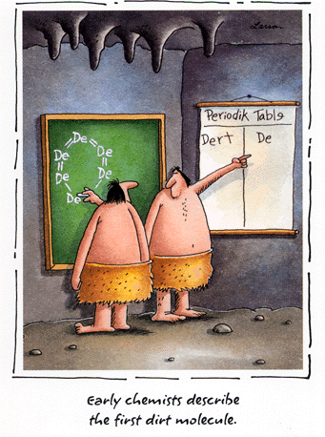
Chemical Calculations Mole to Mass, Mass to Moles

Slide 2
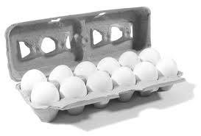
Names associated with an amount
Dozen = 12
Pair = 2

Slide 3
Measuring Amounts
Volume
Mass
Count
Dozen = 12
Pair = 2
Ream = 500
Mole = 6.02 X 10²³ (Avogadro’s #)
Mole of Particles
Atoms, Molecules, Formula Units
1 dozen or 12 eggs
12 eggs 1 dozen

Slide 4
eggs
shoes
Molar mass is the mass of 1 mole of in grams
marbles
atoms
1 mole ¹²C atoms = 6.022 x 10²³ atoms = 12.00 g
1 ¹²C atom = 12.00 amu
1 mole ¹²C atoms = 12.00 g ¹²C
1 mole lithium atoms = 6.941 g of Li
For any element
atomic mass (amu) = molar mass (grams)

Slide 6
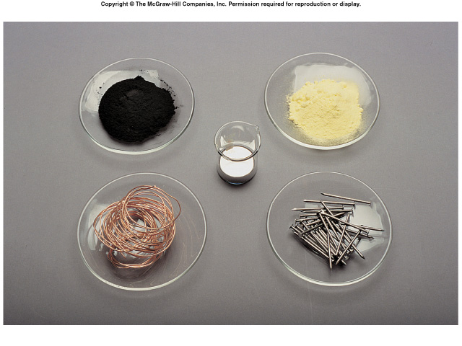
What is the mass of one mole of:
C
S
Hg
Cu
Fe

Slide 7
Gram-Molecular Mass
Mass of 1 mole of molecules
Molecular mass is the sum of the atomic masses in an element.
H₂O
H: 2 X 1g = 2g
O: 1 X 16g = 16g
18g
18 g/mol

Slide 8
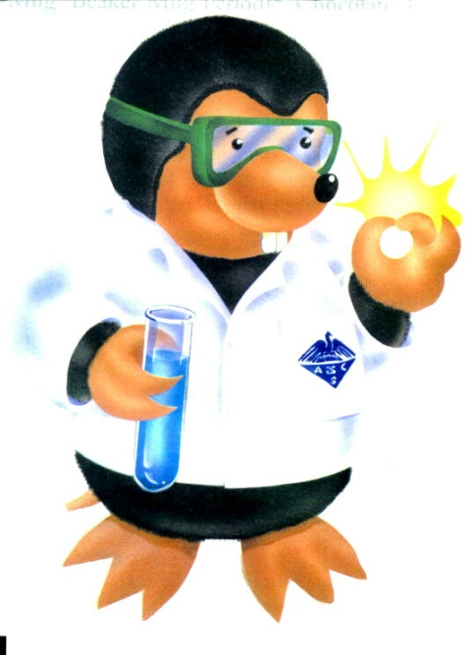
Gram-Formula Mass
Mass of 1 mole of ionic compound
MgCl₂
Mg: 1 X 24g = 24g
Cl: 2 X 35.5g = 71g
95g
95 g/mol

Slide 9
Mole to Mass
What is the mass of 2.0 mol Carbon?
2.0 mol
What is the mass of 1.5 mol Oxygen?
X
12.0 g Carbon
1 mol Carbon
= 24 g Carbon

Slide 10
Mole to Mass
What is the mass of 3.0 mol NaCl?
First find molecular mass or formula mass
Na – 23.0g
Cl – 25.5g
58.5g
3.0 mol NaCl
58.5 g
1 mol
X
= 175.5g NaCl

Slide 11
Mole to Mass
What is the mass of 9.45 mol Al₂O₃?
Al – 2 X 27.0g = 54.0g
O – 3 X 16.0g = 48.0g
102.0g
9.45 mol Al₂O₃
102.0 g
1 mol
= 963.9g Al₂O₃
X

Slide 12
Mass to Moles
How many moles are in 92.2g Fe₂O₃?
Fe – 2 X 55.8g = 111.6g
O – 3 X 16.0g = 48.0g
159.6g
92.2g Fe₂O₃
1 mol
159.6g
X
= 0.578 mol Fe₂O₃

