Slide 1
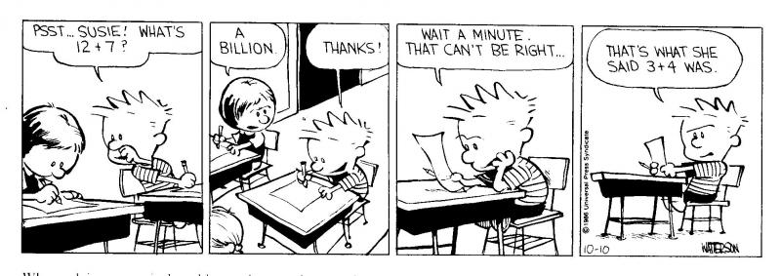
Percent Composition

Slide 2
HW – Ques. 7.1
Find the mass of each of the following:
0.50 mole of NaOH
4.5 moles of CaCO₃
0.25 mole of Ba(NO₃)₂
3.00 moles of sodium oxide

Slide 3
HW – Ques. 7.2
How many moles are contained in each of the following:
60. grams of NaOH
75 grams of CaCO₃
26.1 grams of Ba(NO₃)₂
310 grams of sodium oxide

Slide 4
HW – Ques. 7.3
If the mass of 0.60 mole of a certain substance is 72 grams, what is the molar mass of the substance?
moles = grams
molar mass

Slide 5
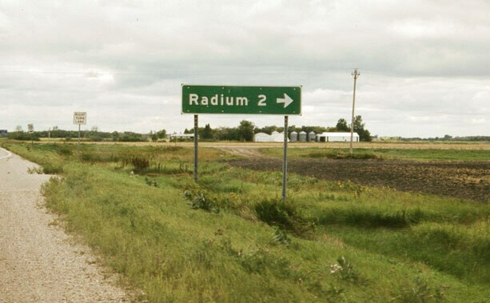
Formula: % Composition
Part
Whole
X 100% = % Composition

Slide 6
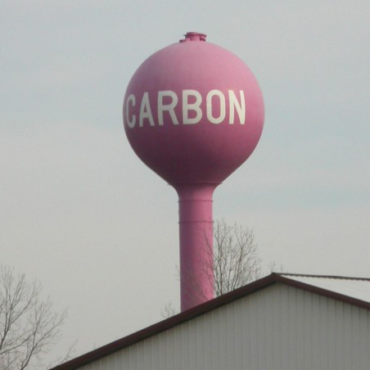
% Composition From Mass
There is 8.20g of Mg in 13.60g of MgO.
What is the % composition of Mg, and O?
Mg → 8.20g
13.60g
O → 5.40g
13.60g
X 100% =
60.3%
X 100% =
39.7%

Slide 7
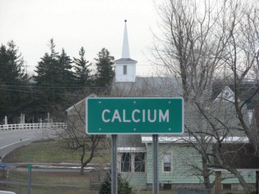
% Composition From Mass
Hg = 13.2g HgO = 14.2g
Hg → 13.2g
14.2g
O → 1.0g
14.2g
X 100% =
93.0%
X 100% =
7.04%

Slide 8
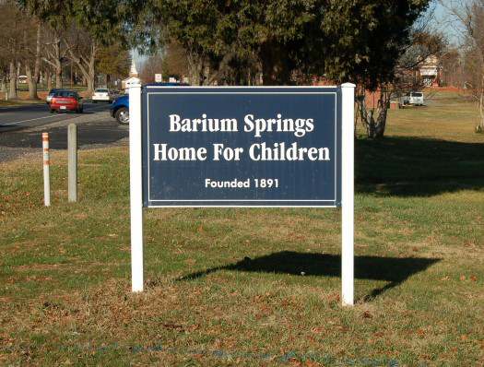
% Composition From Formula
What is the percent composition of water to 2 significant figures?
H → 2 X 1 = 2
O → 1 X 16 = 16
18g/mole
H → 2g
18g
O → 16g
18g
X 100% =
11%
X 100% =
89%

Slide 9
% Composition From Formula
Find the percent composition of
copper (II) sulfate?
Cu →
S →
O →
Solve 1st Now Get Answers
CuSO₄
1 X 63.5 = 64
Cu → 64 X100 = 40%
160
1 X 32.1 = 32
S → 32 X100 = 20%
160
4 X 16 = 64
O → 64 X100 = 40%
160
160

