Slide 1
Percent Composition With Hydrates & Empirical Formulas

Slide 2
HW – Ques. 7.4
Calculate the percent composition to the nearest whole number of each of the following compounds.
CO
ZnSiO₃
H₃PO₄
Ca(NO₃)₂

Slide 3
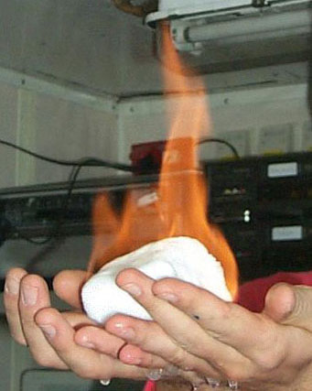
What is a Hydrate?
Water included in the crystal
(crystallized compounds containing water)
Heating removes the water
methane hydrate

Slide 4
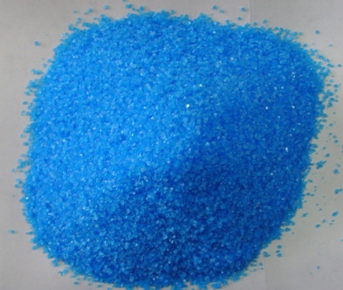
Hydrates
CuSO₄ · 5H2O = copper (II) sulfate pentahydrate
CuSO₄ · 5H2O
water loosely attached
heat
CuSO₄
Hydrate (blue)
Anhydrate – no water (white)

Slide 5
Finding % Water In Hydrates
CuSO₄ · 5H2O
Step 1:
Cu
S
O
160
H
O
90
Step 2:
160
+90
250
1 X 64 = 64
1 X 32 = 32
Step 3:
4 X 16 = 64
Find % H₂O
10 X 1 = 10
90
250
X 100%
= 36%
5 X 16 = 80

Slide 6
Finding % Water In Hydrates
Na₂CO₃ · 10 H2O
Step 1:
Na
C
O
106
H
O
180
Step 2:
106
+180
286
2 X 23 = 46
1 X 12 = 12
Step 3:
3 X 16 = 48
Find % H₂O
20 X 1 = 20
180
286
X 100%
= 63%
10 X 16 = 160

Slide 7
Empirical Formula
The lowest whole number ratio
Molecular Formula
H₂O₂
C₂H₈
C₆H₁₂O₆
C₆H₆
H₂O
Empirical Formula
HO
CH₄
CH₂O
CH
H₂O

Slide 8
Finding Empirical Formulas
Reverse of determining % composition
Divide the percent of each element by the atomic mass of the element (g/mol)
Assume 100g → % is changed to grams
If mole ratio (answers) can not be converted to whole numbers easily, divide each by the smallest number answer
If answer is still not in whole numbers, multiply the answers by 2, 3, 4, … until you get whole numbers

Slide 9
Find the Empirical Formula
A compound of C, H, & O has the following composition by mass:
C - 48.64%, H - 8.16%, O - 43.20%
Step 1:
1 mol C
12.011 g C
48.64 g C
x
= 4.050 mol C
8.16 g H
1 mol H
1.007 g H
x
= 8.103 mol H
43.20 g O
1 mol O
15.999 g O
x
= 2.700 mol O

Slide 10
Step 2:
C?H?O?
C H O
C_{1.5}H₃O₁
Step 3:
Multiply by 2, 3, 4, … until whole # reached
Answer: C₃H₆O₂
4.050
2.700
8.103
2.700
2.700
2.700

Slide 11
Find the Empirical Formula
C – 62.1%, H – 13.8%, N – 24.1%
62.1 g C
1 mol C
12 g C
x
= 5.175 mol C
13.8 g H
1 mol H
1 g H
x
= 13.8 mol H
24.1 g N
1 mol N
14 g N
x
= 1.72 mol N
5.175
1.72
13.8
1.72
1.72
1.72
C H N
C₃H₈N

