Slide 1
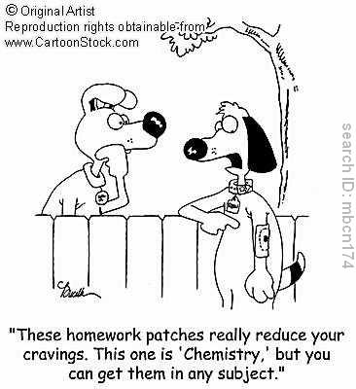
Mole Relationships In Reactions

Slide 2
Conservation of Mass
Mass of Reactants = Mass of Products
4Fe + 3O₂ → 2Fe₂O₃
Reactants:
4 mol Fe X
3 mol O₂ X
Products:
2 mol Fe₂O₃ X
56g/mol =
224g Fe
32g/mol =
96g Fe
320g Reactants
160g Fe₂O₃
mol Fe₂O₃
= 320g
Products

Slide 3
Mole Relationships
The coefficients in a balanced equation give the mole ratio. This allows us to predict the results of reacting any number of moles of reactant.
Tells how many moles of reactant are needed to produce any number of moles of product.

Slide 4
2Al + 6HCl → 2AlCl₃ + 3H₂
The formula above is the same as:
2 mol Al + 6 mol HCl = 2 mol AlCl₃ + 3 mol H₂

Slide 5
2Al + 6HCl → 2AlCl₃ + 3H₂
If you started with 1.0 mole of Al in the reaction above, how many moles of H₂ gas would be produced?
3 mol H₂
1 mol Al X
= 1.5 mol H₂
2 mol Al

Slide 6
2Al + 6HCl → 2AlCl₃ + 3H₂
How many moles of Al are needed to produce 6.0 moles of H₂?
2 mol Al
6 mol H₂ X
= 4.0 mol Al
3 mol H₂

Slide 7
N₂ + 3H₂ → 2NH₃
If there are 0.60 mol N₂, how many moles of NH₃ will be formed?
2 mol NH₃
0.60 mol N₂ X
= 1.2 mol NH₃
1 mol N₂

Slide 8
N₂ + 3H₂ → 2NH₃
How many moles of Hydrogen are needed to produce 6.0 moles of ammonia?

Slide 9
N₂ + 3H₂ → 2NH₃
How many moles of nitrogen are required to react with 0.60 mole of hydrogen?

Slide 10
N₂ + 3H₂ → 2NH₃
How many moles of ammonia are formed from 0.50 mole of nitrogen and excess hydrogen?

