Slide 1
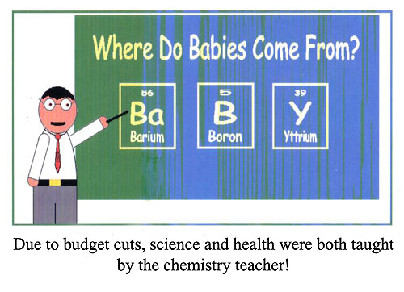
Working With Moles

Slide 2
HW – Ques. 7.14
2Pb(CH₃)₄ + 15O₂ → 2PbO + 8CO₂+ 12H₂O
a. How many moles of O₂ are needed to burn 4.6 moles of Pb(CH₃)₄?

Slide 3
HW – Ques. 7.14
2Pb(CH₃)₄ + 15O₂ → 2PbO + 8CO₂+ 12H₂O
b. How many moles of CO₂ are produced by burning 5 moles of Pb(CH₃)₄?

Slide 4
HW – Ques. 7.14
2Pb(CH₃)₄ + 15O₂ → 2PbO + 8CO₂+ 12H₂O
c. How many moles of H₂O will be produced by reacting 7.5 moles of O₂?

Slide 5
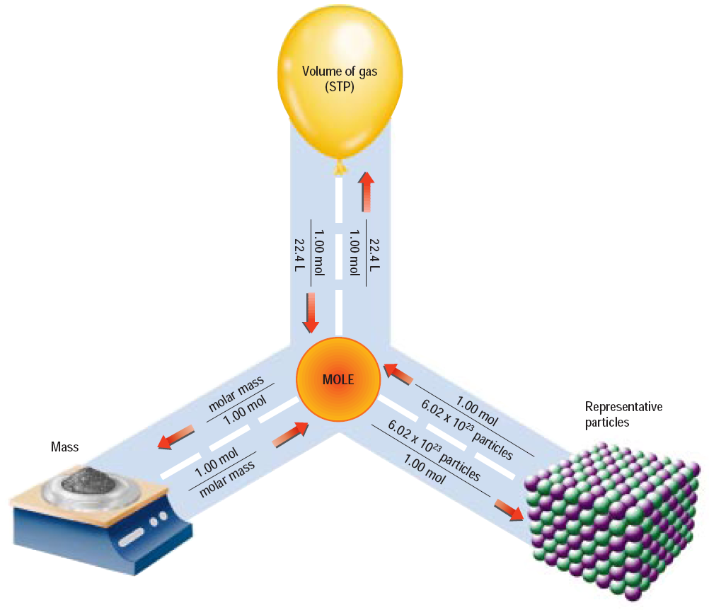
1 mol = 22.4L
1 mol = 6.02 X 10²³
Particles
1 mol = molar mass

Slide 6
Moles: Rules to Remember
1. To convert moles to grams:
*multiply the moles given by the mass of 1 mole.
How many grams are in 4.0 moles of CO₂?
44 grams
4.0 mol X
= 176 grams
mol

Slide 7
2. To convert grams to moles:
*divide the grams given by the mass of 1 mole.
How many moles are in 88g of CO₂?
88 g
= 2.0 moles
44g/mol

Slide 8
3. To convert moles to # of particles:
*multiply the moles given by 6.02 X10²³
How many molecules are in 3.0 moles of CO₂?
6.02 X 10²³ molecules
3.0 mol X
= 1.8 X 10²⁴
mol

Slide 9
4. To convert # of particles to moles:
*divide the number given by 6.02 X10²³
How many moles are in 12.04 X 10²³
CO₂ molecules?
12.04 X 10²³
= 2 moles
6.02 X 10²³

Slide 10
5. To convert grams to # of particles:
*convert grams to moles to # of particles
What is the total number of atoms in 48 grams of magnesium?
48 g
= 2.0 moles
24g/mol
6.02 X 10²³ molecules
2.0 mol X
= 1.2 X 10²⁴
mol

Slide 11
6. To convert # of particles to grams:
*convert # of particles to moles to grams
What is the mass in grams of 1.5 X 10²³ molecules of CO₂?
1.5 X 10²³
= .25 moles
6.02 X 10²³
44 grams
.25 mol X
= 11 grams
mol

Slide 12
7. To convert moles to volume:
*multiply moles by 22.4L/mol
How many liters are in 3.0 moles of CO₂?
3.0 mol X
22.4L/mol
= 67.2 Liters

Slide 13
8. To convert volume to moles:
*divide liters given by 22.4 L/mol
How many moles are in 44.8 Liters of CO₂?
44.8L
= 2.0 moles
22.4L/mol

