Slide 1
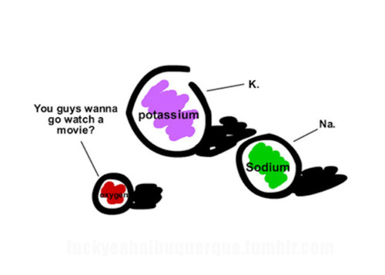
Limiting Reactants & Percent Yield

Slide 2
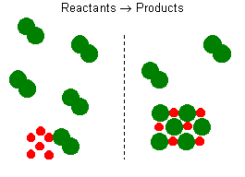
Limiting Reactants
Limiting Reactant → Reactant used up first
Excess Reactant → Reactant left over when the reaction stops
Excess
Limiting

Slide 3
Which is the limiting factor?
2H₂ + O₂ → 2H₂O
Have: 100 mol H₂ 1 mol O₂
Need: 2 mol H₂ 50 mol O₂
O₂ Limiting
H₂ Limiting
Have: 1 mol H₂ 2 mol O₂
Need: 4 mol H₂ 0.5 mol O₂

Slide 4
What is the limiting reactant when 80.0g Cu reacts with 25.0g S?
Cu + S → Cu S
Figure What You Have:
Figure What You Need:
2
₂
1 mol
63.5 g
80.0g Cu X
= 1.26 mol Cu
1 mol
32.1 g
25.0g S X
= .779 mol S
Cu is Limiting
Reactant
1 mol S
2 mol Cu
= 0.630 mol S
1.26 mol Cu X

Slide 5
Percent Yield
Yield is the amount of product produced
Theoretical Yield → how much should be made – calculated
Actual Yield → how much was made - measured
Actual Yield
Theoretical Yield
X 100%
= Percent
Yield

Slide 6
What is the percent yield if 13.1g of CaO is produced when 24.8g of CaCO₃ is heated?
Measured
CaCO₃ → CaO + O₂
24.8g ?g
Step 1: figure out molar mass
Ca
C
O
Ca
O
1 X 40.1 = 40.1
1 X 16.0 = 16.0
56.1
1 X 40.1 = 40.1
1 X 12.0 = 12.0
3 X 16.0 = 48.0
100.1

Slide 7
Step 2: figure out how many moles you have
1 mol CaCO₃
100.1g CaCO₃
24.8g CaCO₃ X
= .248 mol
CaCO₃
1 mol CaO
1 mol CaCO₃
.248 mol CaCO₃ X
= .248 mol
CaO

Slide 8
Step 3: figure out how grams of unknown
56.1g CaO
1 mol CaO
= 13.9g
CaO
.248 mol CaO X
Theoretical
Yield

Slide 9
Step 4: figure out % Yield
Actual Yield
Theoretical Yield
X 100%
= Percent
Yield
13.1g CaO
13.9g CaO
X 100%
= 94.2%

