Slide 1
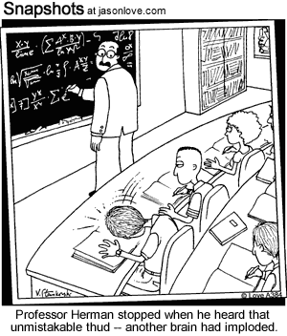
Solutions

Slide 2
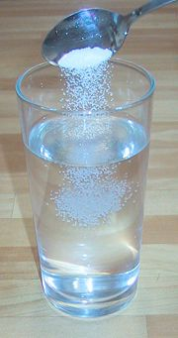
What is a Solution?
Homogeneous mixture of a solvent and a solute.
Homogeneous Mixture:
Same throughout
Not filterable
*No boundaries can be detected
in a solution.

Slide 3
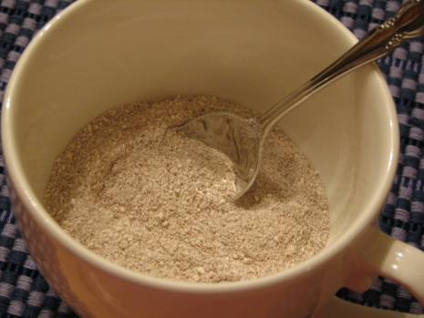
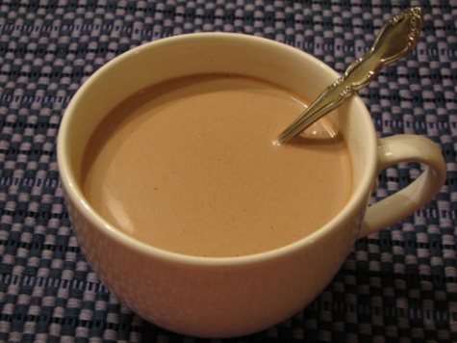
Solvent vs. Solute
Solvent:
Thing doing the dissolving
Aqueous: solvent is water
NaCl_{(aq)} → salt dissolved in water
NaCl_{(l)} → melted salt
Solute:
Thing getting dissolved

Slide 4
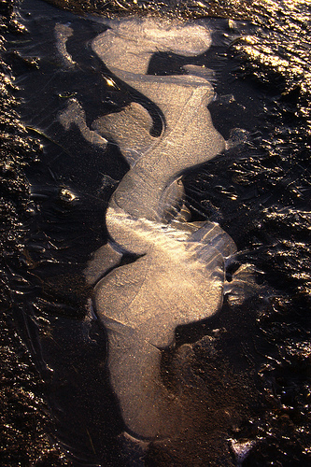
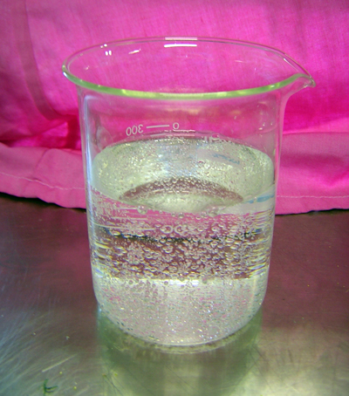
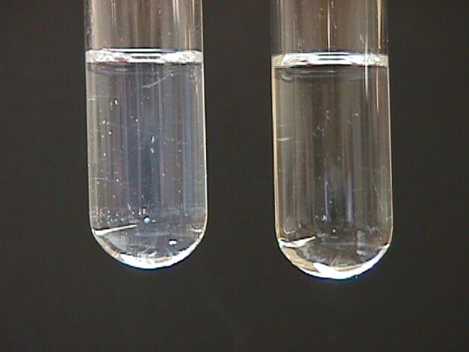
Types of Solutions
Gas in liquid → carbonated water
Liquid in liquid → alcohol dissolved in water
Gas in gas → air
Gas in solid → air dissolved in ice

Slide 5
“Like Dissolves Like”
Substances are likely to dissolve in other substances with similar chemical properties.
Polar dissolves polar
Nonpolar dissolves nonpolar
Oil will not dissolve in water because oil is nonpolar and water is polar.
A polar solvent will generally dissolve polar solutes and sometimes ionic solutes, and a nonpolar solvent will generally dissolve nonpolar solutes.

Slide 6
Polar & Nonpolar Molecules
Polar molecules and ions all dissolve together
“stick” to one another
Nonpolar molecules all dissolve together
But don’t “stick” together
Polar and nonpolar molecules do not dissolve together

Slide 7
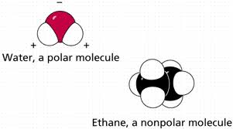
Polar vs. Nonpolar
Polar
Asymmetrical
H₂O
HCl
NaCl
NH₃
CuSO₄
Sugar
Salt
Nonpolar
Symmetrical
CH₄
CF₄
CO₂
Br₂
Oil
Grease
Wax

Slide 8
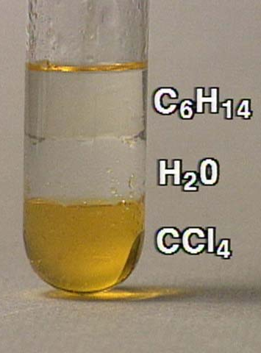
Miscible vs. Immiscible
Miscible → completely soluble (they mix)
Immiscible → liquids form distinct layers
(don’t mix)
Water and Oil Video

Slide 9
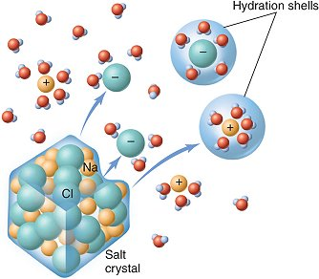
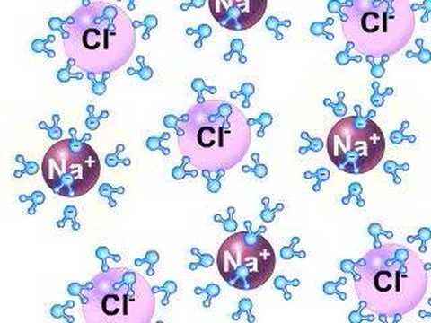
Dissolving Salt - Hydrolysis
Dissolving Salt Animation
Forms Hydrated Ions

Slide 10
Reference Table F
NaCl
CaCO₃
CaNO₃
BaSO₄

