Slide 1
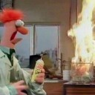
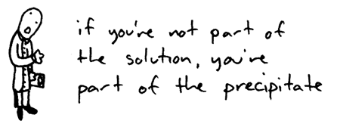
Solubility

Slide 2
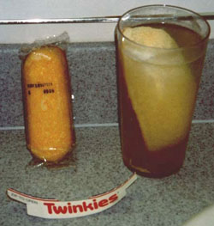
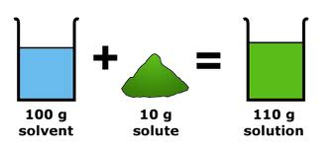
What is Solubility?
Describes the amount of solute that dissolves in a solvent.

Slide 3
Solubility
Saturated – the normal maximum amount of solute the solvent can hold
Unsaturated – solvent can hold more solute
Supersaturated – solvent is holding more solute than normal

Slide 4
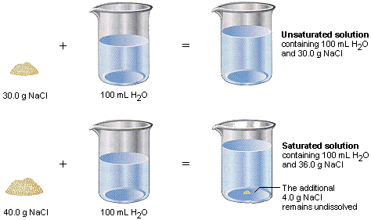
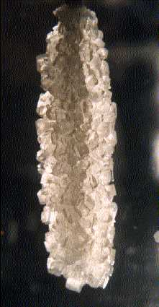
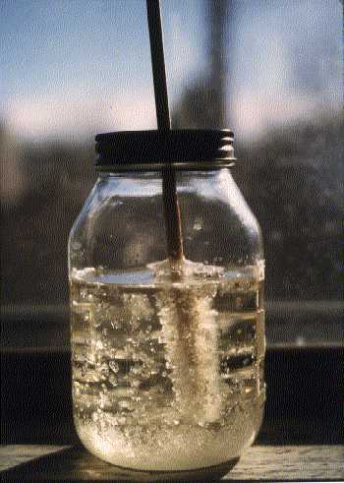
Supersaturated

Slide 5
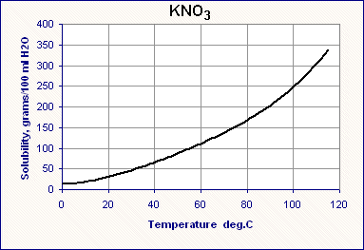
Supersaturated
Saturated
Unsaturated

Slide 6
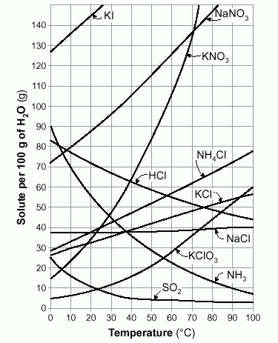
Table G – Solubility Curves

Slide 7
Using Table G – Solubility Curves
How much KNO₃ is needed to create a saturated solution in 100g of water at
20°C?
35g
40°C?
64g
60°C?
106g

Slide 8
Using Table G – Solubility Curves
At what temperature will these solutions in 100g of water be saturated?
80g KNO₃
48°C
40g KClO₃
74°C
130g NaNO₃
64°C

Slide 9
Using Table G – Solubility Curves
How much solute would crystallize out if the following saturated solutions in 100g were totally evaporated?
KCl at 20°C?
32g
NH₄Cl at 60°C?
57g
NaCl at 100°C?
40g

Slide 10
Using Table G – Solubility Curves
How many grams are needed to make the following saturated solutions?
KClO₃ in 300g water at 40°C?
45g
KCl in 500g water at 10°C?
150g
KI in 250g water at 15°C?
350g

Slide 11
Using Table G – Solubility Curves
What is the minimum mass needed to create a saturated solution if
20g NaNO₃ were already dissolved in 100g water at 20°C?
68g
30g KNO₃ were already dissolved in 100g water at 60°C?
76g
14g KCl were already dissolved in 100g water at 40°C?
25g

Slide 12
Using Table G – Solubility Curves
If a saturated solution of KClO₃ in 100g water is cooled from 75°C to 24°C, how much solute will come out of solution?
30g
If a saturated solution of NaNO₃ in 100g of water is cooled from 64°C to 10°C, how much solute will come out of solution?
50g

Slide 13
Using Table G – Solubility Curves
How much salt is needed to saturate when
A saturated solution of KClO₃ in 100g water at 25°C is heated to 75°C?
30g
A saturated solution of NH₄Cl in 100g water at 5°C is heated to 70°C?
31g
A saturated solution of KClO₃ in 500g water at 10°C is heated to 100°C?
130g

