Slide 1
Measuring Concentrations

Slide 2
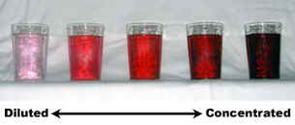
Qualitative
Concentrated → a lot of solute
Dilute → a little solute

Slide 3
Quantitative
Percent Composition (Table T Reference Table)
Part – Solute
Whole - Solution
X 100%
Some tap water has 0.040g of Calcium in 200g water. What is the percent concentration?
0.040g Ca
200g H₂O
X 100%
= 0.020%

Slide 4
You want to make 2000g of 2.8% sugar solution. How much sugar do you need?
Xg Sugar
2000g H₂O
X 100%
= 2.8%
Or… what is 2.8% of 2000g?
X
2000
Answer:
56g
2.8%
100%
=

Slide 5
Parts Per Million (ppm)
g solute
g solution
ppm =
X 1,000,000
How many ppm are in a 100.mL solution of water with 0.0043g oxygen dissolved in it?
0.0043g
100g
= 43 ppm
X 1,000,000

Slide 6
Parts Per Million (ppm)
A certain gas has a concentration in water of 2.00mg per 100.g of water. What is the ppm?
.002g
100g
X 1,000,000
= 20.0 ppm

Slide 7
Problem 1
If 0.025 gram of Pb(NO₃)₂ is dissolved in 100. grams of H₂O, what is the concentration of the resulting solution, in parts per million?
250 ppm

Slide 8
Problem 2
What is the concentration of a solution, in parts per million, if 0.02 gram of Na₃PO₄ is dissolved in 1,000 grams of water?
20 ppm

Slide 9
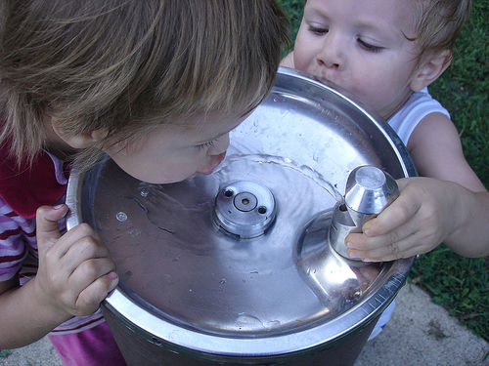
Problem 3
A safe level of fluoride ions is added to many public drinking water supplies. Fluoride ions have been found to help prevent tooth decay. Another common source of fluoride ions is toothpaste. One of the fluoride compounds used in toothpaste is tin (II) fluoride.

Slide 10
Problem 3 (continued)
A town located downstream from a chemical plant was concerned about fluoride ions from the plant leaking into its drinking water. According to the Environmental Protection Agency, the fluoride ion concentration in drinking water cannot exceed 4 ppm. The town hired a chemist to analyze its water. The chemist determined that a 175-gram sample of the town’s water contains 0.000 250 gram of fluoride ions.
How many parts per million of fluoride ions are present in the given analyzed sample?
1.43 ppm

Slide 11
Problem 3 (continued)
A town located downstream from a chemical plant was concerned about fluoride ions from the plant leaking into its drinking water. According to the Environmental Protection Agency, the fluoride ion concentration in drinking water cannot exceed 4 ppm. The town hired a chemist to analyze its water. The chemist determined that a 175-gram sample of the town’s water contains 0.000 250 gram of fluoride ions.
Is the town’s drinking water safe to drink?
yes

