Slide 1
Making Dilutions & Electrolytes

Slide 2
Making Dilutions
When a solution is diluted by adding additional solvent, the # of moles of solute is not changed.
The molarity of the solution changes.
200 mL
5 M
100 mL
2.5 M
.5 mol .5 mol
Moles₁ = Moles₂

Slide 3
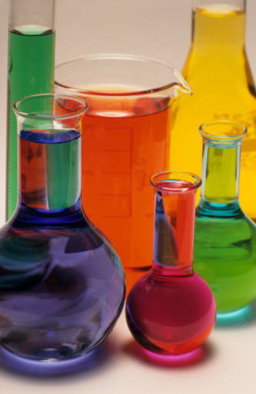
Formula for Molarity of Dilutions
M₁V₁ = M₂V₂
Molarity₁ X Volume₁ = Molarity₂ X Volume₂

Slide 4
How many mL of 2.00M MgSO₄ must be diluted to prepare 100.mL of 0.400M MgSO₄?
M₁V₁ = M₂V₂
2.00M X V₁ = 0.400M X 100mL
2.00M X V₁ = 40M∙mL
V₁ = 40M∙mL
2.00M
20.0 mL

Slide 5
Learning Check
If 400 mL of water is added to 200 mL of 0.6M NaOH, what is the molarity of the new solution?
M₁V₁ = M₂V₂
0.6M X 200mL = (X)M X 600mL
120M∙mL = (X)M X 600mL
0.2 M
M₂ = 120M∙mL
600mL

Slide 6
Electrolytes
Electrolytes → conducts electricity when dissolved in water.
Electrolytes have mobile, charged particles (ions) in the solution.
Metal & Nonmetal
Table E (polyatomic ions)
Acids, Bases, Salts
Ionic

Slide 7
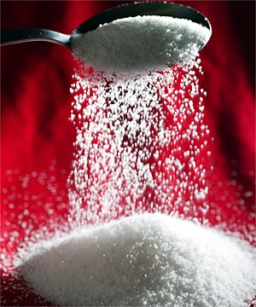
Nonelectrolytes
Nonelectrolytes do NOT conduct electricity.
Molecules Sugar
Alcohol

Slide 8
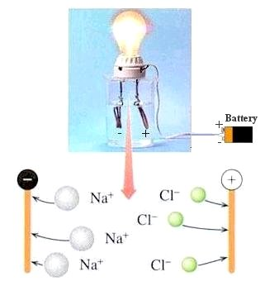
The solution is a good conductor because the dissolved NaCl contains mobile ions.
This is an electrolyte.

Slide 9
Begin Homework

