Slide 1
Colligative Properties
Goal 1: Get in the way Goal 2: Create Disorder
When quantity not quality is the only thing that matters.

Slide 2
What are Colligative Properties?
Properties that depend on the amount of nonvolatile particles in the solution.
Nonvolatile → not easily evaporated
Increasing the amount of particles in the solution:
Increases boiling point
Decreases freezing point
Lowers vapor pressure

Slide 3
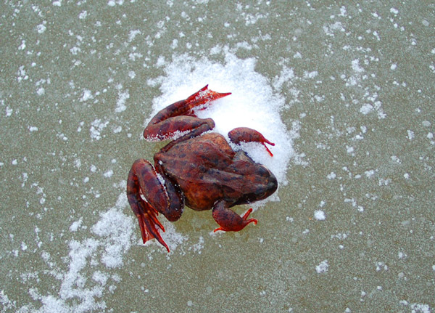
This frog is frozen, but the water in it did not turn into ice crystals, which would have ruptured the cells in its body. Why didn’t ice crystals form?
Glucose and glycerol in its blood and cells prevent water from freezing.

Slide 4
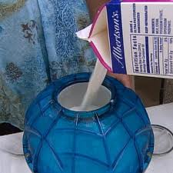
Freezing Point:
The freezing point of a solution (increased solute particles) is lower that the freezing point of pure water.
Why:
Vapor pressure of a solution is lower than the vapor pressure of pure water.
In order to freeze the solvent, it must be cooled to a lower temperature in order to compensate for its lower escaping tendency.

Slide 5
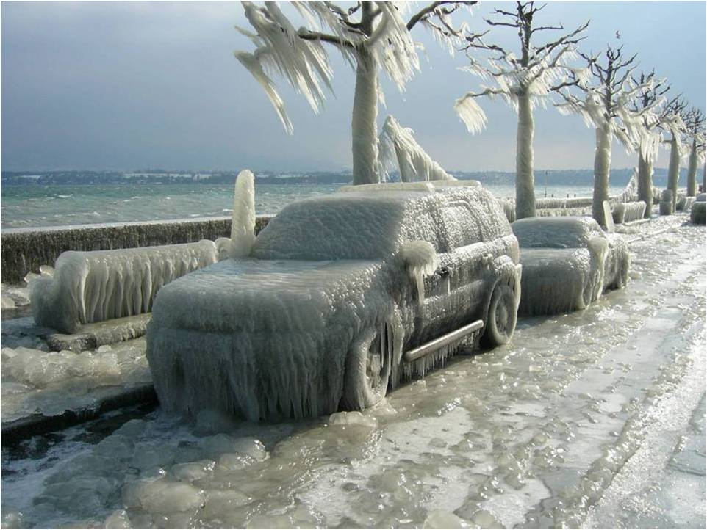
Why?
Colligative Properties

Slide 6
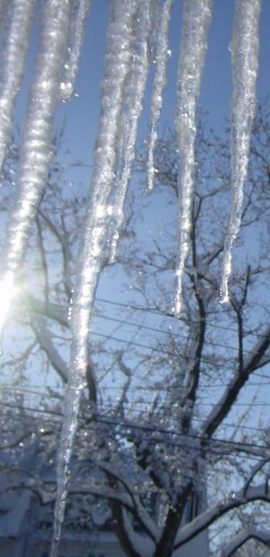
Notice that ice cream melts differently than ice. Ice stays hard until it melts. Ice cream gradually get softer and softer.

Slide 7
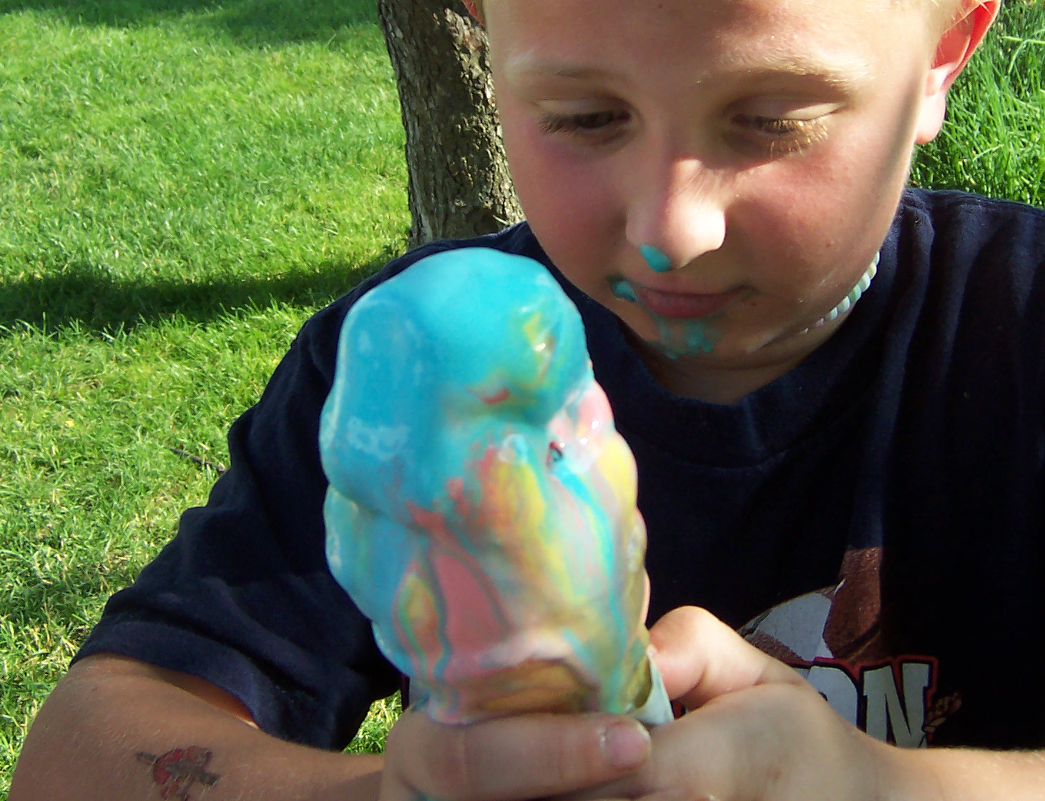
Ice is a pure substance but ice cream is a mixture. In other words, there are other chemicals that get in the way of water freezing. So you have to get colder than 0°C to get it to freeze.
About 30% of the water in ice cream never freezes because of the high level of dissolved solids like sugar, fats, and proteins.

Slide 8
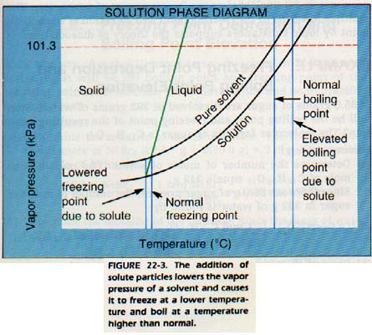
Boiling Point:
Liquids boil when vapor pressure = atmospheric pressure
Salt lowers vapor pressure.
The temperature must increase to increase vapor pressure and make it boil.
Table H

Slide 9
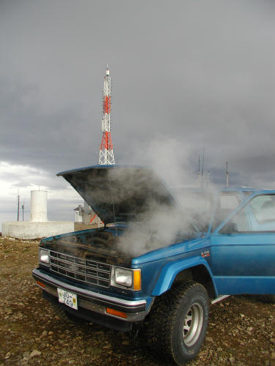
Boiling Point Elevation
Antifreeze is often called “coolant” because it not only can lower the freezing point of water, it can elevate the boiling point of water.
So, if you don’t have any antifreeze (coolant), what could you use instead?
Anything that adds solute particles (ions) to water.

Slide 10
Colligative Properties & Electrolytes
Nonelectrolytes – molecules, don’t conduct
C₆H₁₂O₆(s) → C₆H₁₂O₆(aq)
1 mol 1 mol
Electrolytes – ions, conduct
NaCl → Na⁺(aq) + Cl⁻(aq)
1 mol 2 mol
Which is better for melting ice?
Salt or Sugar

Slide 11
Which is better at melting ice? NaCl or CaCl₂
NaCl → Na⁺ + Cl⁻
2 mol ions
CaCl₂ → Ca²⁺ + 2Cl⁻
3 mol ions

Slide 12
Colligative Properties Videos
Colligative Properties Explained
Instant Freeze

Slide 13
Try This:
Boiling Point
Half fill 250 ml beaker with hot water
Boil and record temperature
Add a good amount of salt
Boil and record temperature
Melting Point
Half fill a styrofoam cup with cold water
Add ice and stir
Monitor temperature until it stops changing and record
Add salt
Monitor temperature until it stops changing and record
How are the freezing point and the boiling point changed when particles are added to water?

